Slide 2
Mary and Joseph are just getting started in life and they have a big problem on their hands.

Slide 3
Mary and Joseph are just getting started in life and they have a big problem on their hands.
1. Joseph’s Problem

Slide 4
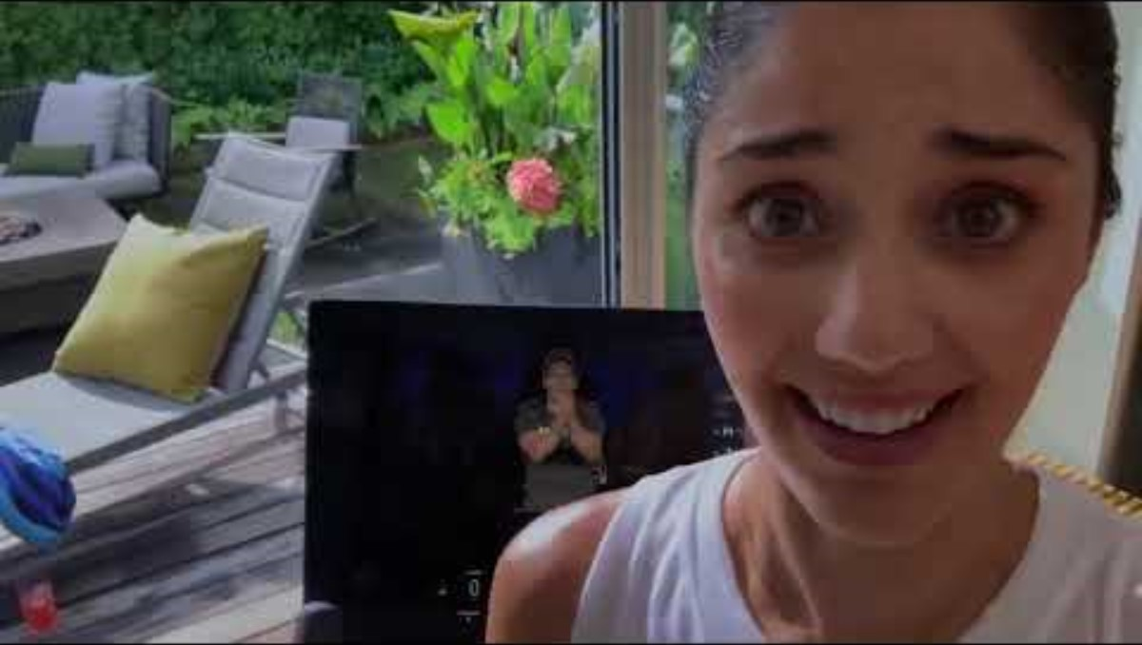

Slide 5
Mary and Joseph are just getting started in life and they have a big problem on their hands.
2. God’s Solution

Slide 6
Mary and Joseph are just getting started in life and they have a big problem on their hands.
3. The Couple’s Obedience

