Slide 1
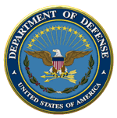
Financial Improvement and Audit Readiness (FIAR)
Office of the Under Secretary of Defense (Comptroller)
November 16, 2011

Slide 2
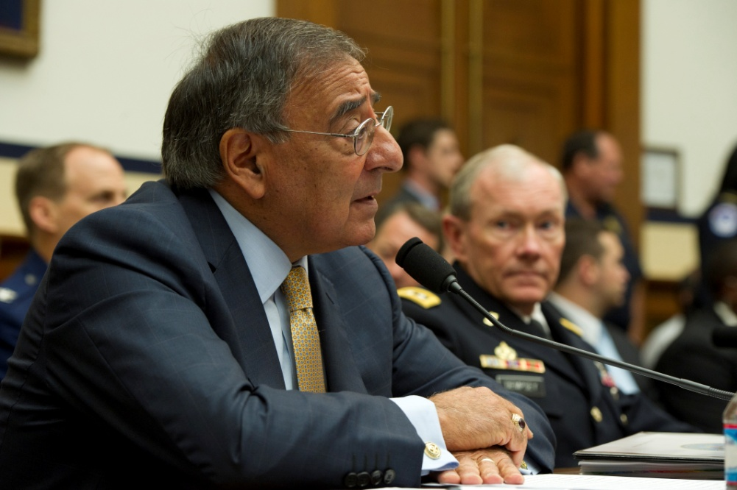
Call to Action
“I’ve directed the Department to cut in half the time it will take to achieve audit readiness for the Statement of Budgetary Resources so that by 2014 we will have the ability to conduct a full-budget audit.”
Secretary Leon E. Panetta, Oct. 13, 2011
Testimony before the House Armed Services Committee

Slide 3
The Directive
Within 60 days, the USD(C) must submit a revised plan to:
Achieve audit readiness of the Statement of Budgetary Resources by the end of FY 2014.
Increase emphasis on accountability of assets.
Review all financial controls over the next two years.
Establish course-based certification program for financial managers.
Resource efforts to meet these goals.
Achieve full audit readiness by 2017.

Slide 4
Revised Plan in 60 Days
OSD working with Components to develop executable revised plan:
Plan will be presented based on essential steps for SBR processes
We will incrementally review plans during 60-day period
Revised plans will incorporate USMC SBR audit lessons learned
OSD will lead efforts to increase involvement of service providers in FIAR work (DFAS, DLA, DCAA, DCMA, etc.)

Slide 5
Overall Strategy Remains in Place
Focus first on information we use most to manage
SBR for General Funds
Existence and Completeness of Mission Critical Assets
Follows existing FIAR Guidance

Slide 6
Why We Can Speed Up
Involvement of CEO will open doors
CEO involvement makes this an “All-Hands” effort
Not just a CFO issue
Active participation from functional communities
CEO involvement will help sustain funding
We will consider new tactical approaches
Add resources or change plans to speed up timetable, where feasible
Judicious us of work-arounds
More detailed milestone commitments enhance accountability

Slide 7
Important Dates
Important Dates in 2014:
June 30: Components assert SBR audit readiness
September 30: USD(C) validates audit readiness of Component SBRs
By December 31: Begin Auditing SBRs

Slide 8
Framework for Components’ SBR Plans
Current approach and methodology for 2014 SBR audit readiness goal:
DOD needs to focus on key areas within the methodology:
Common Questions | Answers
What should be our priority? | The business processes impacting the SBR.
What do we need people to do? | Focus on achieving the outcomes within the SBR business processes.
Who is doing what? | Everyone is responsible for each portion of the SBR process(es) they control: Components are responsible for activities/processes at the local level Service Providers (DFAS, DISA, DCMA, etc.) are responsible for the activities/processes they perform for their customers (Components)
What do we NOT need to focus on? | The portions of the SBR business processes that are audit ready now (e.g. DCPS FY10 SAS70 received an unqualified opinion).
What about existing known weaknesses? | If needed, a request can be submitted for $/FTEs for the portions of the SBR business processes where have identified the weaknesses and can provide a date for remediation. We need to provide a justification of $/FTEs and a plan that shows actions to take over the next 2 ½ years to reach the 2014 goal.
What about the areas that have not yet been started that affect the SBR? | For unassessed SBR business processes, we need to test controls/documents and determine what needs to be done. A plan must be developed to test and develop the corrective action strategy. If $/FTEs are needed, we must provide justifications and action plans to support the request.

Slide 9
Notional Timeline
October 20, 2011 – Kick-off meeting chaired by USD(C)
November 3, 2011 – Components provide their first draft plans to USD(C)
Outcomes to be shown as either:
Audit ready
Corrective actions with completion dates (Any unfunded $ or billets needed)
Discovery testing with completion dates within 6 months (Any unfunded $ or billets needed)
November 15, 2011 – High-level FIAR Plan Status Report due to Congress
November 15, 2011 - Second draft of plans with further detail due to USD(C)
December 2, 2011 – Final draft of plans to USD(C)
December 12, 2011 – USD(C) provides final plan to SecDef
After December 12, 2011 – USD(C) will coordinate review/approval of Component plans by SecDef, to include any funding and manpower increases; USD(C) will release the detailed plans publicly when they are sufficiently complete. Congressional Liaison will determine how/when November FIAR Plan will be updated.

