Slide 1
Access II Wellness
Samantha Bailey FNP-BC
101 Industrial Parkway
Gallatin, MO 64640
660-663-2423
Notes:
NOTES TO PRESENTER: Introductions to you and your clinic. Customize the slide for your office.

Slide 2
Advanced Allergy Therapeutics
Notes:
NOTES TO PRESENTER: Add some of your experiences with the AAT therapy OR share your story of how AAT helped you OR why you started using AAT in your practice OR whatever you deem appropriate.

Slide 3
Have you ever had an allergic reaction and wondered why your body reacts so strongly to something that seems harmless?

Slide 4
Well, allergies and sensitivities can occur when the body mistakenly perceives a harmless substance as harmful and then reacts inappropriately.

Slide 5
If you are suffering with digestive, skin or respiratory symptoms, it might just be a sensitivity…
You are not alone.

Slide 6
Allergies in the 21st Century
In the last 30 years, allergies and sensitivities have increased substantially worldwide, more than doubling in some countries.

Slide 7
Allergies Are on the Rise
More than 100 million Americans suffer from allergies each year.*
*Allergy and Asthma Foundation of America
Percentage of adults who have allergies in the U.S.: 30%
Percentage of children who have allergies in the U.S.: 40%
Allergies are the 6th leading cause of chronic illness in the U.S. with an annual cost in excess of $18 billion.

Slide 8
Are you tired of needlessly suffering with your allergy and sensitivity symptoms?

Slide 9
Are you tired of having to avoid your favorite foods, not being able to go outdoors, or not being able to be around things you love?
Advanced Allergy Therapeutics (AAT) can help you get your life back.

Slide 10
Patient Testimonial
Food, chemical and environmental sensitivities have plagued me for 20 years. I truly didn't understand the systemic effects that they were having on my overall health until I started the AAT therapy. The AAT therapy reduced the stress that my body was under all the time from these allergies. But specifically, there are a host of things that I now can eat without pain. I can enjoy my garden without causing serious side effects. I can travel without worry. I recommend this treatment to anyone who will listen.
Joan Erikson: Sterling, Virginia - USA
Notes:
NOTES TO PRESENTER: Please add your own patient testimonials as they are offered to you in order to expand the PPT presentation for your clinic.

Slide 11
Here are just a few of the most common items that contribute to allergy and sensitivity symptoms…

Slide 12
Animals and Insects
Cats
Dogs
Horses
Insects
Notes:
NOTES TO PRESENTER: Add any specific cases you may have treated within your clinic that relate to any of the items depicted on the slide.
Cases concerning patients and their responses to substances pre- and post-treatment contribute to enhancing the applicability of the treatment

Slide 13
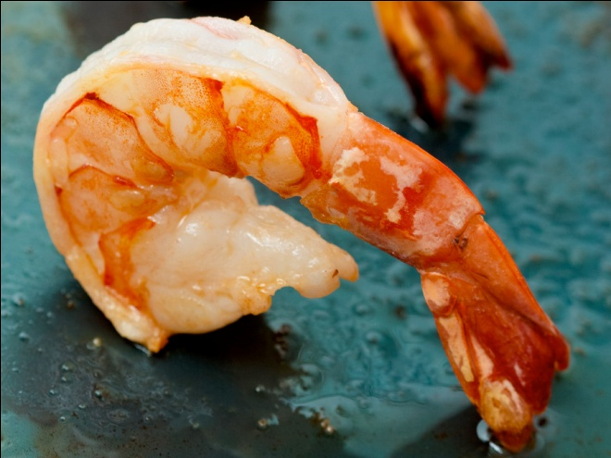
Foods
Dairy
Grains
Eggs
Shellfish
Notes:
NOTES TO PRESENTER: Add any specific cases you may have treated within your clinic that relate to any of the items depicted on the slide.
Cases concerning patients and their responses to substances pre- and post-treatment contribute to enhancing the applicability of the treatment

Slide 14
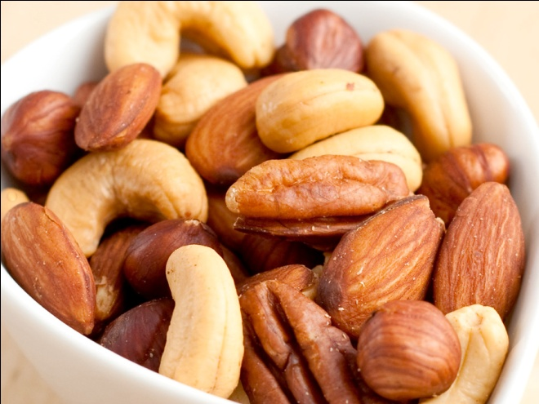
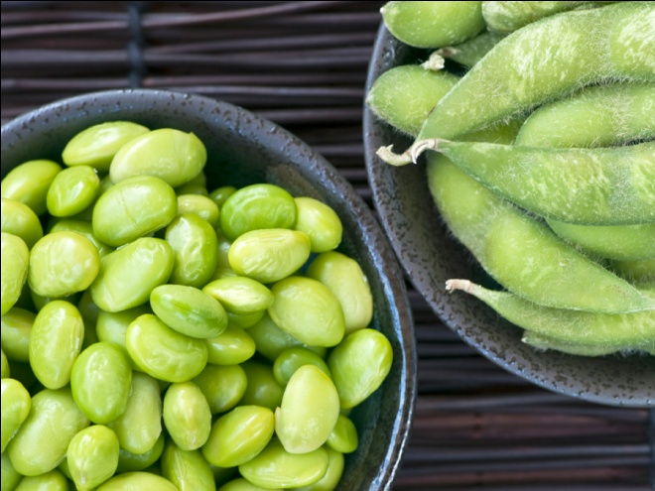
Foods
Sugar
Chocolate
Nuts
Soy
Notes:
NOTES TO PRESENTER: Add any specific cases you may have treated within your clinic that relate to any of the items depicted on the slide.
Cases concerning patients and their responses to substances pre- and post-treatment contribute to enhancing the applicability of the treatment

Slide 15
Foods
Wine
Beer
Coffee
Tea
Notes:
NOTES TO PRESENTER: Add any specific cases you may have treated within your clinic that relate to any of the items depicted on the slide.
Cases concerning patients and their responses to substances pre- and post-treatment contribute to enhancing the applicability of the treatment

Slide 16
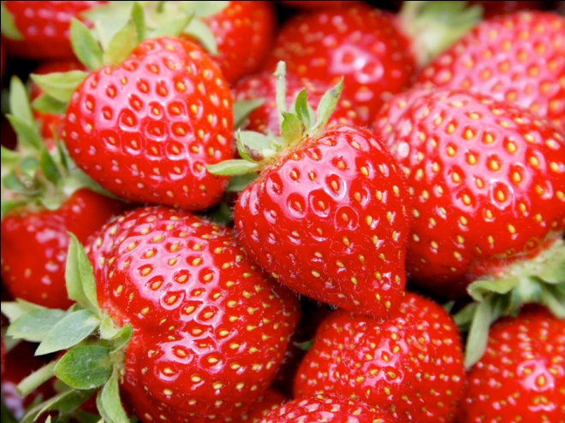
Foods
Tomatoes
Corn
Fruit
Berries
Notes:
NOTES TO PRESENTER: Add any specific cases you may have treated within your clinic that relate to any of the items depicted on the slide.
Cases concerning patients and their responses to substances pre- and post-treatment contribute to enhancing the applicability of the treatment

Slide 17
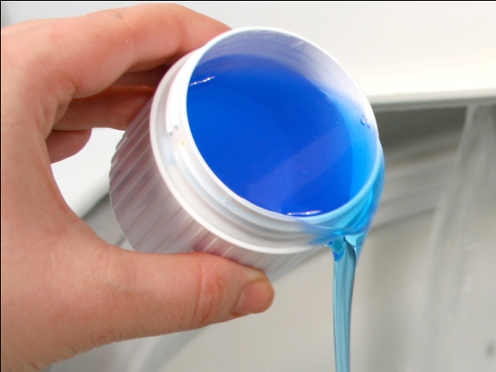
Soaps and Chemicals
Cosmetics / Lotions
Soaps / Shampoos
Detergents
Perfumes
Notes:
NOTES TO PRESENTER: Add any specific cases you may have treated within your clinic that relate to any of the items depicted on the slide.
Cases concerning patients and their responses to substances pre- and post-treatment contribute to enhancing the applicability of the treatment

Slide 18
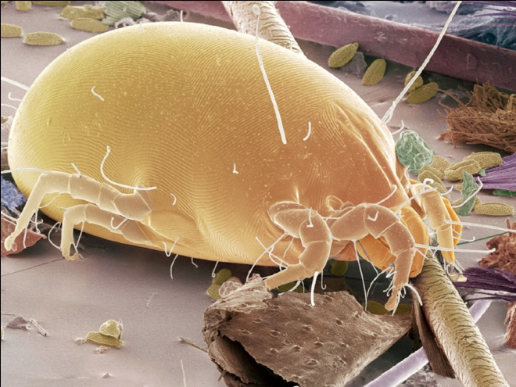
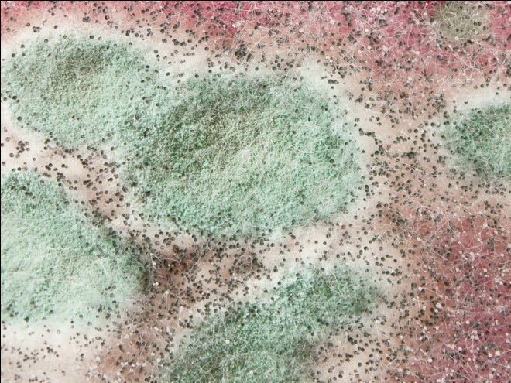
Environmental
Dust / Dust Mites
Mold / Mildew
Pollen
Grass / Weeds
Notes:
NOTES TO PRESENTER: Add any specific cases you may have treated within your clinic that relate to any of the items depicted on the slide.
Cases concerning patients and their responses to substances pre- and post-treatment contribute to enhancing the applicability of the treatment

Slide 19
Chemicals and Latex
Chemicals
Petrol
Cigarette Smoke
Paint / Varnish
Notes:
NOTES TO PRESENTER: Add any specific cases you may have treated within your clinic that relate to any of the items depicted on the slide.
Cases concerning patients and their responses to substances pre- and post-treatment contribute to enhancing the applicability of the treatment

Slide 20
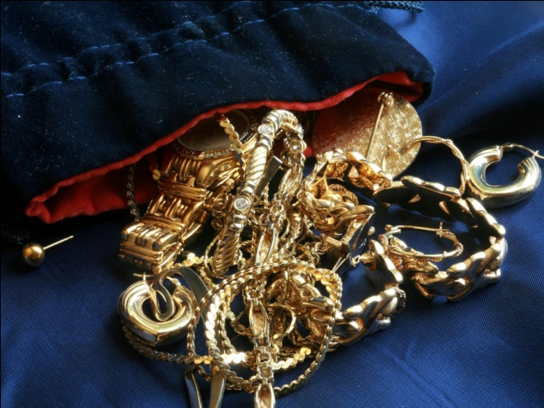
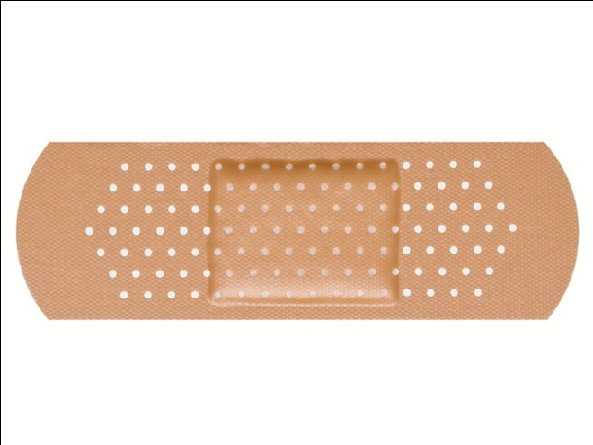
Metals, Fabric, Etc.
Jewelry Metals
Fabrics / Wool
Paper / Ink
Glues / Adhesives
Notes:
NOTES TO PRESENTER: Add any specific cases you may have treated within your clinic that relate to any of the items depicted on the slide.
Cases concerning patients and their responses to substances pre- and post-treatment contribute to enhancing the applicability of the treatment

Slide 21
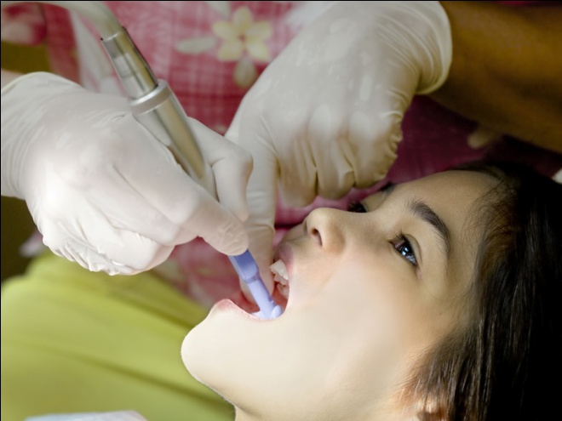
Occupational
Florist
Carpenter
Chef
Dental Assistant
Notes:
NOTES TO PRESENTER: Add any specific cases you may have treated within your clinic that relate to any of the items depicted on the slide.
Cases concerning patients and their responses to substances pre- and post-treatment contribute to enhancing the applicability of the treatment

Slide 22
Stimuli
Motion Sickness
Barometric Pressure
Sunlight
Temperature Changes
Notes:
NOTES TO PRESENTER: Add any specific cases you may have treated within your clinic that relate to any of the items depicted on the slide.
Cases concerning patients and their responses to substances pre- and post-treatment contribute to enhancing the applicability of the treatment

Slide 23
Did you know that people can develop sensitivities to specific “components” within a substance?

Slide 24
Common Food Components
Phenolics Glutamates
Proteins Minerals
Salicylates Phytosterols
Amines Latex
Oxalates Vitamins
Notes:
NOTES FOR AUDIENCE: When it comes to food constituents, individuals may experience symptoms related to various foods, as these constituents can be present in a wide range of food items. For instance, individuals with salicylate sensitivity may exhibit reactions to multiple foods due to the presence of salicylates, which can be found in numerous food sources. This means that individuals might react to the salicylate component within these foods rather than the foods themselves. This common scenario often leads to the manifestation of multiple food reactions. Several commonly consumed foods containing salicylates include tomatoes, avocados, berries, aspirin, nuts, broccoli, coconuts, and seeds. Additionally, salicylates can also be found in products such as aspirin, soaps, toothpaste, and certain personal care items

Slide 25
All these things and more can be successfully addressed with AAT. What is AAT ?

Slide 26
AAT has been specializing in the treatment of the symptoms associated with allergies and sensitivities since 1995.
AAT has successfully treated tens of thousands of patients over the years, all of whom were simply reacting inappropriately to harmless substances.
Notes:
NOTES FOR AUDIENCE: AAT has successfully treated 10’s of thousands of cases in the US, Australia, Japan and Canada

Slide 27
About AAT
Advanced Allergy Therapeutics (AAT) is a clinically proven treatment that merges 21st century science with (3,000-year-old traditional acupuncture) (modern chiropractic) principles that is highly effective in treating the many symptoms associated with allergies and sensitivities.
AAT was developed through over 28 years of collaborative research by healthcare professionals in the fields of acupuncture, naturopathy and chiropractic.
Notes:
NOTES TO PRESENTER: UPDATE THIS SLIDE! Replace the items within the parentheses ( ) in the first paragraph above with the most suitable choice for your office, opting for either Acupuncture principles or chiropractic principles. Do not leave as is.

Slide 28
About AAT
AAT does not rely on medication, herbal remedies, avoidance, injections or supplements.
AAT is non-invasive and totally painless. It is available to people of all ages, even infants. Everyone can benefit from this all-natural therapeutic approach.

Slide 29
Let’s dive deeper into allergies and sensitivities to learn more about how the AAT treatments can help you.

Slide 30
So…What is an Allergy?
Al • ler • gy
(al • er • jee)
Inappropriate response, error:
an abnormal reaction to an ordinarily harmless substance
- AAAAI American Academy of Allergy, Asthma and Immunology
"An allergy is a misguided reaction to foreign substances.
The allergic reaction is misguided in that these foreign
substances are usually harmless."
-MedicineNet.com
Notes:
NOTES FOR AUDIENCE: Allergies are simply an error. The body is perceiving an item as being harmful when it isn’t.

Slide 31
The use of the word “allergy” has become a generic term used by the public to describe allergies, sensitivities and intolerances.
But they are quite different.

Slide 32
What is a True Allergy?
A true allergy is an immune system response to a specific substance, called an allergen, that is usually harmless to most people.
The immune system overreacts to the allergen, producing antibodies that trigger the release of histamine and other chemicals in the body.
This can cause a wide range of symptoms, such as itching, hives, swelling, wheezing, and anaphylaxis in severe cases.

Slide 33
What is a Sensitivity?
A sensitivity is a non-immune reaction to a substance that can cause symptoms like an allergy but is not caused by an immune system response.
Sensitivities are much more common as fewer than 5% of the population actually have a “true” allergy.

Slide 34
What is an Intolerance?
A food intolerance is typically due to a lack of a specific enzyme and cannot be treated with AAT.
For example, lactose intolerance refers to the inability to digest lactose due to a lack of an enzyme called lactase that breaks down lactose.
AAT is therefore ineffective against this intolerance.
Notes:
NOTES FOR AUDIENCE: Moreover, it is important to note that AAT does not address anaphylactic reactions under any circumstances. Therefore, if an individual experiences an anaphylactic reaction, we are unable to conduct testing or provide treatment for that specific item. Similarly, if a patient carries an epi-pen for a particular allergen, we cannot perform testing or administer treatment, as it implies the presence of an anaphylactic reaction.

Slide 35
When allergic symptoms are present, the body is reacting inappropriately to a harmless substance, food or stimuli.
How can this happen?

Slide 36
Understanding Allergies and Sensitivities
The human body is in a constant state of interpretation on whether substances outside or inside the body are acceptable or a threat.

Slide 37
Understanding Allergies and Sensitivities
A poison is registered as dangerous information to the system.

Slide 38
Understanding Allergies and Sensitivities
Vitamin C is registered as beneficial.

Slide 39
Understanding Allergies and Sensitivities
Reactions occur when the mechanism of interpretation becomes impaired.
The cause is the same for all inappropriate reactions: an error in perception.
If the error in perception can be corrected, the related symptoms can be resolved. The body can accept the substance as harmless and no longer react.

Slide 40
Negative Conditioning
“Exposure to allergens at certain times when the body’s defenses are lowered or weakened, such as a viral infection or pregnancy, seems to contribute to the development of allergies.”
-National Institute of Allergy and Infectious Disease
The more stressed the body’s systems are, the more likely they are to become over-reactive to a substance and mistakenly associate that substances as being harmful, even though it isn't.
Notes:
NOTES FOR AUDIENCE: Regarding the NIAID Quote- These various factors share a common characteristic: they elicit heightened sympathetic responses within the body by increasing sympathetic nerve activity. Stress is a factor.

Slide 41
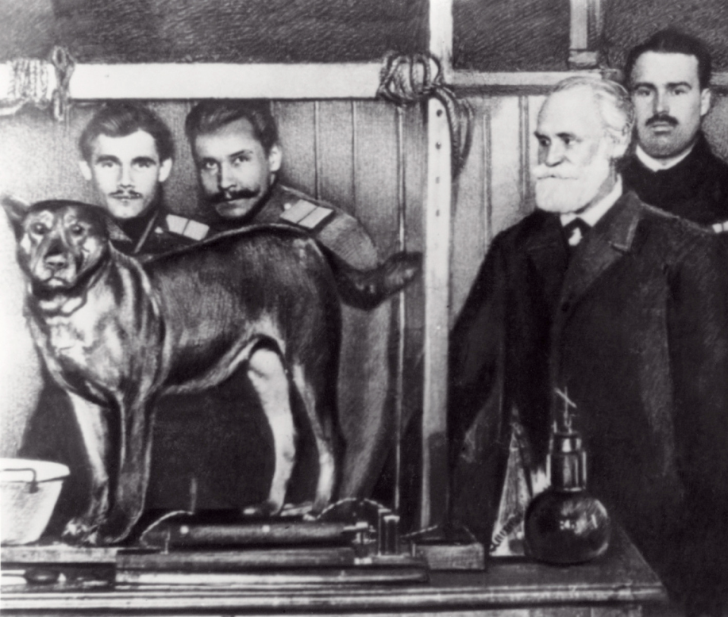
Conditioning Effect
The ability to affect physiology with an external stimulus was first demonstrated by Dr. Ivan Pavlov in 1903.
Dr. Pavlov showed that a dog’s physiology could be conditioned by associating food with an external stimulus in the form of a sound-- produced by ringing a bell.
Notes:
NOTES FOR AUDIENCE: A similar dynamic can occur when associating an allergen with the strengthening of the major organs in the body. The body can associate a positive stimulus
with the exposure of an allergen, perceiving it as beneficial instead of a threat. The body alters its perception, correcting its own erroneous response. This is what AAT is doing.

Slide 42
Conditioning Effect
The dog’s salivary glands would be activated by the stimulus even though there was no food present, simply by creating an association with the food.

Slide 43
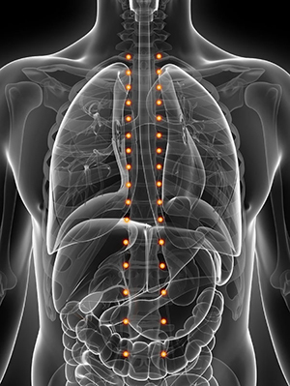
How AAT Works
During treatment, gentle pressure is used on points that correspond with organ systems involved in a reaction and Sympathetic Nervous System (SNS).
While the stimulation is applied, a subtle representation of the offending substance is introduced to the surface of the skin.

Slide 44
How AAT Works
The stimulation reduces the hyperactivity of the effected organ systems and reduces sympathetic nerve activity.
The body associates the enhanced state with the second stimulus, the signal, which together conditions the body to respond more appropriately and creates a new association.

Slide 45
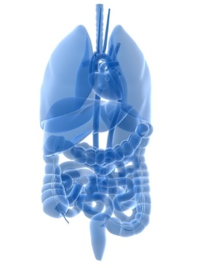
Organ Systems
A sensitivity or inappropriate reaction may cause symptoms from any organ system in the body.
Any substance can cause any form of symptom.
The symptoms of a reaction depend on which organ system is affected in the body.

Slide 46
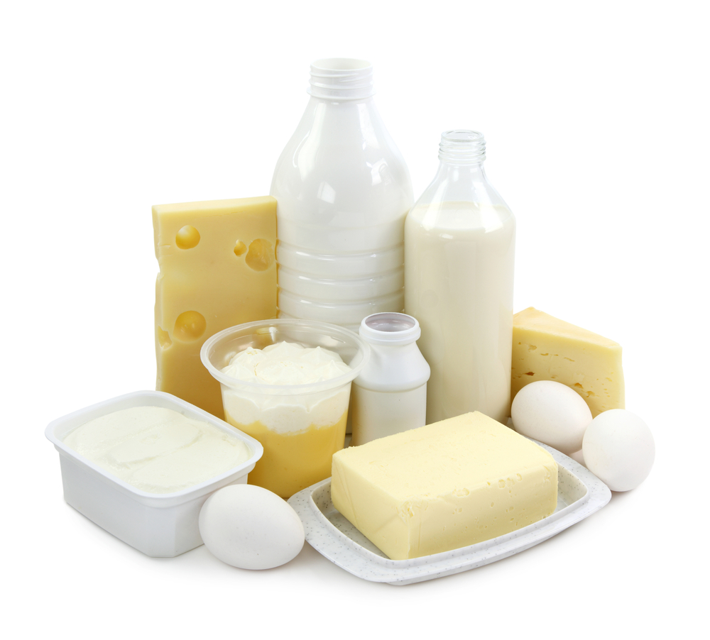
Organ Systems
Let’s use Dairy as an example:

Slide 47
Organ Systems
Stomach:
Reflux, heartburn, cramping, bloating, nausea.
Large Intestine:
Irritable Bowel Syndrome, bloating, abdominal and intestinal pain, constipation, diarrhea.
Notes:
NOTES FOR AUDIENCE: If the stomach or large intestine is reacting, certain individuals may experience digestive symptoms in response to dairy consumption

Slide 48
Organ Systems
Lungs:
Hay fever, wheezing, asthma, skin conditions, rashes and itchy, watery eyes.
Skin:
Eczema, skin rashes, hives, blisters and atopic dermatitis.
Notes:
NOTES FOR AUDIENCE: The manifestation of symptoms related to dairy consumption varies depending on the organ system being affected. For instance, some individuals may experience respiratory or skin symptoms

Slide 49
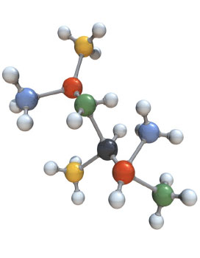
Treatment Specificity
The key to the success of AAT is the extensive research on the substances or offending items causing the reactions.
Any aspect of any substance may be targeted as a threat. The exact micro-substance must be identified for 100% resolve of the associated symptoms.
Notes:
NOTES FOR AUDIENCE: While most allergy therapies address the primary substance, the majority of cases are actually caused by components within the substance.

Slide 50
Treatment Specificity
There are thousands of molecules and substances that my cause hypersensitivities.
Many of the actual substances are impossible to obtain as physical samples, so a signaling system was needed.

Slide 51
Digital Signals
A proprietary signal system was developed by AAT to replace the actual substances needed for treatment.

Slide 52
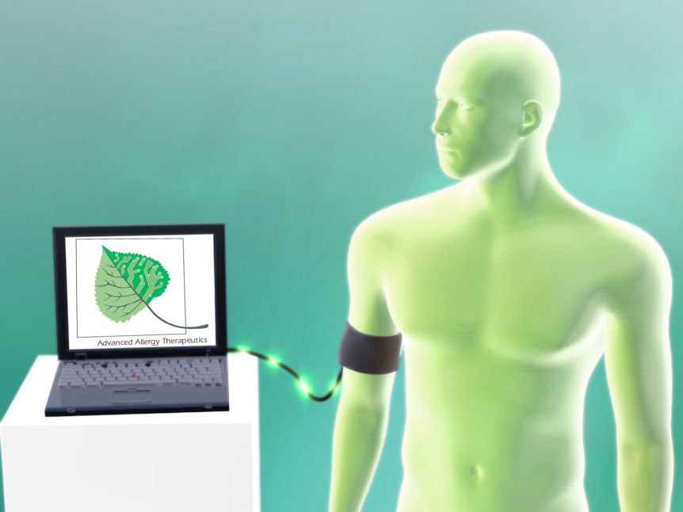
Digital Signals
Digital signals are utilized to represent a substance.
Digital signals are non-invasive and have no therapeutic effect on the body.
Notes:
NOTES FOR AUDIENCE: The digital signals simply represent a substance and can be used in place of the actual substance during testing and treatment. This allows for a much broader range of substances that can be addressed as many of the items needed for treatment are impossible to obtain in a physical sample. The digital signals have no therapeutic benefit on the body, they are simply used to represent the actual substances. It is the acupressure stimulation along the spine that is responsible for reducing the stress caused by the substance, thus modifying the inappropriate reaction.

Slide 53
AAT Substance Library
Over 65,000 substances have been compiled into digital signals for the AAT technology.
Digital samples include:
Individual Items
Species
Components
Components of Components
Protein Molecules

Slide 54
AAT Specificity
Most people are not even aware that there are multiple components within an item that can contribute to a reaction.
Here are just a few examples of components found in everyday items that are commonly addressed during an AAT session:

Slide 55
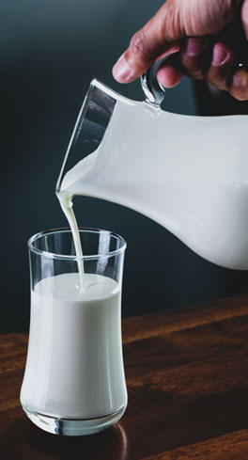
Milk Components
Whey
A-1 Protein
A-2 Protein
Caseinogen
Casein
Dairy Antibiotics
Dairy Hormones
Dairy Phenolics
Casomorphin
Homogenized Proteins
Lactose
Milk Albumin
A-Lactoalbumin
Lactoglobulin
Alpha-Lactoglobulin
Beta-Lactoglobulin
Milk Fats
Milk Protein Molecules
Notes:
NOTES FOR AUDIENCE: Here is a partial list of all the items in dairy that can cause a reaction. Most people only think of Lactose or Casein, the sugar and the protein, but any component in milk can cause an inappropriate reaction.

Slide 56
Red Wine
Alcohol
Amines
Catechins
Esters
Flavonoids
Glutamates
Ketones
Enzymes
Fructose
Resveratrol
Yeast
Salicylates
Stilbenes
Sulfites
Tannins
Tyramine
Notes:
NOTES FOR AUDIENCE: When considering wine sensitivity, many individuals commonly associate it with sulfites or tannins. However, it is important to recognize that there are various other components that can potentially trigger a reaction

Slide 57
Cats
Dander
Epithelial
Hair
Mucin
Pheromones
Saliva Pepsin
Saliva Enzymes
Cat Mites
Cat Saliva
Cat Serum Globulin
F-1 Protein
F-2 Protein
Fel d 1
Cat Sebum
Notes:
NOTES FOR AUDIENCE: Fel d1, a singular protein, is the ONLY allergen tested in conventional medical allergy tests. The above slide provides a limited selection of additional components that could potentially contribute to symptoms. To guarantee the most comprehensive treatments, AAT possesses an extensive database of substances, encompassing all of their associated components

Slide 58
With so many substances and components, how do we figure out which substances are causing stress on the body?
We use a
Stress Assessment.

Slide 59
Stress Assessment
AAT does not perform traditional Allergy Testing.
Instead, the AAT treatment uses a dedicated and specialized Stress Assessment method that allows the practitioner to determine whether any organ system in the body is responding defensively or inappropriately to a specific stimuli or substance.
A stress test is a method of a manual biofeedback technique that tests the body’s perception of stress caused by a substance or stimuli.

Slide 60
AAT has shown that a vast number of symptoms and conditions are actually caused by an inappropriate or negative reaction to a harmless stimuli.

Slide 61
Common Conditions Addressed with AAT:
Sinusitis/Chronic Congestion
Irritable Bowel Syndrome
Seasonal Allergies
Environmental Allergies
Acid Reflux/Heartburn
Respiratory Symptoms
Headaches/Migraines
Skin Conditions
Chemical Sensitivities
Food Sensitivities/Allergies
Digestive Issues
and many more…

Slide 62
Sinusitis / Chronic Congestion
28.9% of adults are diagnosed with sinusitis
Allergies can contribute to persistent inflammation of the sinus and mucus linings, increasing the susceptibility to sinus issues and chronic sinusitis.
Common Sinus Triggers:
Dust
Molds
Pets
Environmental Allergens
Fragrance
There are over
2.7 million visits to doctor’s offices a year for sinusitis

Slide 63
Irritable Bowel Syndrome
Hidden food allergies and sensitivities play a significant role in the development and exacerbation of irritable bowel syndrome.
Common Food Triggers:
Dairy
Wheat
Sugar
Yeast
Salicylates
Corn
Soy
Just to name a few
IBS affects between 25 and 45 million people in the U.S.
About 2 in 3 IBS sufferers are female

Slide 64
Patient Testimonial
I have had digestive problems for several years.
I went on a gluten-free diet and did well, but avoiding foods is pretty hard if you have an active lifestyle. Also, there were many foods that I missed eating. After going through the procedures of Advanced Allergy Therapeutics, I can now eat whatever I want without fear of a reaction. It has made my life so much simpler, less stressful and better tasting.
Stan Black: Little Rock, Arkansas – USA
Notes:
NOTES TO PRESENTER: Please add your own testimonials to the PPT as you get them, so they are local to your area.

Slide 65
Acid Reflux/ Heartburn
20% of the U.S. population suffers with Acid Reflux
Acid reflux can occur at any time, although it is frequently experienced following a meal.
Common food sensitivities that can contribute to Heartburn:
Spicy Foods
Onions
Citrus
Tomato Products
Fatty or Fried Foods
Alcohol
Carbonated Beverages
Allergies have the potential to trigger or exacerbate reflux symptoms.

Slide 66
Seasonal Allergies
Symptoms associated with allergies can occur during various seasons, depending on the specific type of pollen to which an individual reacts and the time of year.
Trees | Grass | Weeds
Common Seasonal Allergy Symptoms:
Runny Nose
Itchy Eyes
Sneezing
Congestion
Headaches
Fatigue
Coughing
19.2 million adults were diagnosed with hay fever within the past 12 months
5.2 million children were diagnosed with hay fever within the past 12 months

Slide 67
Patient Testimonial
Prior to AAT, I suffered hay fever constantly throughout the day & night. I tried everything for relief but never found a permanent fix. I was skeptical at first, but after 2 visits with AAT I went from having hay fever on average 4 hours a day to not having hay fever at all! The results speak for themselves! I now recommend AAT to everyone I know that has allergy problems.
Cameron McEwan: Brisbane QLD - Australia
Notes:
NOTES TO PRESENTER: Please add your own testimonials to the PPT as you get them, so they are local to your area.

Slide 68
Environmental Allergies
As many as 10% of Americans are sensitive to dust mites
Individuals may exhibit reactions to substances present in common environments, such as workplaces, residences, and outdoor settings.
Most Common Environmental Allergens:
Pollen
Dust
Pet Dander
Mold
Cockroaches
Chemicals in Pollution
About 1 in 5 people
in the U.S. have been diagnosed with environmental allergies

Slide 69
Headaches / Migraines
Approximately
45 million Americans complain
of headaches each year
Allergies can contribute to the occurrence of two types of headaches: migraine headaches and sinus headaches.
Common Headache Triggers:
Foods
Pollen
Mold
Pet Dander
Fragrances
Every year more than 8 million Americans visit their doctor for a headache

Slide 70
Patient Testimonial
I used to get headaches if I drank red wine. After treatment for the red wine, I could drink red wine with no side effects. All I know is that now I feel like a different person.
Barbara Main: Andover, Massachusetts - USA
Notes:
NOTES TO PRESENTER: Please add your own testimonials to the PPT as you get them, so they are local to your area.

Slide 71
Asthma
8% of adults suffer with asthma
Allergy-induced asthma is very common.
Most Common Triggers:
Molds
Dust
Dust Mites
Pet Dander
Grass
Pollens
Fragrance
Chemicals
6.5% of children suffer with asthma

Slide 72
Skin Conditions
A variety of Skin Conditions can arise as a result of allergic reactions:
Urticaria
Eczema
Contact Dermatitis
Atopic Dermatitis
Common Allergen Triggers:
Foods
Nickel
Pet Dander
Fragrance
Grass
Chemicals in Soaps/Lotions
In the past 12 months, there have been 9.2 million reported cases of skin allergies in children.
Hives affect approximately 20% of the population at some point in their lives.

Slide 73
Patient Testimonial
"I had eczema for over 7 years. I used to use steroids every few days for years, but the eczema would keep coming back. After a few treatments, I don't have any eczema symptoms and don't need to use any medications. I also had a chronic cough for over 10 years. My doctor thought it was reflux. However, after only a few treatments my cough is almost completely gone."
Anthony Geminden: Leesburg, Virginia - USA
Notes:
NOTES TO PRESENTER: Please add your own testimonials to the PPT as you get them, so they are local to your area.

Slide 74
Chemical Sensitivities
Certain individuals may experience sensitivities to a diverse range of environmental substances commonly encountered in their day-to-day activities.
Chemicals that may cause sensitivity include synthetic and natural substances found in:
Carpeting
Plastics
Perfumes
Paint
Cigarette smoke
Personal Care Products
Just to name a few
Approximately 25% of Americans report experiencing chemical sensitivity.
Chemical sensitivities have increased more than 200% in the past 10 years

Slide 75
Food Sensitivities / Allergies
These sensitivities are prevalent and can contribute to a wide range of symptoms, including those related to the digestive, respiratory, and skin systems, among others.
The Most Common Culprits:
Dairy
Sugar
Wheat
Soy
Corn
Nuts
Food Components
About 32 million people in the U.S. have food allergies
That is
10.8 % of Adults
7.6% of Kids

Slide 76
Patient Testimonial
"I wasn't able to eat many of my favorite foods for years, unless I wanted to suffer with uncomfortable digestive symptoms. I figured I would have to suffer from now on until I heard about this therapy from a friend. I figured it couldn’t hurt to try it since I had tried everything else. After just a few treatments I am already eating some of my favorite foods without any symptoms. It's been really great for me, thanks!"
Steve Posey: Chantilly, Virginia – USA
Notes:
NOTES TO PRESENTER: Please add your own testimonials to the PPT as you get them, so they are local to your area.

Slide 77
Advanced Allergy Therapeutics
AAT can help resolve the many symptoms and conditions associated with allergies and sensitivities.
AAT treatments are performed without pain, avoidance or needles and offer rapid, long-term results.

Slide 78
Advanced Allergy Therapeutics
Stop avoiding substances that are causing symptoms
Start living the life you want to live
Enjoy the things you have been missing:
Get outside again!
Eat your favorite foods!
Play with your pets!
Stop avoiding and start enjoying!

Slide 79
Advanced Allergy Therapeutics
If you are interested in moving past your allergy or sensitivity symptoms, contact our office to make an appointment today and give AAT a try...
You will be happy you did!

Slide 80
Access II Wellness
660-663-2423
http://accessii.org/memberships
Schedule you appointment today!
Online or at the number above!
Notes:
NOTES TO PRESENTER: Customize this slide for your office and how you want them to book in. Feel free to add slides for any specials or promotions associated with the talk you are giving.

