Slide 1
Word Embedded Indexing and Linking with IndexExploit
Word and IndexExploit
Barry Campbell
barry.campbell@indexbase.co.uk
http://www.indexbase.co.uk

Slide 2
Word Embedded Index Entries
Insertion point entries
{ XE “citizens’ rights“ } Simple insertion point entry
{ XE “citizens’ rights“ \i } Italic locator
{ XE “citizens’ rights“ \b } Bold locator
{ XE “citizens’ rights“ \b \i }
Range entries
{ XE “citizens’ rights" \r "idxCitizensRights" } Range entry
{ XE “citizens’ rights" \r "idxCitizensRights“ \b \i }
Cross references
{ XE “rights" \t “see citizens’ rights" } Page number is suppressed
Page numbers in the index are calculated using insertion point location or range start and end page. For range entries the location of the XE field determines where the range appears in the index entry.
Repeated insertion point entries on the same page are suppressed.

Slide 3
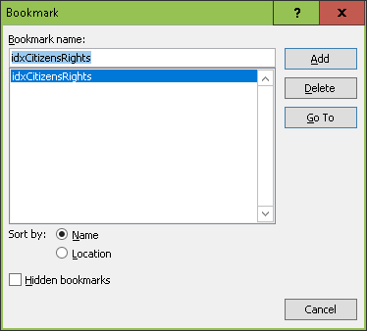
Word – Insert Bookmark
Bookmark is used to name ranges.
Benefits
Easy marking of ranges of interest
Disadvantages when indexing
Closes when a bookmark is written
You must ensure bookmark names are unique. Re-using a bookmark name moves the range

Slide 4
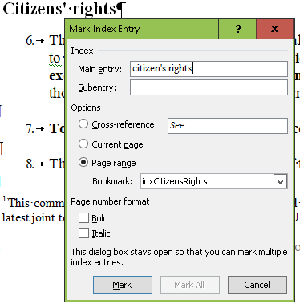
Word - Mark Index Entry
Advantages
Work in the document. Supports complex rich text terms, bookmarked ranges and cross references.
High indexing speeds can be achieved for Main entries.
Copy/paste/edit can speed index entry
Select text in Word document, move cursor to Mark Index Entry and the selected text is copied to Main entry.
Disadvantages
Following Mark, all XE fields are displayed, pagination and layout is altered.
Copy and paste to Subentry or Cross-reference requires care to prevent the Main entry changing.

Slide 5
Know How to Edit Entries
Editing entries in the text is essential when correcting errors, can also be used when adding forced sorts.
Copy/paste/edit can be used for indexing and for adding cross references.
{ XE “citizens’ rights" \r "idxCitizensRights" }
{ XE “rights" \t “see citizens’ rights" }

Slide 6
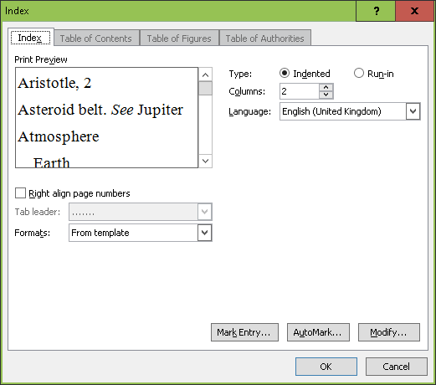
Word - Insert INDEX Form
Use Modify to format the index.
Switches can be added after the index has been created
\b use named range
\c number of columns
\d, \e, \g, \k, \l separators
\f type (main, names etc.)
\h group headings
\p alphabet range
\r run-on
\s include chapter number

Slide 7
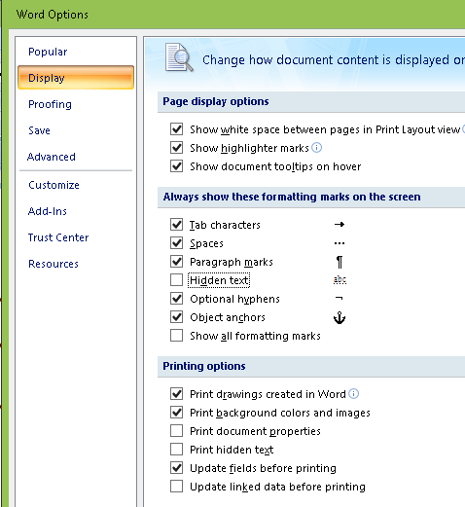
Hide Embedded Entries
Use the paragraph symbol to hide hidden text. This hides the embedded XE fields.
If it doesn’t work, use Word Options and deselect Hidden text
Or use IndexExploit

Slide 8
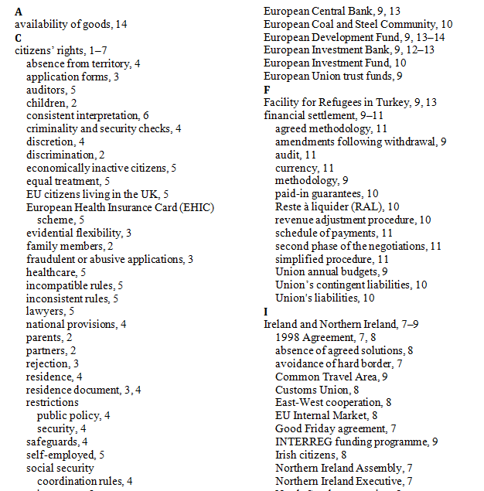
Example Word Index

Slide 9
IndexExploit at a Glance
Mark Entry
Integrated bookmarking and index entry form
Integrated search/index feature
Compatibility with InDesign (Option setting)
Automark File
Highlighted text is added to an existing Automark file
Index
Linked index picklist – goto XE field or referenced range
Check index and report errors
Adjust
Add ranges to insertion point entries (necessary for linking)
Re-sort by reference to a stop word list (to follow indexing standard practice)
Move XE fields to referenced bookmarked range (compatibility)
Add compatibility information (e.g. for InDesign and others)
Export
Multiple exports available including linked indexes, IndexConvert compatible files for import to indexing software, spreadsheets, databases.

Slide 10
IndexExploit Main Menu
IndexExploit is a Word add-in to enhance the existing Word indexing capabilities.
Click on Version to check for updates.
Click on Word embedded to show/hide XE fields
Select Configuration to install your user licence and select Word embedded
Options controls IndexExploit behaviour.
Mark Entry combines bookmarking and Mark entry
AutoMark File updates an Automark file from highlighted text
Index creates an index picklist and updates and goes to the Word index.
Adjust alters the embedded index entries, including re-sort
Export exports index content according to the Options selected
Exit halts IndexExploit

Slide 11
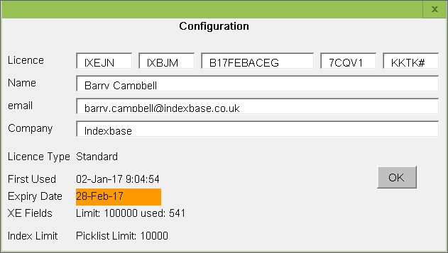
Configuration
If you have been given a new licence then load it using Configuration.

Slide 12
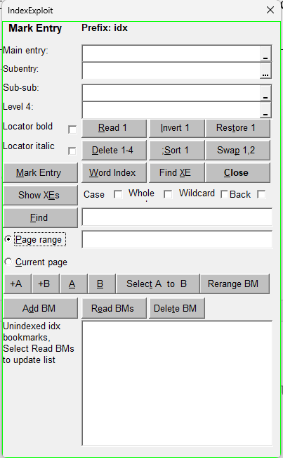
Mark Entry
Mark entry and bookmarking integrated into a single form.
Four entry levels
Read, Invert, Restore entries reduces typing
Optional autocomplete
Delete in form senses location
;Sort uses stop word file
, Swap
Find entry in Word index
Find XE field
Show/Hide XEs
Find text in document and index entries with Case, Whole words, Wildcard
Entry and bookmark selection +A, +B, A, B, Select A to B
Bookmark management +A, +B, A, B, Select A to B, Add BM, Rerange BM, Read BMs, Delete BM, Unique boolmark naming

Slide 13
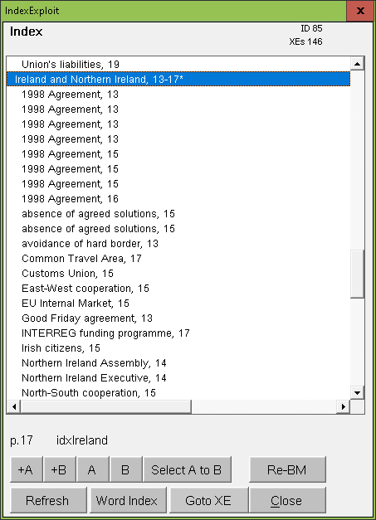
Index
Up to seven heading levels (six subheadings are supported).
Note are lab labels by default are f (footnotes) , e (endnotes), t (tables), x (text boxes). Entries with bookmarked ranges are labeled *.
When Option>Picklist>Allow RE-BM is selected:
+A, +B inserts bookmark ixeA, ixeB
A, B goes to ixeA, ixeB (Use to mark place in Word index)
Select A to B selects range A to B
Re-BM adjusts range of referenced bookmark in XE field
Refresh refreshes picklist
Word Index goes to Word index and allows return to the initial location.
Goto XE goes to XE field.

Slide 14
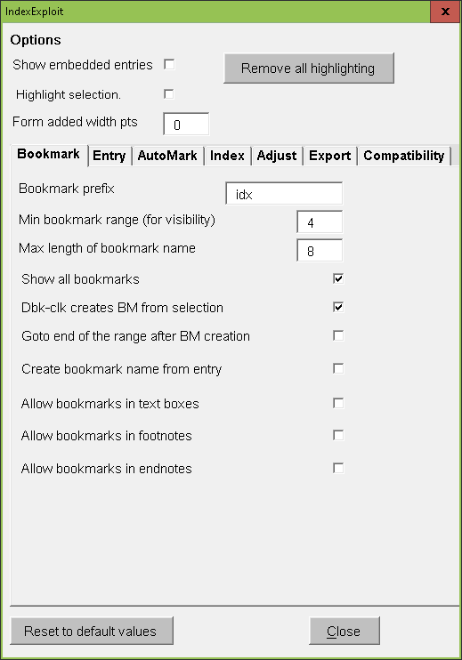
Options always available + Bookmark options
Show Embedded Entries When checked, bookmark range symbols and embedded index XE fields are visible.
Highlight selection causes the selected XE field to be highlighted. Selected bookmarked ranges if present will be highlighted.
Form added width pts widens the Mark Entry and Index form by the number of points entered.
Remove all Highlighting. If too much highlighting is present, it can all be removed by selecting Remove all highlighting.

Slide 15
Options - Bookmark

Slide 16
Options – Bookmark
Bookmark prefix is prepended to bookmarks created by IndexExploit.
Min bookmark range is the minimum number of characters that can be selected as the referenced range in an XE field.
Max length of bookmark name is the maximum number of characters that will be used when a bookmark name is created automatically.
Show all bookmarks - The bookmarks list shows bookmarks prefixed with Bookmark prefix. By default only un-indexed bookmarks are shown. Selecting this option shows all bookmarks
Dbl-clk creates BM from selection - When the Bookmark text box is double clicked in the Mark Entry form, the selected text in the Word document is used to create a bookmark name.
Goto end of range after BM creation defines where the cursor is located after inserting a bookmark. The default is the beginning of the range.
Create bookmark name from entry causes a bookmark name to be generated from the lowest level heading.
Allow bookmarks in text boxes, footnotes, endnotes allows bookmarks in text boxes, footnotes and endnotes respectively. Also used by Adjust.

Slide 17
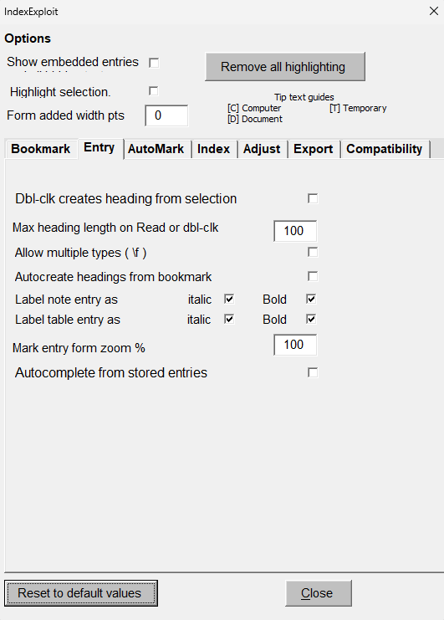
Options - Entry

Slide 18
Options – Entry
When Dbl-clck creates heading from selection is selected, double clicking in Main entry or a subentry transfers selected text to the selected text box. Read performs the same transfer and is the recommended method.
Max heading length on dbl-clk defines the maximum number of characters that will be transferred when text selected in the Word document is transferred
Allow multiple types ( \f ) opens the Type field in front of the Main heading. A letter entered here will be added to the entry as a type flag. Use this when multiple indexes are to be generated.
Autocreate headings from bookmarks. If structured bookmarks are used, (heading_subheading_subsub) entries are offered automatically by the Mark Entry form.
Label notes / table entry as Bold/Italic when checked causes IndexExploit to recognise when an entry is in a table entry, footnote, or endnote and automatically includes a \b or \i or both) in the embedded entry to cause the page number to appear as bold /italic text.
Mark entry form zoom % scales the form to suit the screen
Autocomplete from stored entries uses entries from the last Index selection and later entries. Remembers case of entries.

Slide 19
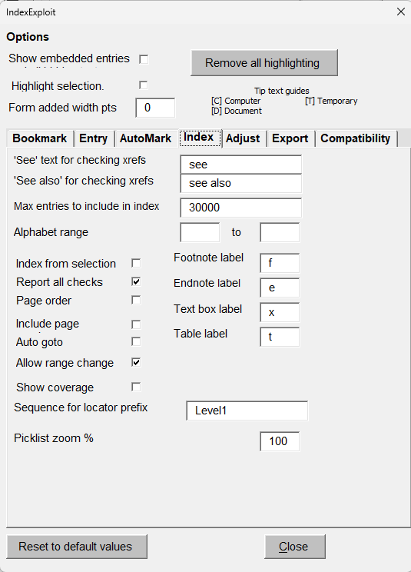
Options - Index

Slide 20
Options – Index (1)
‘See’ text for checking xrefs, ‘See also’ for checking xrefs are used when checking matches to a target cross reference. Non-English cross reference terms can be entered supporting the multi-language abilities of Word. Checking occurs when Report all checks is selected. Cross references are matched to the heading level only.
Max entries to include in index defines the maximum number of entries used for the Index picklist. If no value or a negative value is set the default value will be applied which is derived from the licence. If 0 is chosen the picklist will contain entries in footnotes, endnotes and tables only.
Alphabet Range causes the index picklist to be created for a selected alphabet range
Index from selection causes the Index picklist to be populated using the selected range. When Index from selection is not selected, IndexExploit generates a picklist from the entire document and creates an ixe file that can be loaded when Index is selected during a later session.
Report all checks causes IndexExploit to report possible faults when the picklist is created. An error report is created.

Slide 21
Options – Index (2)
Page Order when checked causes the Index picklist to appear in page order.
Include Page Numbers Includes page numbers when the picklist is created. Not normally necessary and slows picklist creation. For a 500 page document with 2000 index entries and 2000 footnotes, Index completed in about 1 minute without page numbers. With page numbers it took 8 hours because Word repaginates at each request for a page number. When Index is complete, an ixe file is saved, which loads in about 1 second when Report all checks is not selected.
Auto Goto causes IndexExploit to find the indexed content immediately an entry is selected. Double clicking the entry is normally required.
Allow range change allows bookmarks to be re-ranged from the Picklist.
Show coverage , when selected uses highlighting to show index coverage.
Footnote label is added to a picklist entry for a footnote. Default is f
Endnote label is added to the picklist entry for an endnote. Default is e
Textbox label is added to the picklist entry for an endnote. Default is x
Table label is added to the picklist entry for a table cell. Default is t
Sequence for locator prefix defines the heading level used to define chapters. Heading 1 is recommended.
Picklist zoom % adjusts the picklist size for your display.

Slide 22
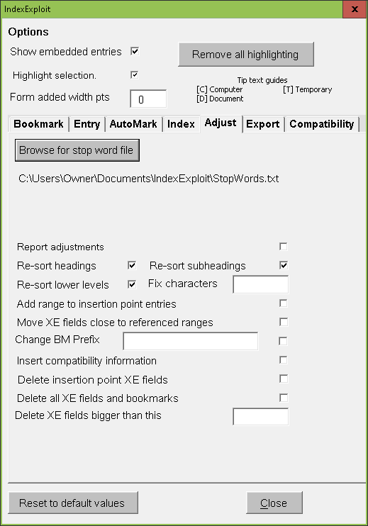
Options - Adjust

Slide 23
Options – Adjust (1)
Allow bookmarks in text boxes, Allow bookmarks in footnotes, Allow bookmarks in endnotes in Bookmark options allows bookmarks to be added as referenced ranges to insertion point XE fields in text boxes, footnotes and endnotes.
Browse for Stop Word File selects a stop word file.
Report adjustments shows adjustments as they occur.
Re-sort headings using stop word file causes heading forced sorts in XE fields to be adjusted by reference to the selected stop word file which is read when Adjust is selected.
Re-sort subheadings using stop word file
Re-sort sub-sub headings and lower level headings causes Level 3 to Level 7 heading forced sorts to be adjusted
Fix Sort Override A user may wish to prevent a forced sort being altered during Adjust processing. Any character in Fix sort override present in an existing forced sort will prevent any alteration. # is a good initial choice

Slide 24
Options – Adjust (2)
Add range to insertion point entries Entry point embedded entries are modified to include a range. The range name includes the Bookmark prefix, a name based on the lowest level subheading in the embedded entry and optionally a number chosen to make the bookmark unique.
Move XE fields close to referenced ranges Word allows XE fields containing referenced bookmarks to be located anywhere in the document. This can present problems when a text is to be modified and re-indexed. Moving XE fields close to their referenced ranges may remove maintainability problems.
Change BM Prefix Any bookmarks already with prefix Change BM Prefix will be unchanged. Any prefixed by Bookmark prefix will have the bookmark prefix changed . Other bookmark names will be prepended with Change BM Prefix. XE fields referencing the bookmark are updated.
Insert compatibility information causes compatibility information to be written to XE fields.
Delete Insertion Point XE Fields causes all insertion point XE fields to be deleted.
Delete all XE fields and bookmarks causes all XE fields and their associated bookmarks to be permanently removed.
Delete XE fields bigger than this is used in conjunction with Delete Insertion Point XE Fields and Delete all XE fields and bookmarks. It causes XE fields larger than this value to be deleted.

Slide 25
Export
If you know you are going to link the index, then the following options are recommended
Bookmark Options
Allow bookmarks in text boxes
Allow bookmarks in footnotes
Allow bookmarks in endnotes
Index Options
Include page will include page numbers in the export
Compatibility Options
Enforce compatibility. This forces XE fields to the start of selected ranges and improves linked index performance
Run Adjust using the two options below on a copy of the file as significant changes may be made and you may want to keep your original as the working master. Run the processes separately for each option.
Move XE fields close to referenced ranges
Add ranges to insertion point entries
Then Export, with options to suit your requirement. This creates a new file. If you are linking the index, then copy the content of the export file to the working copy, select all and update all fields (F9). The index will link.

Slide 26
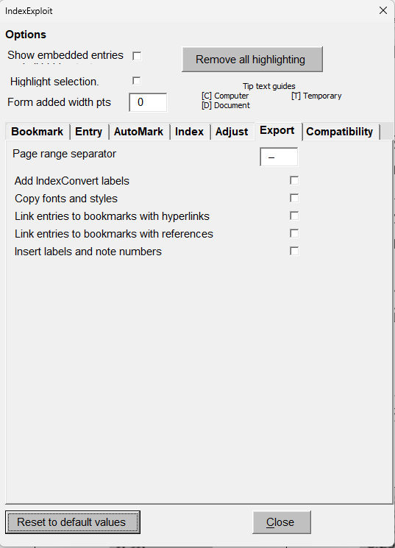
Options – Export

Slide 27
Options – Export
Page range separator By default this is an en dash. Change as required.
Add IndexConvert labels makes the export compatible with IndexConvert by adding $H (heading), $L (locator string) and $F (forced sort) labels. Word embedded indexes can be imported into your indexing software or to a spreadsheet or database.
Copy fonts and styles By default the export is an extract from the database with a single font and style. Copy fonts and styles copies entries from the Word index to ensure the correct fonts and styles are shown.
Link entries to bookmarks with hyperlinks uses hyperlinks the link to bookmarks. The hyperlink display text depends on whether page numbers are included when Index is run. Page numbers are static.
Link entries to bookmarks with references uses references to link to bookmarks. Page numbers are dynamic and will update if the document is repaginated.
Insert labels and note numbers includes labels for footnotes, endnotes, text boxes and table cells. Note numbers are shown.

Slide 28
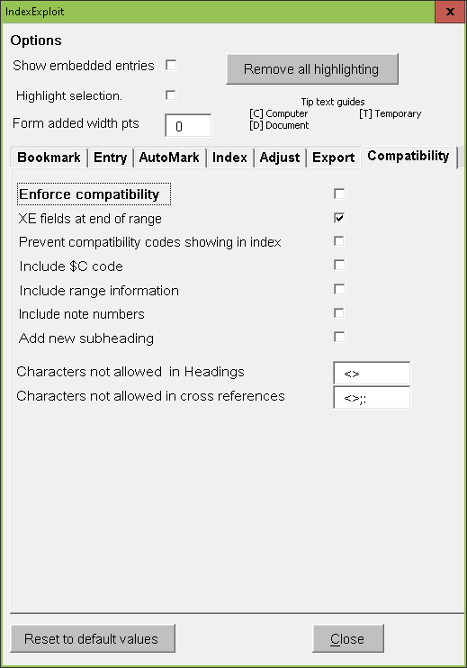
Options - Compatibility
When another application reads a Word file including XE fields there is often insufficient information to support accurate range page numbering and linking. Once discovered, indexers will sometimes avoid using page ranges.
IndexExploit can control where XE fields are placed in relation to indexed content. It can also move XE fields and add $CA_...........$CZ_ compatibility codes to be read by another application after import.
More information is included in the user guide.

Slide 29
Options - Compatibility
Enforce compatibility forces range entries to be close to expected positions when indexing
XE Fields at end of range - default is beginning of range
Prevent compatibility codes showing in index – codes are placed beyond the entry text in the XE field so they don’t appear in the index
Include $C code- these are codes that can be read by the publishing software
{ XE “subject:heading$CA_ Wrpp=10 $CZ_” \b \i } – appears in index
{ XE “subject:heading” \b \i $CA_ Wrpp=10 $CZ_} – doesn’t appear in index
Include range information – includes range information for publishing software
Add new subheading – writes compatibility code in new subheading
Characters not allowed in headings – avoids characters that may cause problems in publishing software
Characters not allowed in cross references avoids characters that may cause problems in publishing software

Slide 30
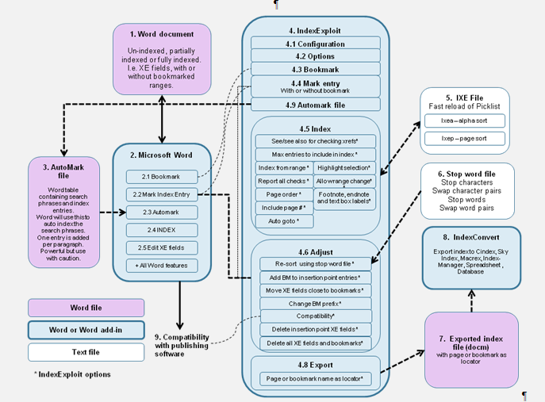
Word / IndexExploit Process

