Slide 1
VABEXPO
VIRGINIA BUSINESS EXPO CORPORATION
3rd Annual
African American Book Festival
April 13, 2024
Richmond Diversity Center
(Richmond, VA)
-----------------------------------------
2nd Annual
African American Book Festival
June 8, 2024
Second Ward Gymnasium
(Charlotte, NC)
--------------------------------------
Bringing Together Readers and Writers

Slide 2
VABEXPO
VIRGINIA BUSINESS EXPO CORPORATION
1st Annual
Minority Business Expo
August 17, 2024
Richmond Diversity Center
(Richmond, VA)
-----------------------------------------
1st Annual
Minority Business Expo
Date: TBD
Second Ward Gymnasium
(Charlotte, NC)
--------------------------------------
Celebrating Minority, Women, and Veteran-Owned Businesses

Slide 3
Who Are We?
Virginia Business Expo Corporation (VABEXPO) is a 501 (c) 3 nonprofit organization.
Our mission is two-fold:
to promote public awareness of the importance of African American contributions to American literature and public conversation, and
Celebrating minorities, women, and veteran-owned businesses, past and present, by exposing the community to business opportunities and cultural resources.

Slide 4
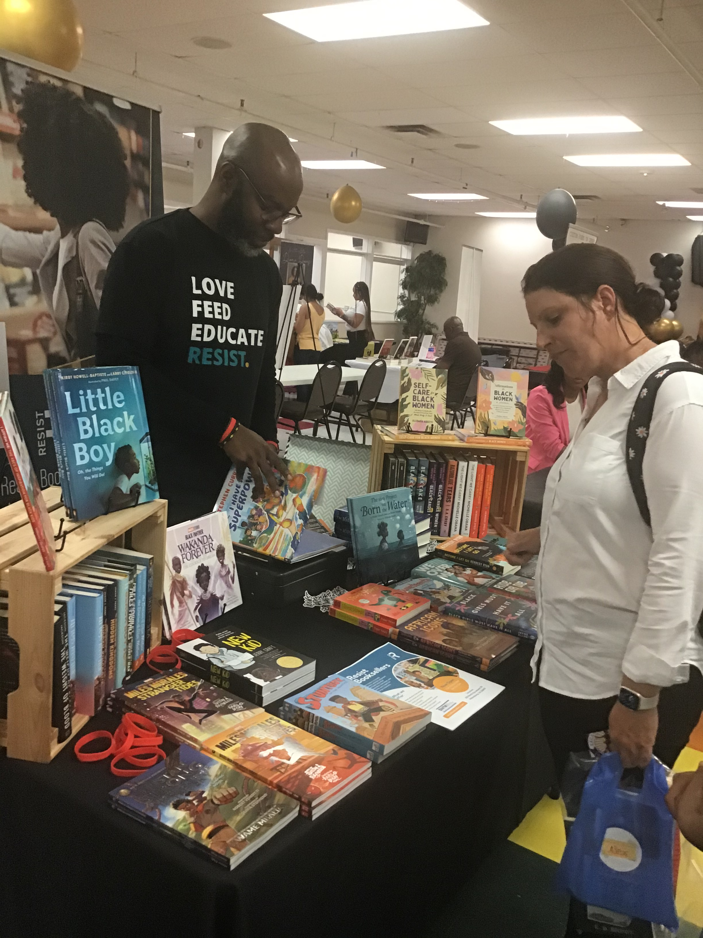
Purpose
Virginia Business Expo Corporation (VABEXPO) is proud to announce that it will host four events in 2024, including Richmond, Virginia, and Charlotte, North Carolina.
VABEXPO would like to invite you to be a sponsor of these prominent, local events!

Slide 5
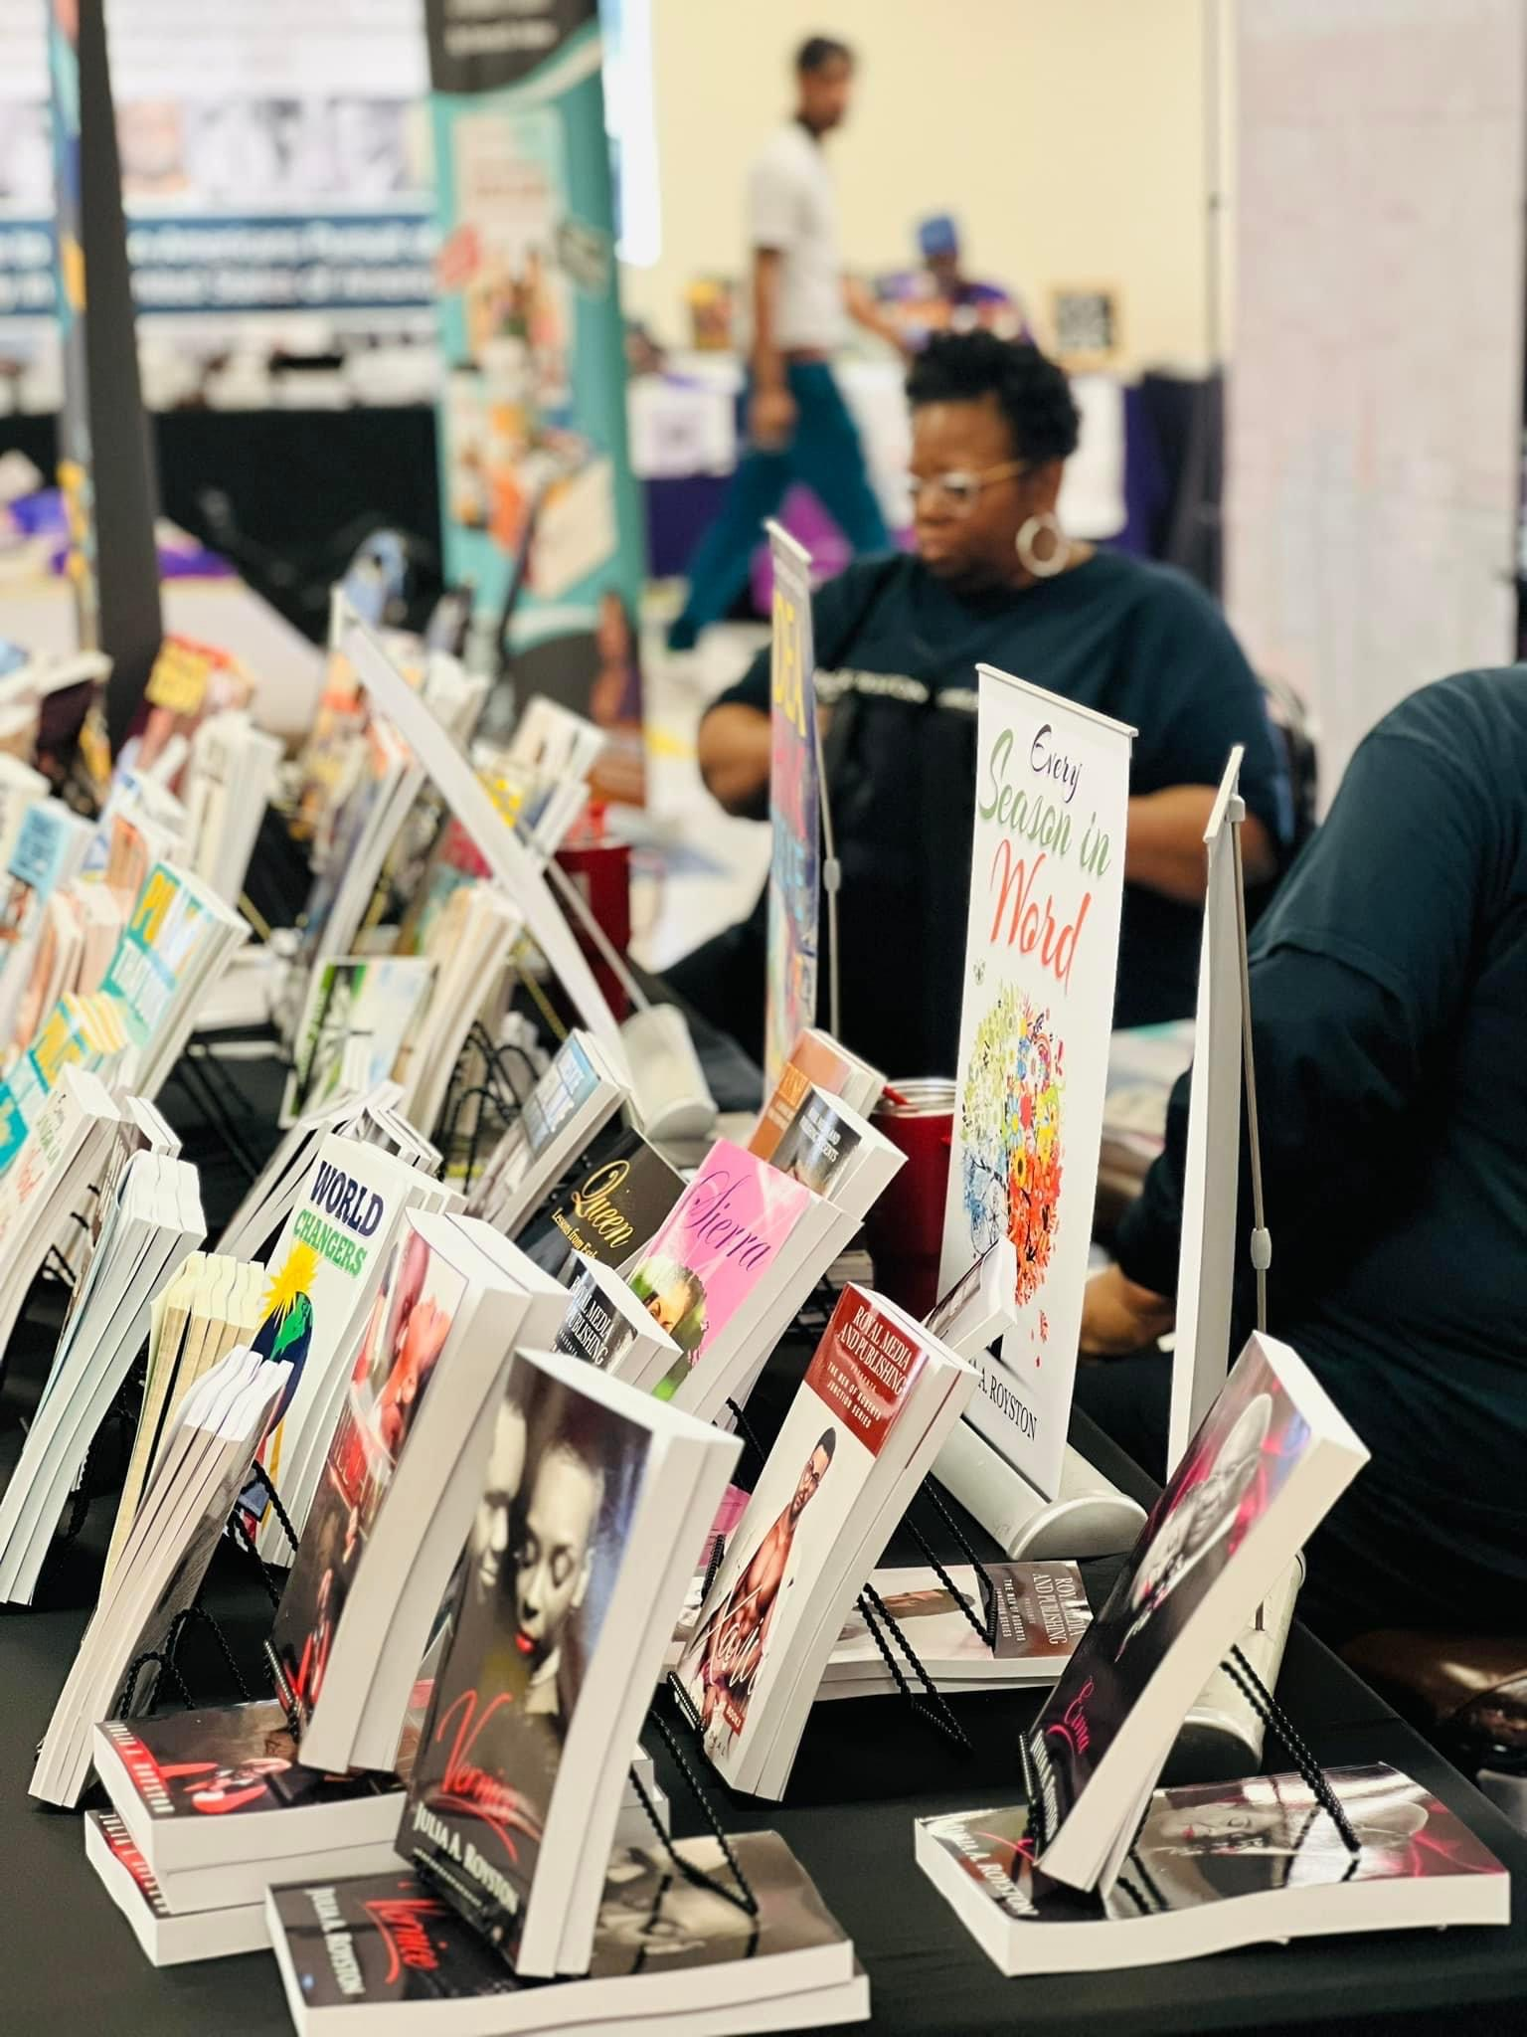
Why a Book Festival?
VABEXPO has grown to over 70 members.
In order to meet our mission, the African American Book Festival was created to bring writing talent to the people, they write for, and in the city’s they write for.

Slide 6
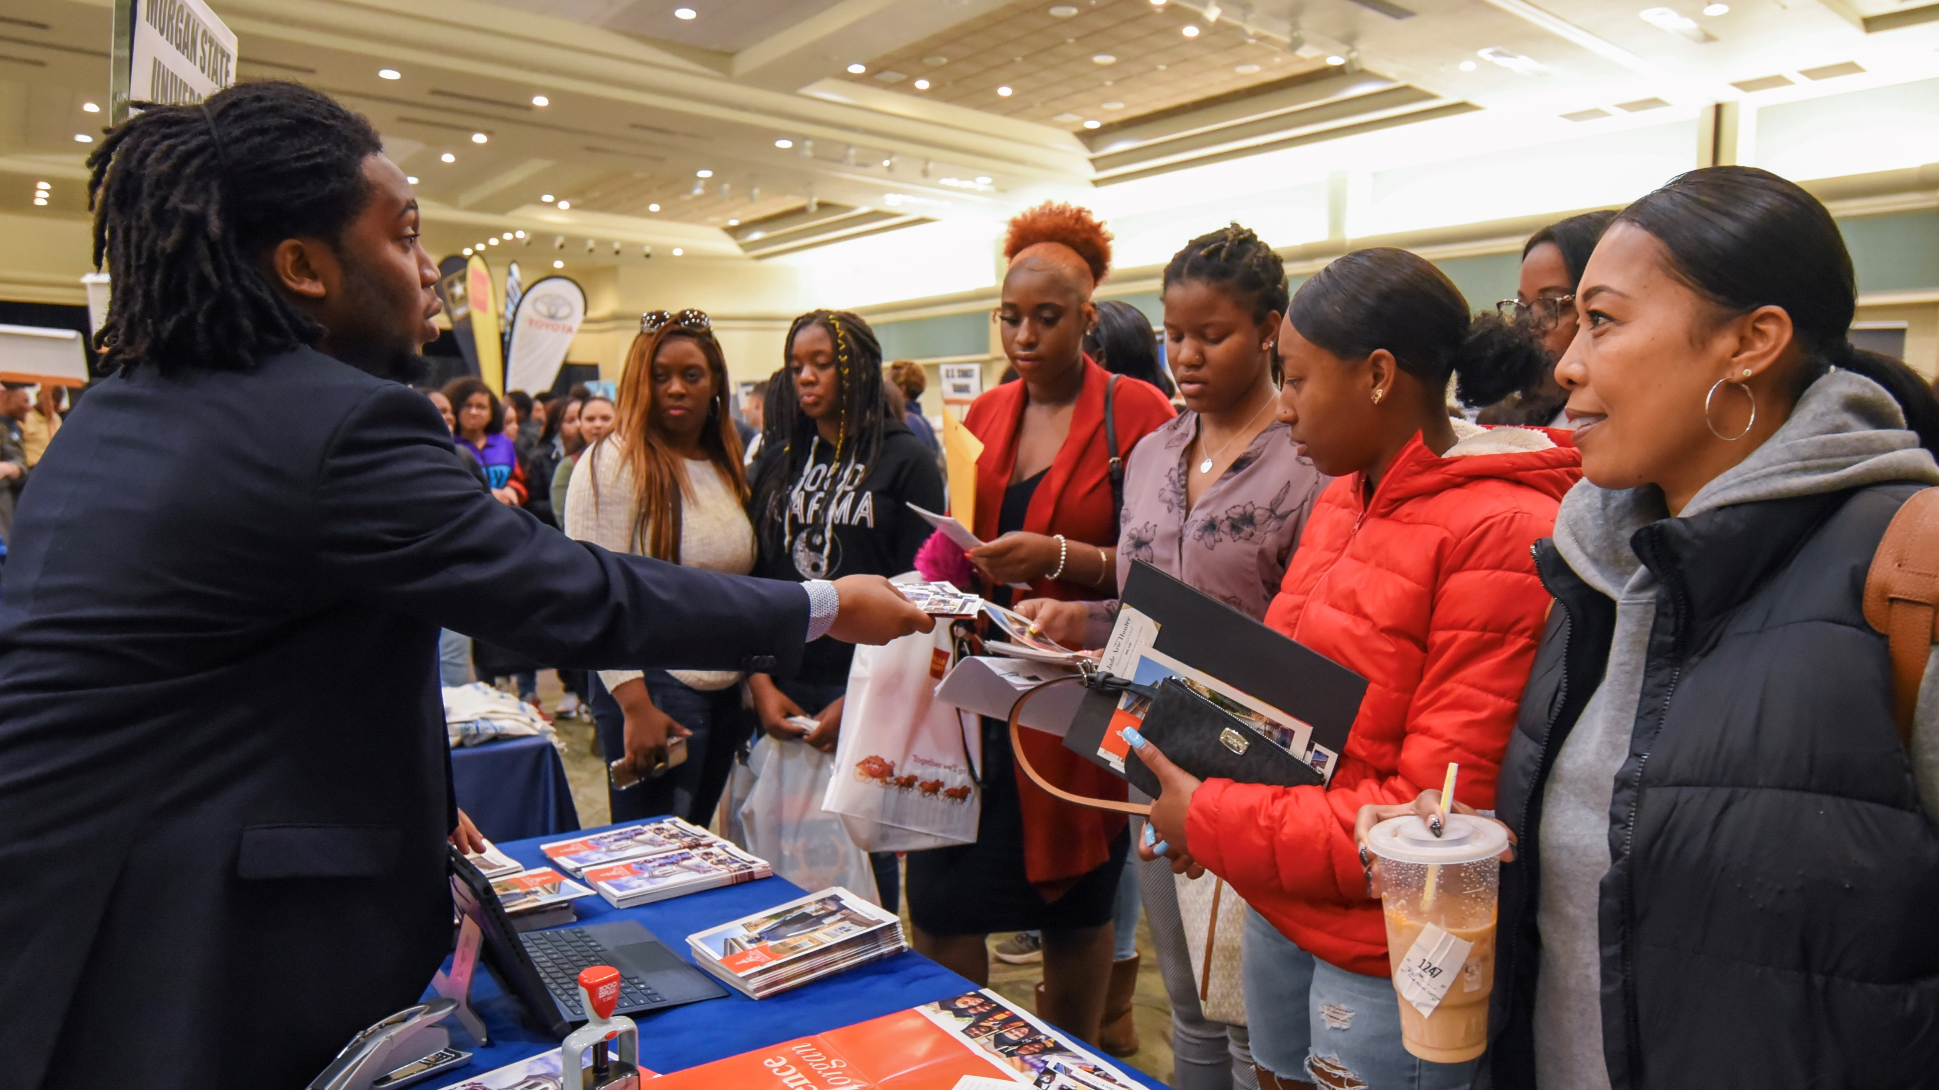
Why a Minority Business Expo?
By focusing on entrepreneurship and the economic and cultural empowerment of underperforming communities, the Expo provides an opportunity for business owners, entrepreneurs, and people from the community to come together and create ways to improve the black economy.

Slide 7
How Can You Join Us?
We would love the chance to help you share your brand and good will with the Community!
We have several levels of Sponsorship.
Logo featured on company website
Recognized on all event-related promotional materials
Option for a table display
Display banner throughout event
One-half page advertisement in festival pamphlet
GOLD LEVEL SPONSORSHIP $3,000 +

Slide 8
How Can You Join Us?
SILVER LEVEL SPONSORSHIP $1,500 - $2,999
Logo featured on company website
Display banner throughout event
One-quarter page advertisement in festival pamphlet
Log featured on company website
Recognized in festival pamphlet
Logo featured on website
Recognized in festival pamphlet
BRONZE LEVEL SPONSORSHIP $500 - $1,499
COMMUNITY LEVEL SPONSORSHIP $200 - $499

Slide 9
How Can You Join Us?
FRIEND OR SUPPORTER $ UP TO $199
Logo featured on company website
Display banner throughout event
One-quarter page advertisement in festival pamphlet

Slide 10
Where Your Sponsorship Dollars Go
All Staff are volunteers
Space rental
Additional equipment/rental (tents, bouncy house, games, air dancer, tables & chairs, etc.)
Entertainers/Speakers
Marketing and advertising
Radio
Online
Social Media
Newspaper
Printing Costs
Banners, stands, tents, runners, etc.
Miscellaneous (certificates, holders, badges, lanyards, decorations, etc.)
$ 0
$ 4,200.00
$ 2,300.00
$ 2,600.00
$ 3,500.00
$ 900.00
$ 1,100.00
$ 900.00
$ 1,650.00
$ 1,700.00
$ 1,350.00
TOTAL $18,850.00

Slide 11
Thank You!
Thank you for giving us a chance to explain what a wonderful opportunity we can offer your company to share in these popular events in Richmond and Charlotte.
Thanks to sponsors like you, the African American Book festival can continue to bring readers and writers together.
To give,
Please send a check made out to
Virginia Business Expo Corporation
P.O. Box 37511
North Chesterfield, Va. 23234
Or
Make a Donation on the
Virginia Business Expo Website
https://www.vabexpo.com

Slide 12
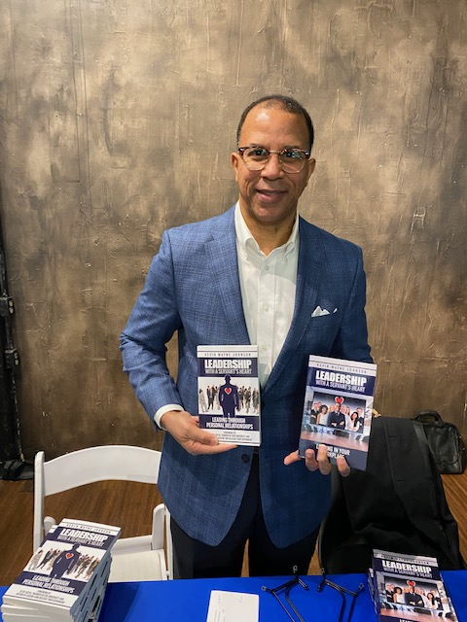
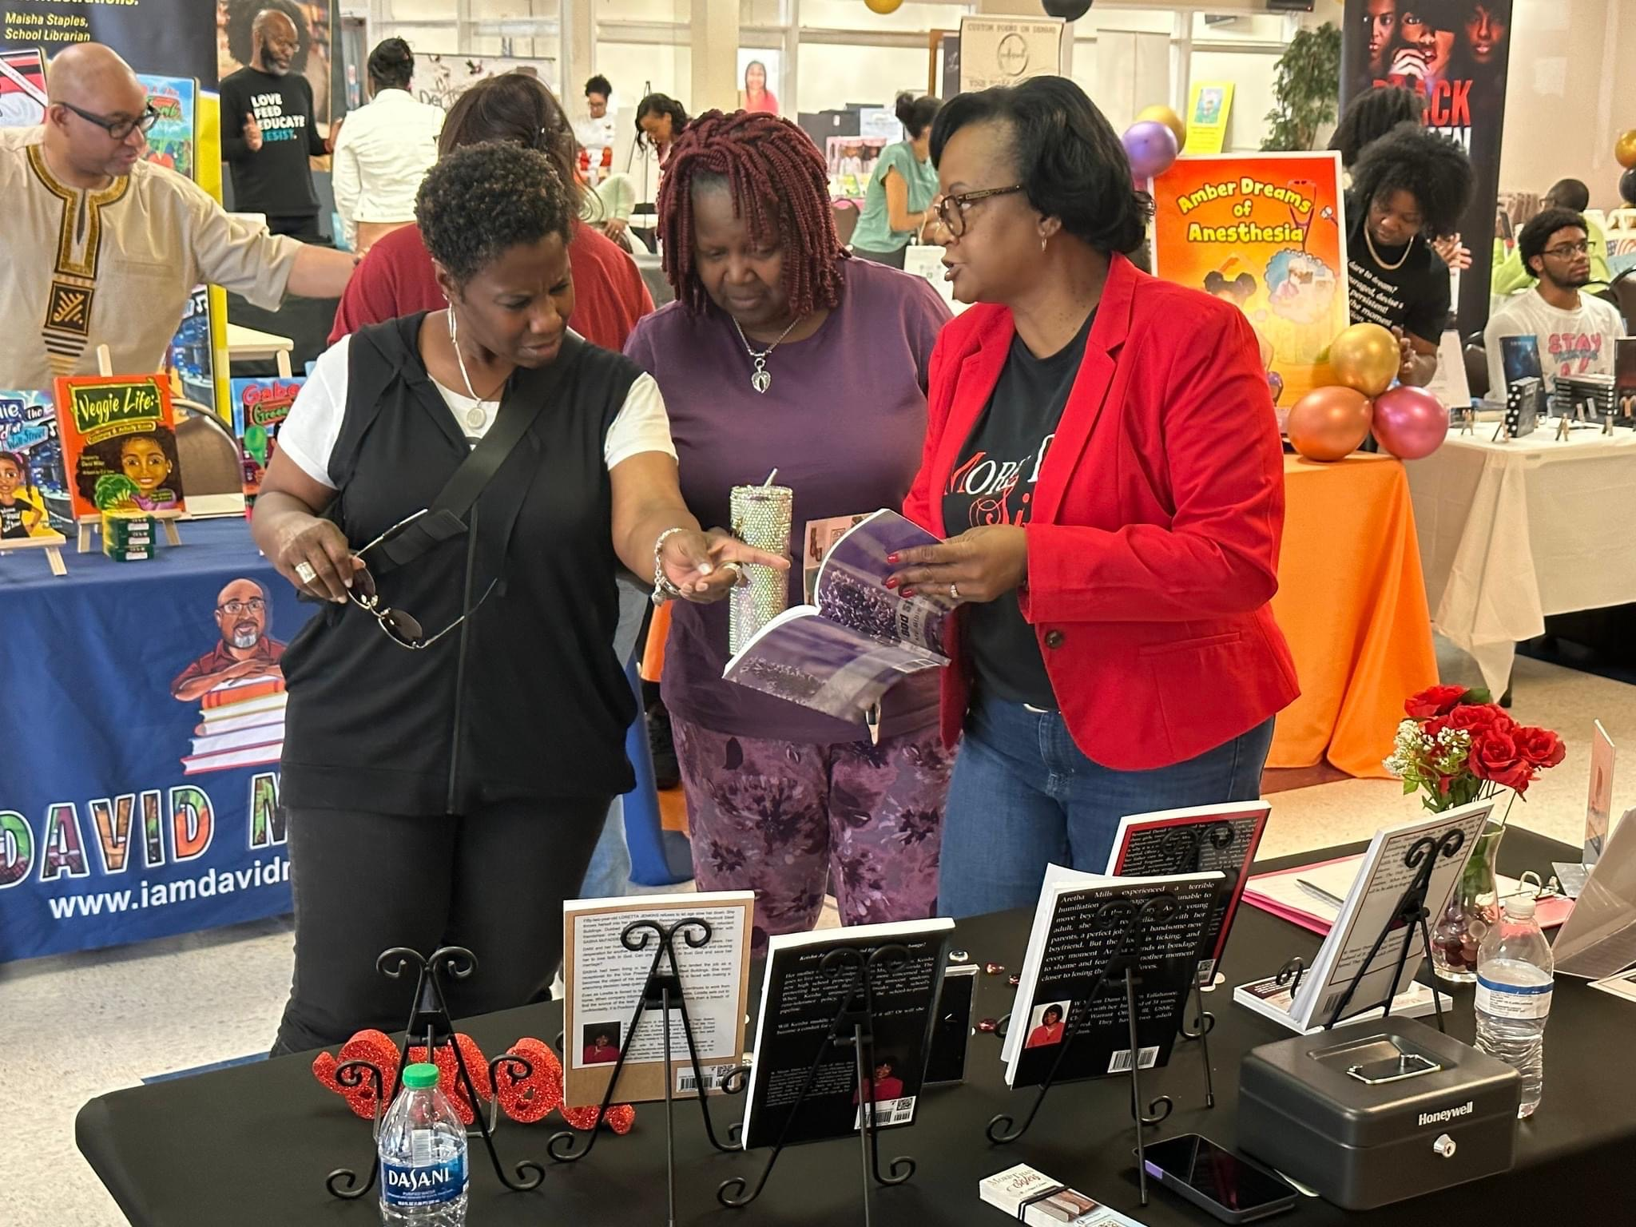
Your Contact
Do you have questions? Please contact Roy Wyatt
at vabexpo@yahoo.com or call him at (804) 873-0982
As a reminder, please visit our website at
https://www.vabexpo.com

Slide 13
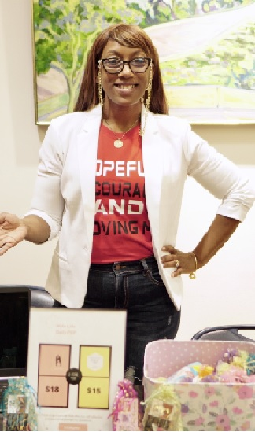
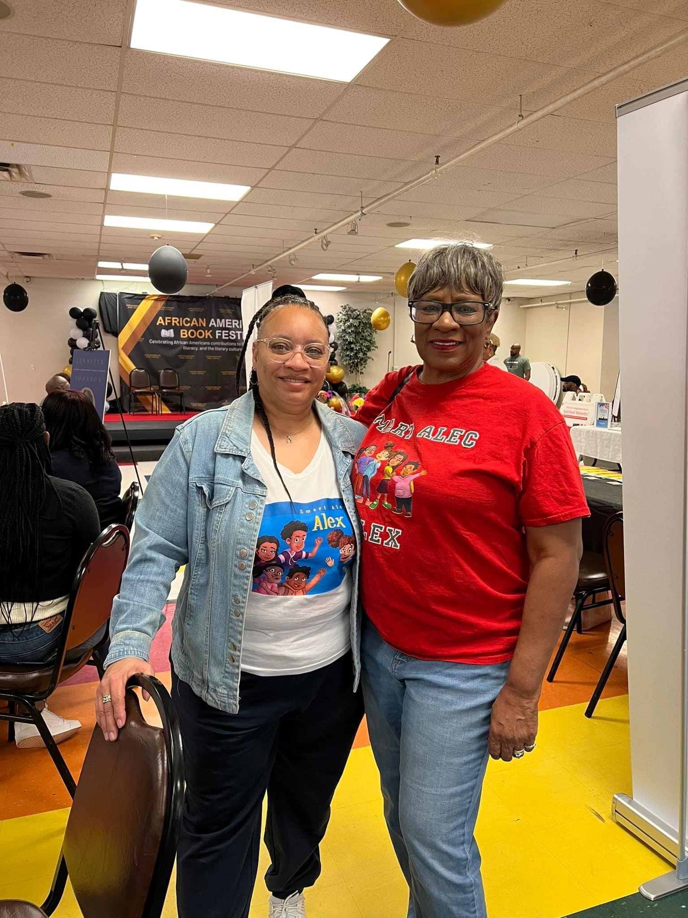
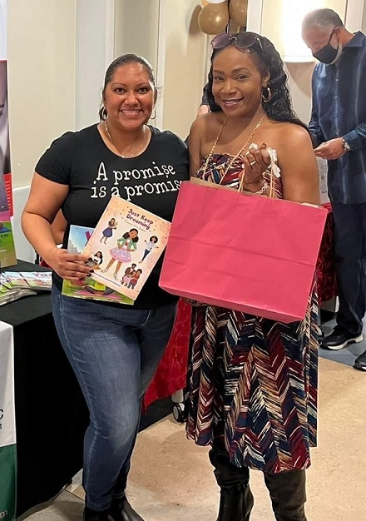
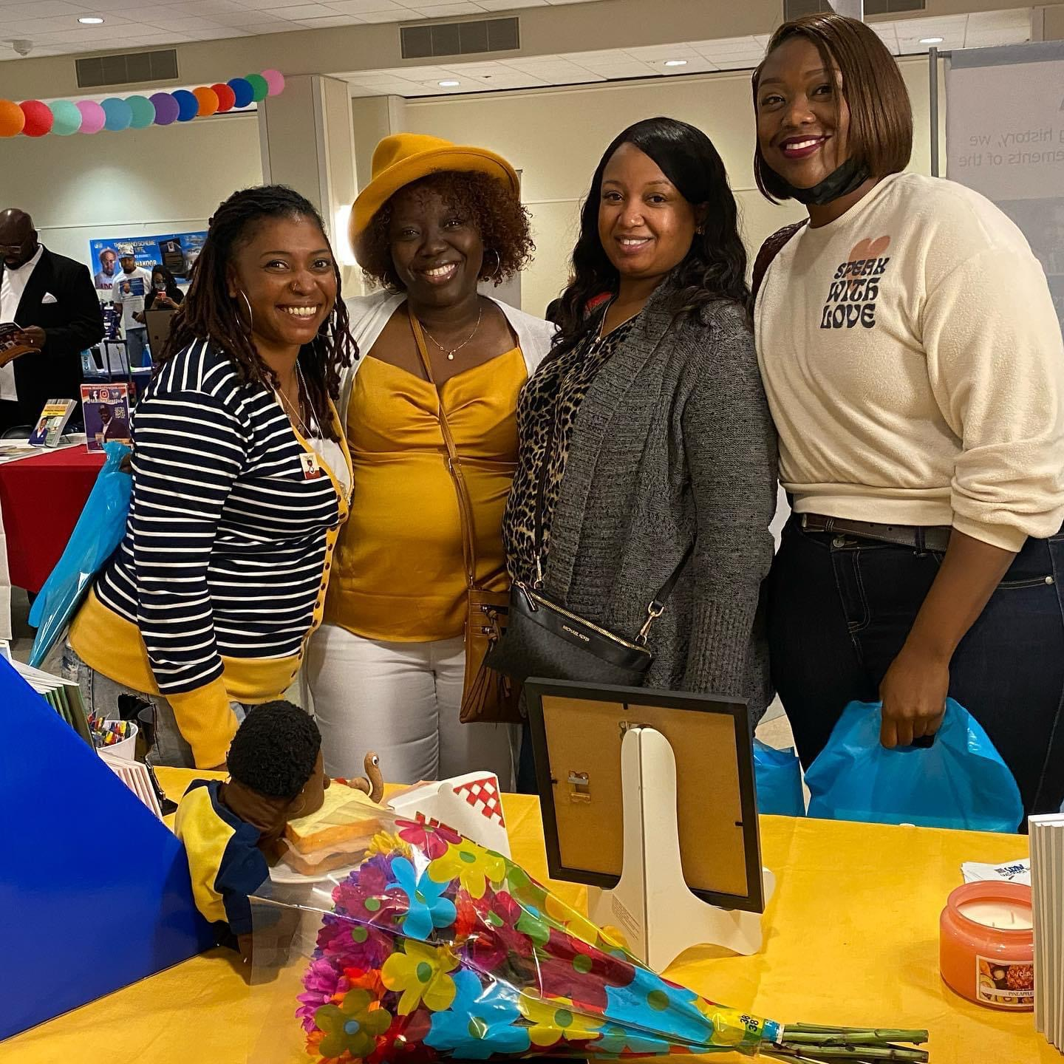
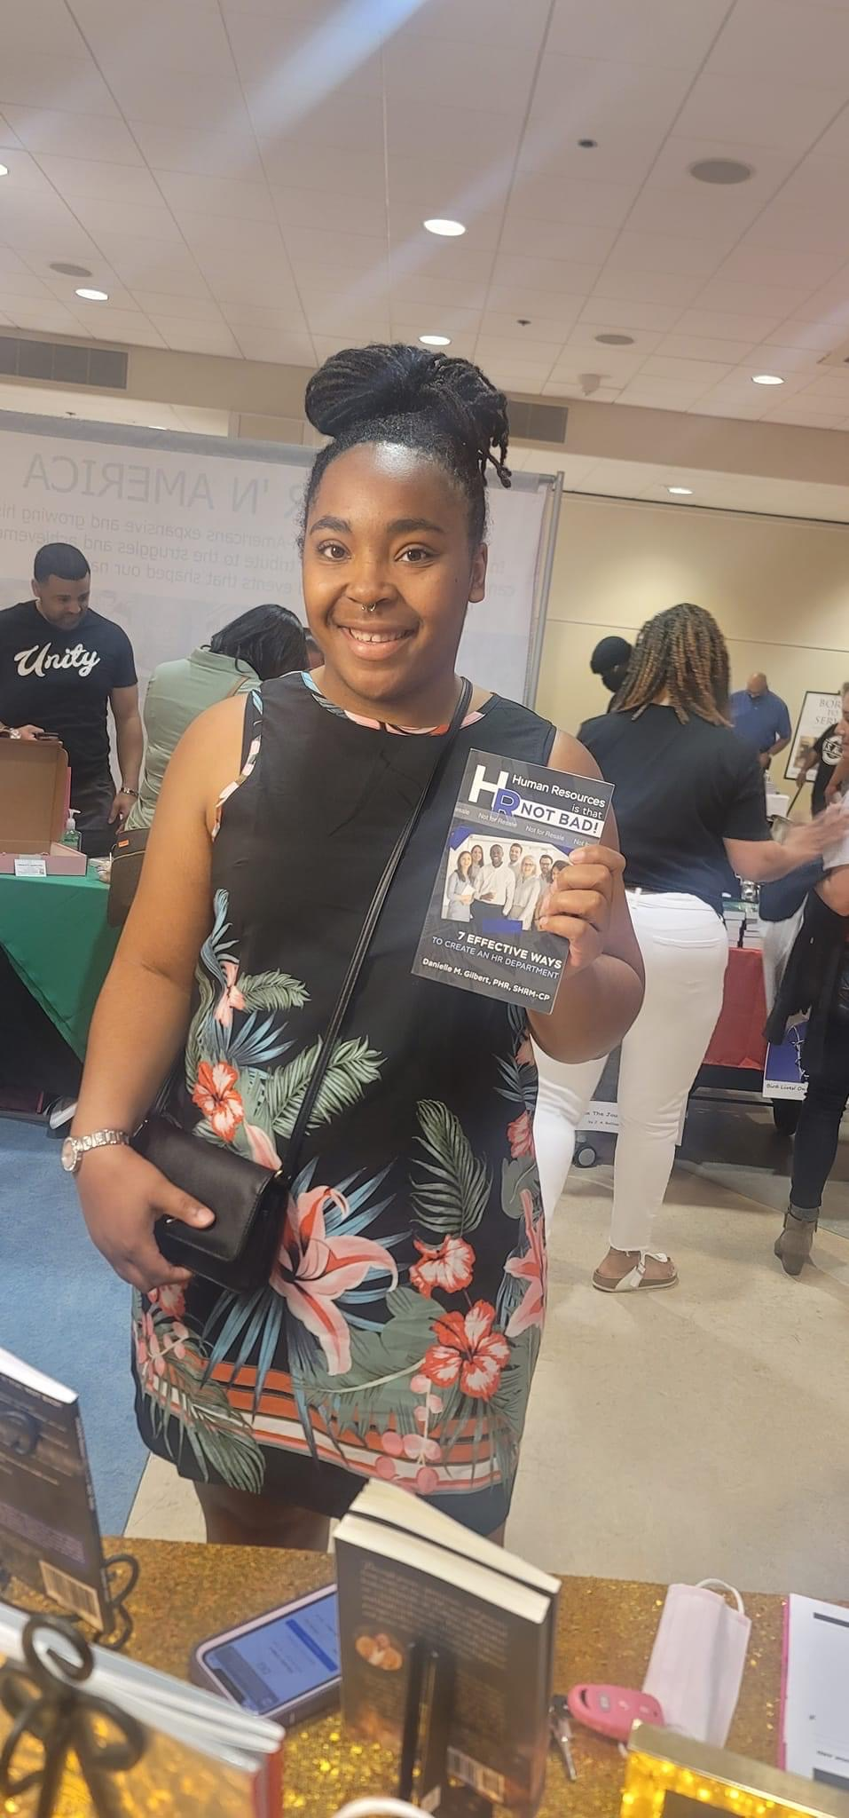
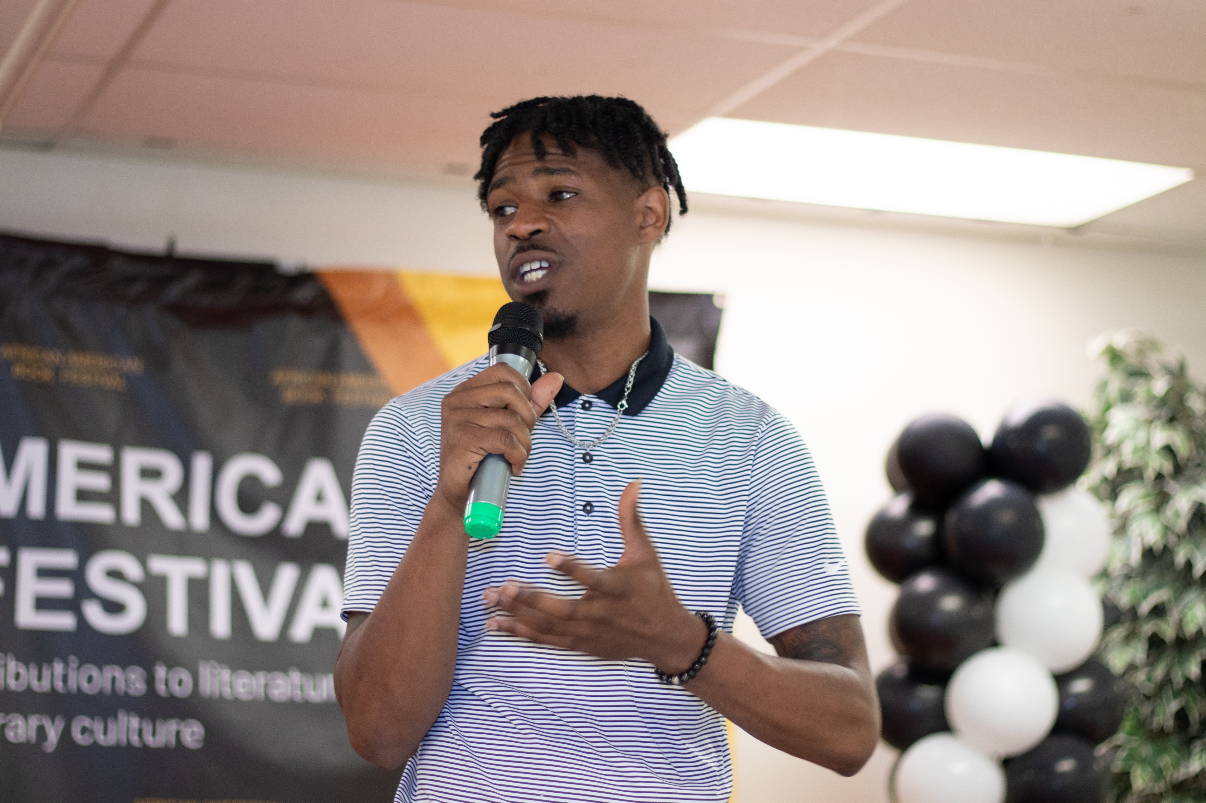
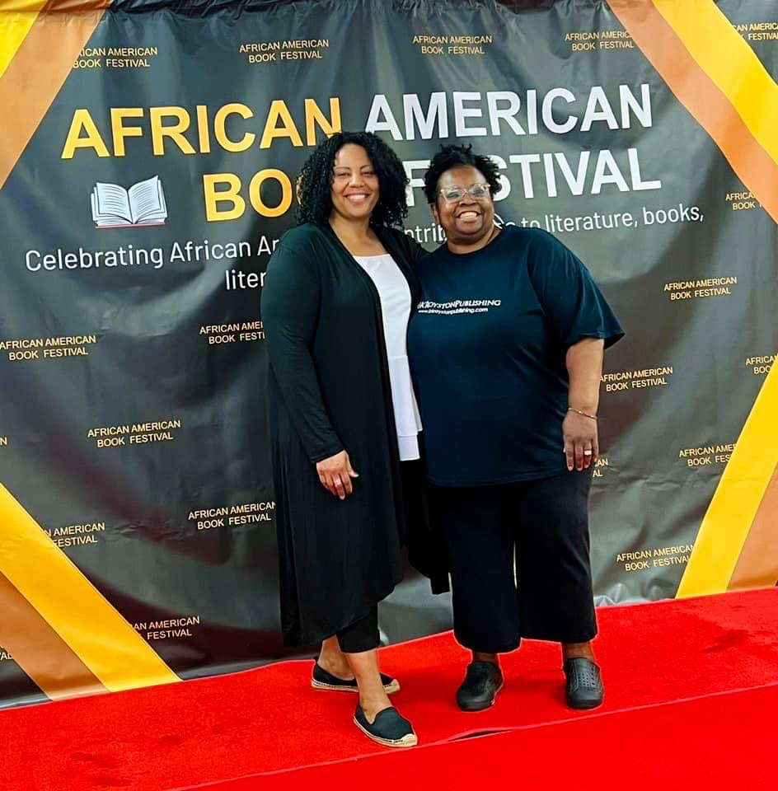
Some of our Talented Authors

