Slide 1
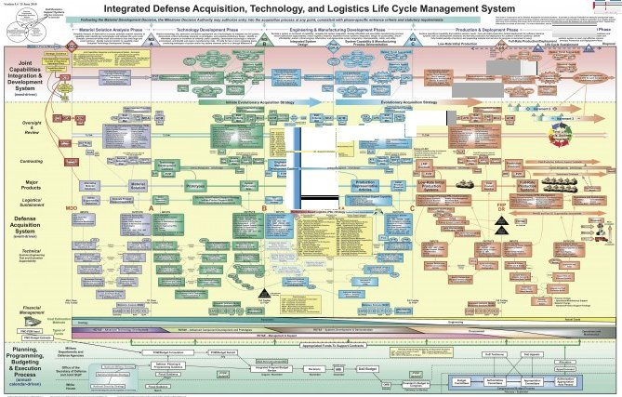

Slide 2
Miles Law and Other Eponymous Minutae
ASMC Luncheon 15 October
Lou Crenshaw
© Can Stock Photo Inc. / ajithclicks

Slide 3
Miles Law and Other Eponymous Minutiae
ASMC Luncheon 15 October
Lou Crenshaw

Slide 4
When it comes to PowerPoint slides:
Keep them simple. Pictures and graphs are best. Use few words. Remember people will be reading the slides and not listening to you if there are words on the them.
Make sure the words are spelled correctly. Most Admirals and Generals spend more time checking the spelling on slides than either reading what the words say or listening to you. One misspelling and you are labeled an Idiot For Life and all future slides are null and void!
Have a time budget for your slides. It’s hard to spend less than 5 minutes on a slide. If you have to spend less that that, then you probably don’t need it.
DON”T READ THE SLIDES!! Guess what? Everyone in the room can read.
From Power Counter-point, CCA Website

Slide 5
When it comes to PowerPoint slides:
Make sure the material on the slide is large enough so that it can be seen in the back. I hate it when someone flashes up a slide with a 50 element spreadsheet and says, ” You probably can’t see this, but……..” Why waste my time with something I can’t see?
Don’t read the slides!! (Did I already say that? It’s worth repeating…..Don’t read the slides)
Don’t use Power Point.
From Power Counter-point, CCA Website

Slide 6
Miles Law and Other Eponymous Minutae
ASMC Luncheon 15 October
Lou Crenshaw

Slide 7
Work expands so as to fill the time available for completion
Parkinson’s Law first published in 1955 in The Economist
© Can Stock Photo Inc. / iqoncept

Slide 8
If you wait until the last minute, it only takes a minute to do.
Stock-Sanford Corollary to Parkinson’s Law
© Can Stock Photo Inc. / kikkerdirk

Slide 9
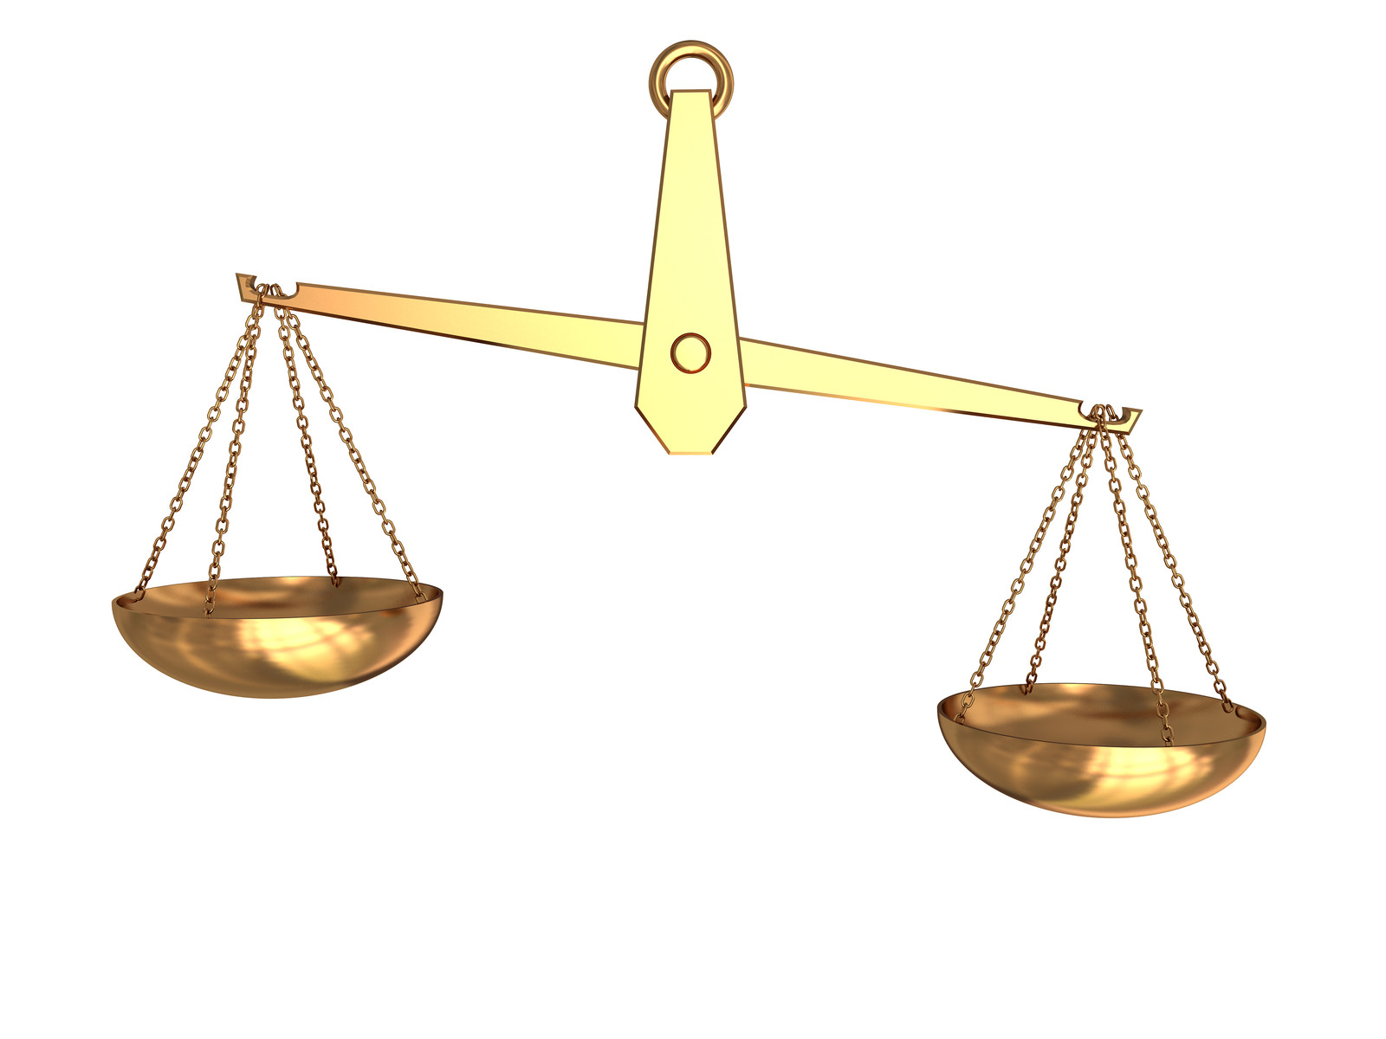
The time spent on any item of the agenda will be in inverse proportion to the sum of money involved
Parkinson’s Law of Triviality
Global Nuclear War
CFC Campaign
© Can Stock Photo Inc. / mmaxer

Slide 10
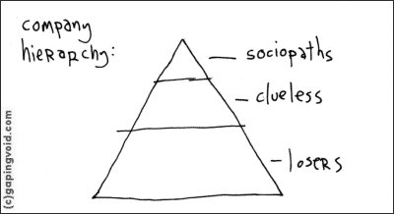
In time, every post tends to be occupied by an employee who is incompetent to carry out its duties. Work is accomplished by those employees who have not yet reached their level of incompetence.
Peter Principle, 1969 by Laurence J. Peter in The Peter Principle: Why Things Always Go Wrong

Slide 11
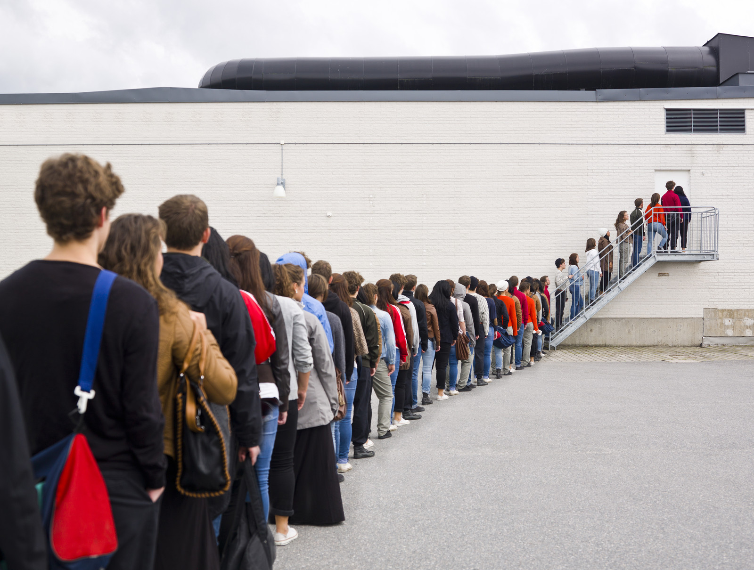
It always takes longer than you expect, even if you take into account [this law]
Hofstadter’s Law by Douglas Hofstadter, 1979, in Gödel, Escher, Bach: An Eternal Golden Braid
© Can Stock Photo Inc. / gemenacom

Slide 12
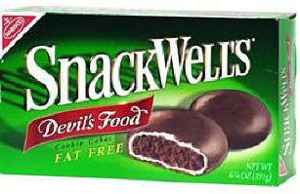
Dieters will eat more low-calorie cookies than they otherwise would for normal cookies
The SnackWell Effect

Slide 13
People with energy efficient lights leave them on longer and lose 5-12% of the expected energy savings
The SnackWell Effect

Slide 14
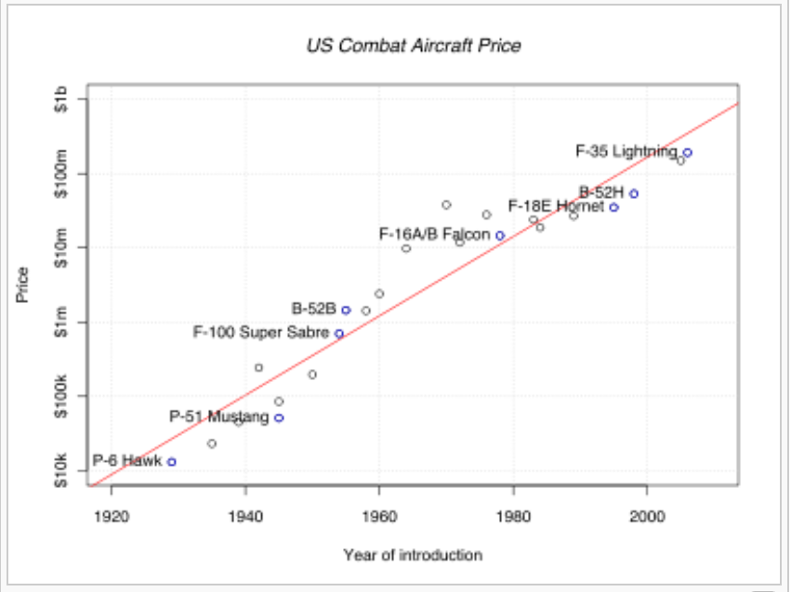
In the year 2054, the entire defense budget will purchase one tactical aircraft, shared by the Air Force and Navy 3 ½ days per week except leap year, when it will be made available to the Marines
Augustine’s Law 16, Norm Augustine, 1984

Slide 15
If anything can go wrong, it will
Murphy’s Law, CAPT Ed Murphy USAF 1949

Slide 16
There are no rumors in the Pentagon; sooner or later everything comes true.
© Can Stock Photo Inc. / iagodina
Gen. Colin Powell, 1992

Slide 17
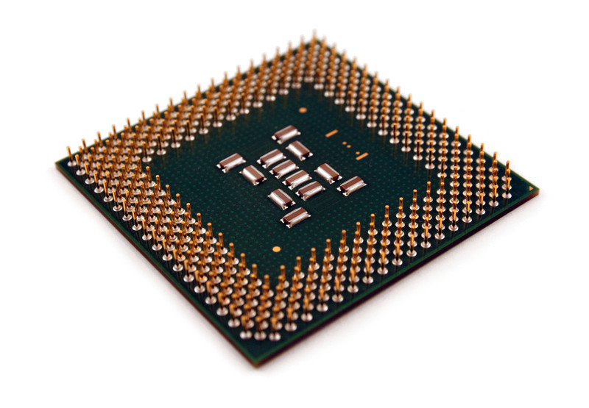
The number of transistors in a dense integrated circuit doubles approximately every two years
© Can Stock Photo Inc. / CanadaFirst
© Can Stock Photo Inc. / BrandonSeidel
© Can Stock Photo Inc. / Vladyslav
© Can Stock Photo Inc. / Sergpet
Moore’s Law, Gordon E. Moore, 1965

Slide 18
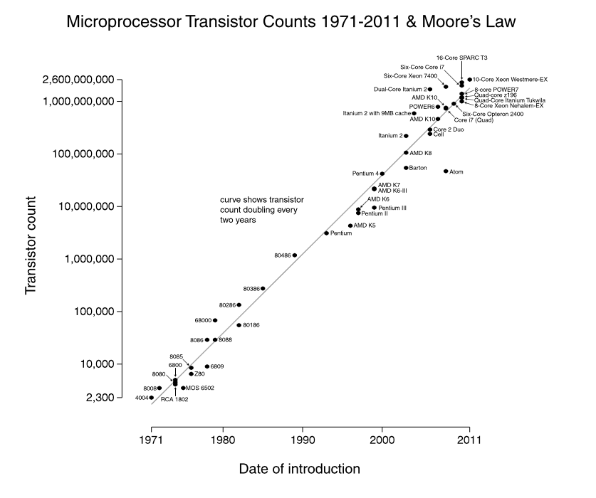

Slide 19
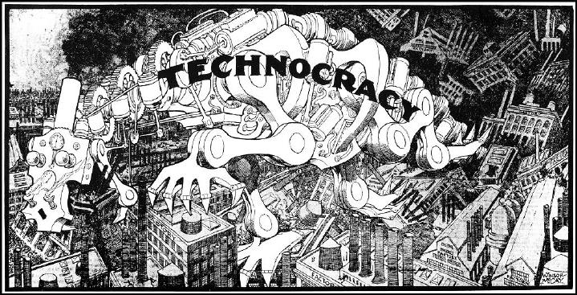
Technology is dominated by two types of people: those who understand what they do not manage and those who manage what they do not understand
Putt’s Law, Archibald Putt, 1981, Putt’s Law and the Successful Technocrat
Notes:
Technology is dominated by two types of people: those who understand what they do not manage and those who manage what they do not understand.

Slide 20
You can not double revenue by doing twice as much of the same thing
R₂=2R₁- F_{LP}
Crenshaw’s Anti-multiplicative Rule, 2014, A Self-Licking Ice Cream Cone

Slide 21
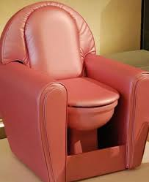
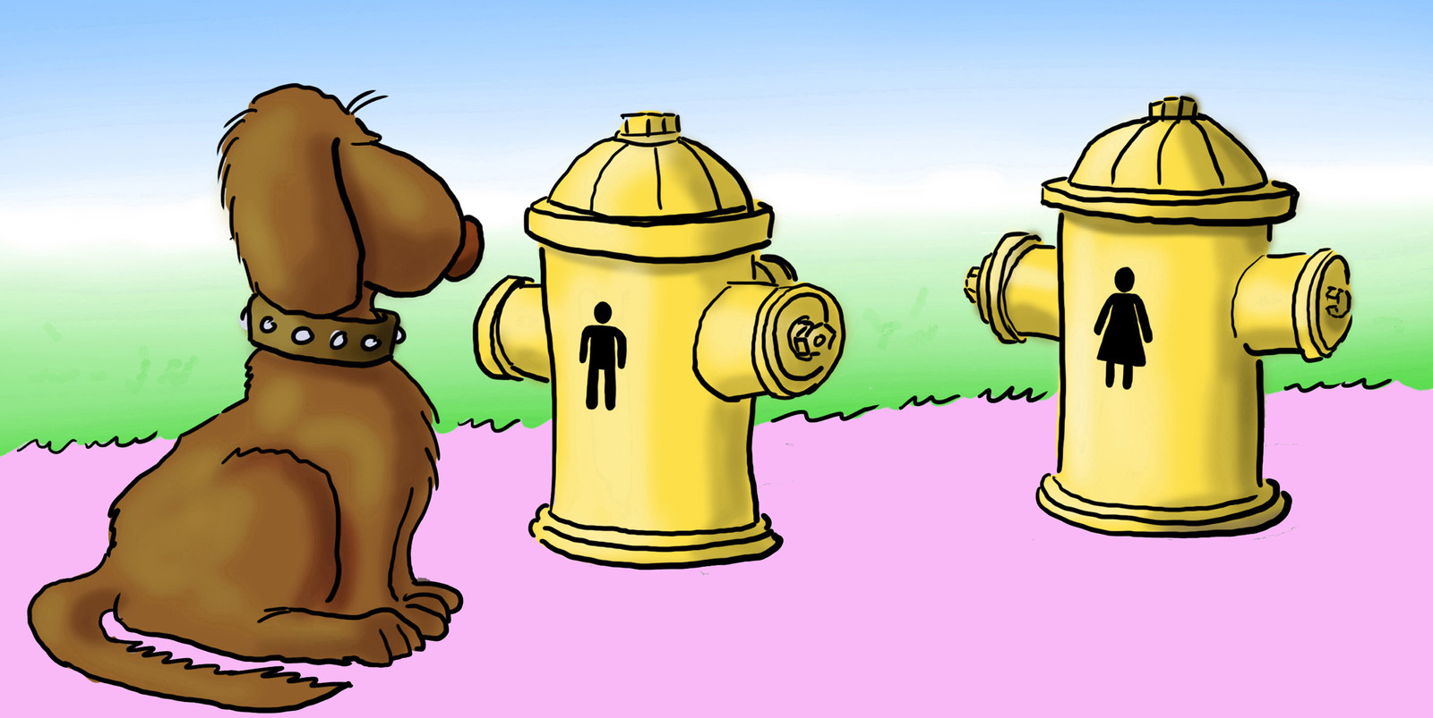
Where you stand depends on where you sit
Miles Law, 1949, Prof. Rufus E. Miles, Princeton

Slide 22
Miles Seven Maxims
#2. The responsibility of every manager exceeds his authority, and if he tries to increase his authority to equal his responsibility, he is likely to diminish both.

Slide 23
Miles Seven Maxims
#2. The responsibility of every manager exceeds his authority, and if he tries to increase his authority to equal his responsibility, he is likely to diminish both.
#3. Managers at any level tend to think they can make better decisions than either their superiors or subordinates; Most managers seek to maximize delegation from superiors and minimize delegation to subordinates.

Slide 24
Miles Seven Maxims
#2. The responsibility of every manager exceeds his authority, and if he tries to increase his authority to equal his responsibility, he is likely to diminish both.
#3. Managers at any level tend to think they can make better decisions than either their superiors or subordinates; Most managers seek to maximize delegation from superiors and minimize delegation to subordinates.
#4. Serving more than one master is neither improper nor unusually difficult, if the servant can get prompt resolution when masters disagree.

Slide 25
Miles Seven Maxims
#2. The responsibility of every manager exceeds his authority, and if he tries to increase his authority to equal his responsibility, he is likely to diminish both.
#3. Managers at any level tend to think they can make better decisions than either their superiors or subordinates; Most managers seek to maximize delegation from superiors and minimize delegation to subordinates.
#4. Serving more than one master is neither improper nor unusually difficult, if the servant can get prompt resolution when masters disagree.
#5. Since managers usually make better talkers than listeners, subordinates need courage and tenacity to make their bosses hear what they do not want to hear.

Slide 26
Miles Seven Maxims
#2. The responsibility of every manager exceeds his authority, and if he tries to increase his authority to equal his responsibility, he is likely to diminish both.
#3. Managers at any level tend to think they can make better decisions than either their superiors or subordinates; Most managers seek to maximize delegation from superiors and minimize delegation to subordinates.
#4. Serving more than one master is neither improper nor unusually difficult, if the servant can get prompt resolution when masters disagree.
#5. Since managers usually make better talkers than listeners, subordinates need courage and tenacity to make their bosses hear what they do not want to hear.
# 6. Being two-faced in not a vice, but a virtue for a program manager if he presents his two faces openly and candidly.

Slide 27
Miles Seven Maxims
#2. The responsibility of every manager exceeds his authority, and if he tries to increase his authority to equal his responsibility, he is likely to diminish both.
#3. Managers at any level tend to think they can make better decisions than either their superiors or subordinates; Most managers seek to maximize delegation from superiors and minimize delegation to subordinates.
#4. Serving more than one master is neither improper nor unusually difficult, if the servant can get prompt resolution when masters disagree.
#5. Since managers usually make better talkers than listeners, subordinates need courage and tenacity to make their bosses hear what they do not want to hear.
# 6. Being two-faced in not a vice, but a virtue for a program manager if he presents his two faces openly and candidly.
#7. Dissatisfaction with service tends to rise rapidly when the provider becomes bureaucratically bigger, more remote and less flexible, even if the costs are lower.

Slide 28
Miles Seven Maxims
#2. The responsibility of every manager exceeds his authority, and if he tries to increase his authority to equal his responsibility, he is likely to diminish both.
#3. Managers at any level tend to think they can make better decisions than either their superiors or subordinates; Most managers seek to maximize delegation from superiors and minimize delegation to subordinates.
#4. Serving more than one master is neither improper nor unusually difficult, if the servant can get prompt resolution when masters disagree.
#5. Since managers usually make better talkers than listeners, subordinates need courage and tenacity to make their bosses hear what they do not want to hear.
# 6. Being two-faced in not a vice, but a virtue for a program manager if he presents his two faces openly and candidly.
#7. Dissatisfaction with service tends to rise rapidly when the provider becomes bureaucratically bigger, more remote and less flexible, even if the costs are lower.

Slide 29
