Slide 1
The Importance of PTSD Assessment following Man-made and Natural Disasters
Michele Louviere, LMFT
Certified SITT and EFT Therapist and Supervisor
Michele@refuge182.com
www.refuge182.com

Slide 2
Workshop Objectives
Licensed mental health professionals will identify the diagnosis criteria for Post-Traumatic Stress and Post-Traumatic Stress Disorder that can develop after man-made and natural disasters.
Licensed mental health professionals will explore current assessments that effectively assess for PTSD and provide essential information for determining treatment goals.
Licensed mental health professionals will utilize a case study to practically apply assessments into treatment planning for a disaster client.

Slide 3
I have told you all this so that you may have peace in me. Here on earth, you will have many trials and sorrows. But take heart, because I have overcome the world. (John 16:33 NLT)

Slide 4
Normal Reactions to Abnormal Events: Post-Traumatic Stress (PTS)
Physical: Headaches, Stomach Issues, Weakness, Dizziness, Sleep Issues, Fatigue, Thirst
Cognitive: Confusion, Blaming, Poor Concentration and Decision Making, Memory Problems, Hypervigilance, Nightmares, Flashbacks
Emotional: Anxiety, Guilt, Grief, Denial, Shock, Feeling Overwhelmed, Depression, Anger, Fear, Agitation, Irritability

Slide 5
Normal Reactions to Abnormal Events: Post-Traumatic Stress (PTS)
Behavioral: Change in Activity, Change in Speech, Withdrawal, Emotional Outbursts, Paranoia, Restlessness, Increase Alcohol or Drug Usage, Acting Out Sexually, Loss/ Increase in Appetite, Body Complaints, Intensified Startle Reflex
Spiritual: Anger at God, Feeling Distant from God, Anger at Clergy, Questioning Spiritual Beliefs, Feeling Closer to God, Believing that God is not in Control or has Failed

Slide 6
Normal Reactions to Abnormal Events for Children:
Sleep Issues/ Nightmares/ Bed Wetting
Fear/ Anxiety/ Confusion/ Trouble Concentrating
Crying and Fearful Clinging/ Attachment
Preoccupation with Event/ Playing Out Trauma
Withdrawal/ Shame/ Feeling Responsible/ Decreased Activity
Behavior Problems/ Regressive Behaviors

Slide 7
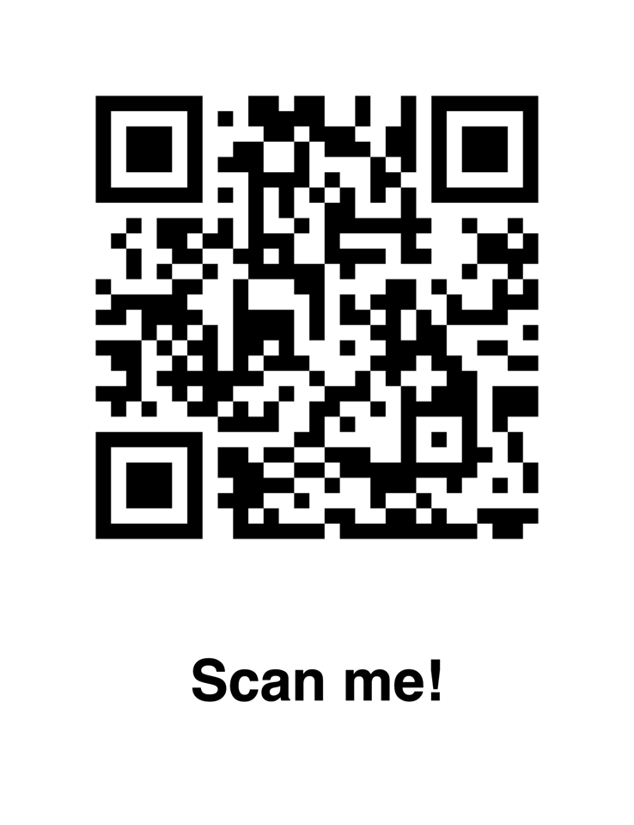
Understanding and Assessing PTSD
PTSD is the primary psychological response to trauma exposure.
Understanding PTSD is imperative to creating safety for our clients and helping them navigate the landscape of their traumatic experience.
Even with the increasing numbers of people struggling with PTSD, mental and physical health professionals struggle with diagnosis and treatment of PTSD. Often, PTSD symptoms are treated rather than the core issues. Professionals use band-aids rather than “cleaning the puss out of the wounds” so real healing can occur.

Slide 8
DSM 5 Criteria for PTSD
Exposure to traumatic stressor – direct, indirect, or repeated
Recurrent, involuntary intrusive memories – traumatic nightmares or flashbacks; intensive or prolonged distress; body memories
Avoidance – avoiding places, conversations, people or experiences that even remotely remind them of an experience, trauma-related thoughts/ feelings, external reminders; psychogenic amnesia of traumatic memories (central organizing feature of PTSD)
Negative alterations in thinking and mood – persistent negative beliefs and expectations; persistent negative fears, blame, horror, anger, guilt, shame; diminished interest in activities; constricted affect

Slide 9
DSM 5 Criteria for PTSD
Alterations in arousal and reactivity – irritable and aggressive; self-destructive; hypervigilance; problems in concentration; sleep disturbance; startle response
Functional social or occupational impairment
Symptoms that last longer than 30 days
Significant disruption in normal life pursuits

Slide 10
King David – “Man After God’s Own Heart” and a Man with PTSD?
“My heart is in anguish within me; the terrors of death have fallen upon me. Fear and trembling come upon me, and horror overwhelms me” (Ps. 55:4–5).
“And I would say, ‘Oh, that I had wings like a dove! I would fly away and be at rest; yes, I would wander far away; I would lodge in the wilderness; I would hurry to find a shelter from the raging wind and tempest’” (Psalm 55:6–8)
Do not abandon me, Lord. Do not stand at a distance, my God. Come quickly to help me, O Lord my Savior. – Psalm 28:22, 22

Slide 12
Needing a New Diagnosis – Complex PTSD
People who have gone through a long-standing, extremely traumatic situation may exhibit both physical and emotional symptoms related to their ordeal that aren’t reflected in the narrower definition of PTSD.
Emotional symptoms may include:
Rage displayed through violence, destruction of property, or theft
Depression, denial, fear of abandonment, thoughts of suicide, and anger issues
Low self-esteem, panic attacks, and self-loathing
Perfectionism, blaming others instead of dealing with a situation, and selective memory
Loss of faith in humanity, distrust, isolation, and inability to form close personal relationships
Shame, guilt, and focusing on wanting revenge
Flashbacks, memory repression, and dissociation

Slide 13
Needing a New Diagnosis – Complex PTSD
Physical symptoms may include:
Eating disorders, substance abuse, alcoholism, and promiscuity
Chronic pain
Cardiovascular problems
Gastrointestinal problems
Migraines
The characteristics of complex PTSD are far more common than the literature would suggest. These characteristics are typical aftereffects of the childhood trauma experience.

Slide 14
PTSD Co-Morbidity
80% of People with PTSD meet criteria for another psychiatric disorder
3 to 5 times more likely to have depressive disorder
46% meet criteria for substance-use disorder
“large percentage” meets criteria for anxiety disorder (generalized, social, OCD, etc…)
Neurocognitive Disorders and Traumatic Brain Injuries
Borderline Personality Disorder
Physical Health Issues (Obesity, Diabetes, Heart Failure, Autoimmune Disorders)

Slide 15
PTSD Prevalence (Center for Disease Control and Prevention)
6% or 3 in every 50 American adults will have gone through PTSD or post-traumatic stress disorder at some point in their lives
The leading cause of PTSD is sexual violence at 33%, with 94% of rape victims developing symptoms of PTS during the first two weeks after their traumatic experience
PTSD is most prevalent among American adults between the ages of 45 and 49 years old at 9.2%
11% to 23% of veterans have experienced PTSD within a given year

Slide 16
PTSD Prevalence (Sidrian Institute )
Estimated risk for developing PTSD for those who have experienced the following traumatic events:
Rape (49%)
Severe beating of physical assault (31.9%)
Other sexual assault (23.7%)
Serious accident or injury (16.8%)

Slide 17
PTSD Prevalence (Sidrian Institute )
Shooting or stabbing (15.4%
Sudden unexpected death of family member or friend (14.3%)
Child’s life-threatening illness (10.4%)
Witness to killing or serious injury (10.4%)
Natural disaster (3.8%)

Slide 18
Risk Factors for PTSD
Prior exposure to severe adverse life events
Prior victimization
Significant losses
Extended exposure to danger
Proximity to the danger
Pre-trauma anxiety and depression
Substance Involvement
Chronic Medical Condition or Cognitive Impairment
History of Trouble with Authority

Slide 19
Risk Factors for PTSD
Genetic Vulnerability
Mental illness
Lack of familial and social support
Having no opportunity to vent
Physically injured by event
Strong Emotional Reactions Upon Exposure
Gender and Minority Groups
Age – children, young adults, and elderly

Slide 20
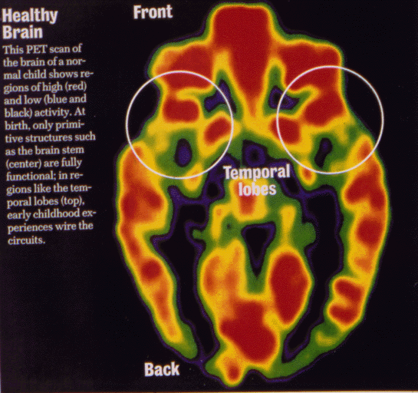
Recovery Themes for Survivors

Slide 21
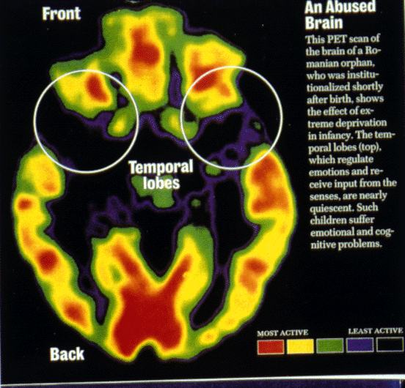
Recovery Themes for Survivors

Slide 23
Making the Invisible Visible – PTSD Assessment
Since clients do not usually present with “I have PTSD,” they need clinicians who can properly assess and treat PTSD.
When clients are resistant to idea that their trauma may be the reason that they are having physical, emotional, relational, or spiritual problems, therapists need to be able to present assessments in a safe manner encouraging checking in to see exposure to traumatic events and lingering issues related to their trauma.
The results from trauma assessments can be utilized in helping clients recognize the deeper, root issues of their distress and need for trauma-based therapy.

Slide 24
PTSD ASSESSMENTS
PCL5 – PTSD Checklist for DSM-5 (http://traumadissociation.com/pcl5-ptsd)
Quick online assessment with scoring
Can also be used to see if symptoms are improving
National Center for PTSD – CAP-5 (www.ptsd.va.gov › professional › assessment)
New assessment – very thorough
Training available

Slide 25
Adverse Childhood Experiences (ACE)
ACE – Adverse Childhood Experience questionnaire (http://www.odmhsas.org/picis/TraningInfo/ACE.pdf)
You can send questions home or simply ask client questions
10 questions/ yes or no
If clients score more than 3 or 4 on ACE, then encourage client to watch Dr. Nadine Burke- Harris’ Ted Talk on childhood trauma. (https://www.ted.com/talks/nadine_burke_harris_how_childhood_trauma_affects_health_across_a_lifetime)
Great assessment to utilize to help client recognize the long-term impact of PTSD

Slide 26
Adverse Childhood Experiences (ACE)

Slide 27
Trauma Symptom Checklist (TSC-40)
TSC-40 – Trauma Symptom Checklist (https://www.une.edu/sites/default/files/Trauma-Symptom-Checklist.pdf)
Usually, first assessment that I utilize to begin to assess scope and severity of symptoms connected in with PTSD
Will go through all that are circled 2 or 3, assessing for when symptom started and how severe symptoms are
Scoring is not necessarily useful/ more useful to see the current over-activity of the brain due to the trauma experienced
Great assessment to use to start working on practical areas, such as sleep and emotion regulation

Slide 28
Patient Health Questionnaire (PHQ-9)
PHQ-9 – Patient Health Questionnaire (https://www.mvphealthcare.com/wp-content/uploads/download-manager-files/Pfizer-Patient_Health_Questionnaire-PHQ9-ZT274388.pdf)
This assessment is used in many health care settings to check for depression.
A PHQ-9 score total of 0-4 points equals "normal" or minimal depression . Scoring between 5-9 points indicates mild depression, 10-14 points indicates moderate depression, 15-19 points indicates moderately severe depression, and 20 or more points indicates severe depression.
PHQ-9 can be given to assess progress in depression treatment.

Slide 29
Post Traumatic Stress Index (PTSI)
PTSI – Post-Traumatic Stress Index (https://traumatest.com/Original-Post-Traumatic-Stress-Index-PTSI-Test-by-Patrick-Carnes.pdf)
PTSI assesses 8 different categories connected to the impact of trauma – reactivity, repetition, bonding, shame, pleasure, blocking, and abstinence
Life Score versus Current Score
PTSI can be used for assessing progress

Slide 30
Dissociative Experiences Scale II (DES-ll)
DES –II – Dissociative Experiences Scale II (https://novopsych.com.au/assessments/diagnosis/dissociative-experiences-scale-ii-des-ii/)
This assessment will give scores for PTSD and other psychiatric disorders
Very helpful if therapist is checking for possible DID
Scoring directions is on the assessment

Slide 31
Comprehensive Coping Inventory - 55
Comprehensive Coping Inventory- 55 (http://www.newharbinger.com/50218)
This is a brand- new assessment located in the Healing Emotional Pain workbook written by Matthew McKay, Patrick Fanning, Erica Pool, and Patricia Ona.
Assessment focuses on maladaptive coping strategies that harm more than help in managing negative emotions.
Clients focus on chapters related to their highest scores helping them begin to learn healthier coping strategies.
This is excellent resource for on-going assessment.

Slide 32
Attachment History Interview
Attachment History Interview (https://couplestherapynj.com/wp-content/uploads/2019/10/Attachment-EFT-Questions-PDF.pdf)
This assessment is utilized in Emotionally Focused Therapy.
This assessment begins to explore how emotion was handled in family systems.
Often, people develop PTSD when there are no safe attachments.
Asking about trauma on this assessment needs to be done carefully.
This assessment will also show what current attachment needs and wounds look like in adult relationships.

Slide 33
Your Turn to Practice PTSD Assessments!
Discuss client’s assessment.
Please form groups of 3 or 4.
Look over the results from a trauma client’s assessments.
Does this client meet criteria for PTSD? Complex PTSD?
What evidence supports your diagnosis?

Slide 34
PTSD TREATMENT
Treating PTSD is complicated!
Importance of Evidence-Based Treatment and Specialized Training
Difference Between a Road-Map Therapy Model and Trauma Tools

Slide 35
www.storyinformed.com
Eternally Grateful for the Gift of Byron Kehler and Story-Informed Trauma Therapy – 2006 – Post Hurricane Katrina
Thousands Impacted and Helped by SITT
SITT Researched by Tulane University

Slide 36
EFT

Slide 37
Trauma Therapy Tools for Emotion Regulation
Personalized Workbook that Utilizes ACT, DBT, and CBT to help Change Maladaptive Coping Skills, such as avoidance, rumination, and blocking, to Healthy Coping Skills
Handouts are Online
Great tool to Use Early in Therapy for Building Healthy Toolbox for SITT Journey

Slide 38
Trauma Therapy Tools for Emotion Regulation
Excellent, Evidence-Based Resource for Individuals or Groups
Applicable for PTSD and Substance Abuse
Great Worksheets around Multiple Topics, Including Grounding, Safety, Boundaries, and Anger Management

Slide 39
Trauma Therapy Tools for Emotion Regulation
Excellent Resource to Examine Feelings from a Biblical Perspective
Workbook Available that Provides Excellent Resource for In-depth Journaling around Emotions
On-line Workshop Also Available

Slide 40
Trauma Therapy Tools for Emotion Regulation
Tension in the…
Head, forehead, eyes
Cheeks, mouth, jaw
Grip in the throat /Lump in the throat
Often a sign of….
Mental stress; thinking a lot; trying to analyze things out
Holding feelings in and not speaking up. Can also be a sign of anger or disgust
Anxiety/ sadness/ hurt

Slide 41
Trauma Therapy Tools for Emotion Regulation
Tension in the…
Weight on the chest; Grip or band around the center of the chest
Knot in the solar plexus, diaphragm, or gut Knot in the belly; butterflies
Tension in the genitals, thighs, anus, or butt
Often a sign of….
Sadness, hurt, disappointment, anxiety or fear
Guilt, self-punishment, feelings of responsibility, or heavy obligation/ anger or fear/ dread about the future
Feelings of shame
Adapted by L. Blum & S. Irwin from The Heart of Desire © 2012 Stella Resnick, Ph.D

Slide 42
Trauma Therapy Tools for Safety
"Trauma is a fact of life," teaches Peter Levine, "but it doesn't have to be a life sentence."
Workbook with CD that Levine Shares His Somatic Tools to Help Calm the Body to Help Heal Trauma

Slide 43
Trauma Therapy Tools for Safety

Slide 44
Trauma Therapy Apps

Slide 45
Trauma Therapy Tools for Processing Trauma

Slide 46
Trauma Therapy Tools for Processing Trauma

Slide 47
So Many Other Trauma Tools…. What Is YOUR Favorite Trauma Tool?

Slide 48
Finishing up……

Slide 49
www.refuge182.com

