Slide 1
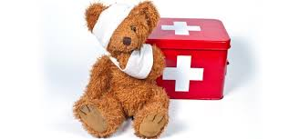
First Aid Training For Children
We have contacted an outside company with the aim of conducting a first aid training class for children aged from junior preschool upwards to after school children.
The one hour training will consist of a child friendly approach on topics such as:
How to do simple bandaging
How to put a person in the recovery position.
What to do if someone is very sleepy and needs help to wake up.
This training would take place during Caterpillars opening hours. We have been quoted a cost of €10 per child. If you would like your child to attend this training please let Clare know and we will come back to you with organised dates.

