Slide 1
Chapter 1: Evaluating Transactions

Slide 2
Learning Objectives
After studying this chapter, you will be able to:
Understand the accounting equation
Differentiate between account types
Evaluate a transaction
Convey transaction details

Slide 3
Using the Accounting Equation
Assets: Items of value within a business
Liabilities: The portion of assets that are owed to entities outside the business
Owner’s Equity: The portion of assets that are not owed to entities outside the business

Slide 4
The Different Business Types
Sole Proprietorship: Owned by one individual
Profits are only taxed once on owner’s personal tax return
Partnership: Owned by two or more individuals
Profits taxed once; decisions must be agreed upon and profits shared
Corporation: Issues shares of its stock and can be either public or private
Double-taxed, once on business tax return, and again on owner’s personal tax returns

Slide 5
Using Account Names and Descriptions
Assets | Liabilities | Owner’s Equity
Cash | Accounts Payable | Sales Revenue
Accounts Receivable | Notes Payable | Service Revenue
Supplies | Salaries Payable | Rent Expense
Prepaid Insurance | Unearned Revenue | Utilities Expense
Inventory | Mortgage Payable | Telephone Expense
Equipment |  | John Doe, Capital
Buildings |  | John Doe, Drawing
Land
TIP! Different companies use many different account names. These are the most common.

Slide 6
Evaluating or analyzing a Transaction
Phase 1 – Company purchases Furniture with $1,500 cash
Step 1: | Step 2: | Step 3:
Determine which accounts have been impacted | Determine whether the balance in each account has increased or decreased | Determine by how much each account has been impacted
Accounts Impacted | Increased or Decrease? | Amount
Furniture | Increase | $1,500
Cash | Decrease | $1,500
TIP! When a transaction takes place, the concept of double-entry bookkeeping dictates that at least two accounts must be impacted.
Notes:
Step 1: If a company purchases equipment for cash, then the two accounts impacted are Cash and Equipment
Step 2: If equipment was purchased, therefore the equipment account (asset) balance has increased. Cash (asset)vwas paid out, therefore the cash account balance has decreased.
Step 3: If there are only two accounts that are affected, then they will both be affected by the same amount. However, if there are more than two accounts affected, you will need to look more closely to determine by how much each account has changed.

Slide 7
Determine which account is impacted
Which accounts have been impacted by each transaction, and by how much they have either increased or decreased?
TIP! When a transaction takes place, the concept of double-entry bookkeeping dictates that at least two accounts must be impacted.
Notes:
We will look at various scenarios now

Slide 8
Nathaniel invests $35,000 to open Nathan’s Donut School
.
+35,000 = $0 + $35,000
Assets = | Liabilities + | Equity
TIP! When a transaction takes place, the concept of double-entry bookkeeping dictates that at least two accounts must be impacted.
Notes:
Step 1: Cash was invested in the business, and since none of the $35,000 is owed to anybody, Nathaniel can claim ownership of the entire amount. Therefore, the Cash account and the Nathaniel H. Spencer, Capital account (which represents Nathaniel’s share of the equity), are impacted.
Step 2: As a result of the investment, the company has more cash than it did before. Nathaniel’s ownership interest has also increased, as he is now the owner of more assets. Therefore, both accounts have increased.
Step 3: Since $35,000 was invested by Nathaniel, both the cash account and the Nathaniel H. Spencer, Capital account have increased by $35,000.

Slide 9
Nathan’s Donut School pays $20,000 for baking equipment.
Assets = Liabilities + Owner’s Equity
Notes:
Step 1: Cash was paid to complete the purchase, and baking equipment was obtained. Therefore, the Cash and Equipment accounts are impacted
Step 2: Nathan’s Donut School now has less cash than it did before, but it has more equipment. Therefore, the cash account has decreased and the equipment account has increased.
Step 3: Since $20,000 was paid to obtain the baking equipment, the cash account decreases by $20,000, while the equipment account increases by $20,000.

Slide 10
The company purchases $500 of supplies and $1,000 of furniture on account
Assets = Liabilities + Owner’s Equity
This Photo by Unknown Author is licensed under CC BY-NC-ND
Notes:
NOTE! When an asset is purchased on account, cash is not paid when the asset is acquired, but instead is owed.
Step 1: Both supplies and furniture were obtained, and cash was not paid. As a result, the Supplies, Furniture, and Accounts Payable (an amount owed to others) accounts are all impacted. Step 2: The Company now has more supplies and furniture. In addition, Nathan’s Donut School owes more money than it did before the transaction. Therefore, all three accounts have increased.
Step 3: In this transaction, each account is impacted by a different amount. Supplies increased by $500, furniture increased by $1,000, and because the total amount is owed, Accounts Payable increased by $1,500

Slide 11
Nathan’s Donut School opens for business, and on its first day earns $850. As of now, the company only accepts cash payments.
Assets = Liabilities + Owner’s Equity
Notes:
Step 1: The Company received cash in exchange for services, and in doing so has earned revenue. Therefore, the Cash account and Service Revenue account were impacted.
Step 2: The Company has more cash than it did before and has now earned more revenue than it had previously. Therefore, both accounts have increased.
Step 3: As $850 was both earned and received for these services, both accounts increased by $850.

Slide 12
Recording Transactions
To calculate account balances, combine the impact of every transaction
Notes:
Jump to page 11-14, chapter 1

Slide 13
How Companies Handle the Sale of a Product
Recorded by using two sets of accounts
Company must both remove the inventory from its books and add the revenue earned to its books
Revenue
Cash (or Accounts Receivable)
Cost of Goods Sold (COGS is not calculated as an expense until products are sold. It also considers the depreciation of assets, money invested in the business by its owners, and accumulated profits.)
Inventory
Notes:
As Nathan’s Donut School is a culinary school, it does not sell a product, but instead provides a service (baking lessons) to its clients.
For a company that does sell a product, a slightly more complicated approach to the transaction is required. Transactions in which inventory is sold are unique, in that they are recorded by using two sets of accounts instead of one as you have seen in all prior examples.
This is because when selling inventory, the company must both remove the inventory from its books and add the revenue earned to its books.
Therefore, not only do the revenue and cash (or accounts receivable, if the customer has not yet paid) accounts increase, but the Cost of Goods Sold expense account increases (to account for the money the seller originally paid for the item), and the Inventory account decreases (as the seller now has less inventory).

Slide 14
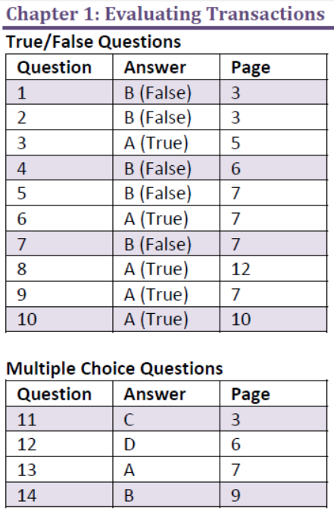

Slide 15
Chapter 1: Evaluating Transactions

