Slide 2
Nondestructive Testing of the
Shroud of Turin
2
Robert A. Rucker
August 12, 2021
www.shroudresearch.net
American Society for Nondestructive Testing
ASNT: 16th INTERNATIONAL SYMPOSIUM OF NONDESTRUCTIVE CHARACTERIZATION OF MATERIALS
Notes:
www.stlouisshroudconference.com
Oct. 11, 2014
Robert A. Rucker
2

Slide 3
Bob Rucker
MS in Nuclear, U. of Michigan
38 years in the nuclear industry
  Nuclear reactor design
  NDT for fissile material in containers
  Criticality safety for nuclear fuel production
8 years in Shroud research
  30 papers on www.shroudresearch.net
  Organized Shroud conference in 2017
  Goal: Explain the mysteries of the Shroud
ASNT: 16th INTERNATIONAL SYMPOSIUM OF NONDESTRUCTIVE CHARACTERIZATION OF MATERIALS

Slide 4
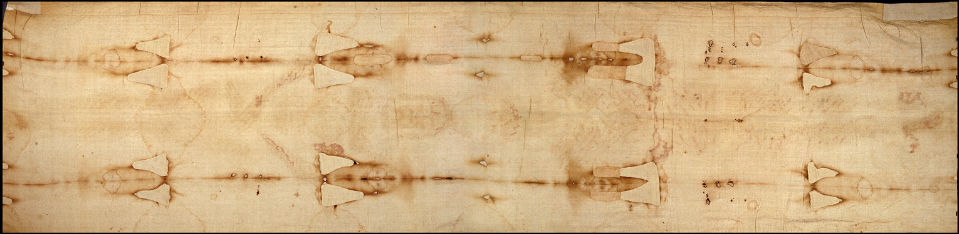
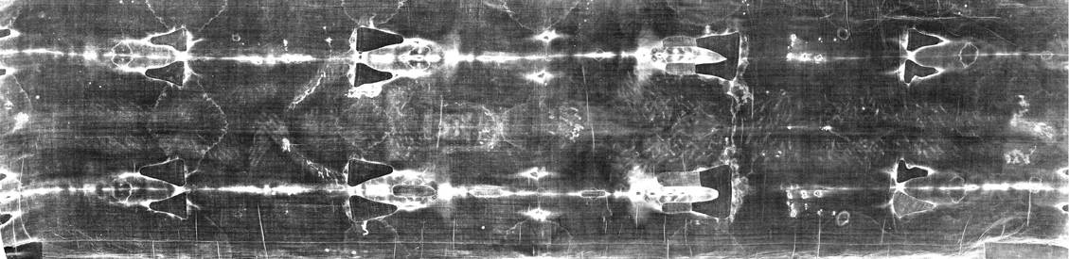
Images on the Shroud of Turin
4
Photos ©1978 Barrie M. Schwortz Collection, STERA, INC.
ASNT: 16th INTERNATIONAL SYMPOSIUM OF NONDESTRUCTIVE CHARACTERIZATION OF MATERIALS

Slide 5
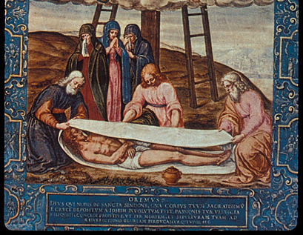
Descent from the Cross with the Shroud of Turin by Giulio Clovio, 1498-1578
Photo ©1978 Barrie M. Schwortz Collection, STERA, INC.
ASNT: 16th INTERNATIONAL SYMPOSIUM OF NONDESTRUCTIVE CHARACTERIZATION OF MATERIALS
Notes:
5

Slide 6
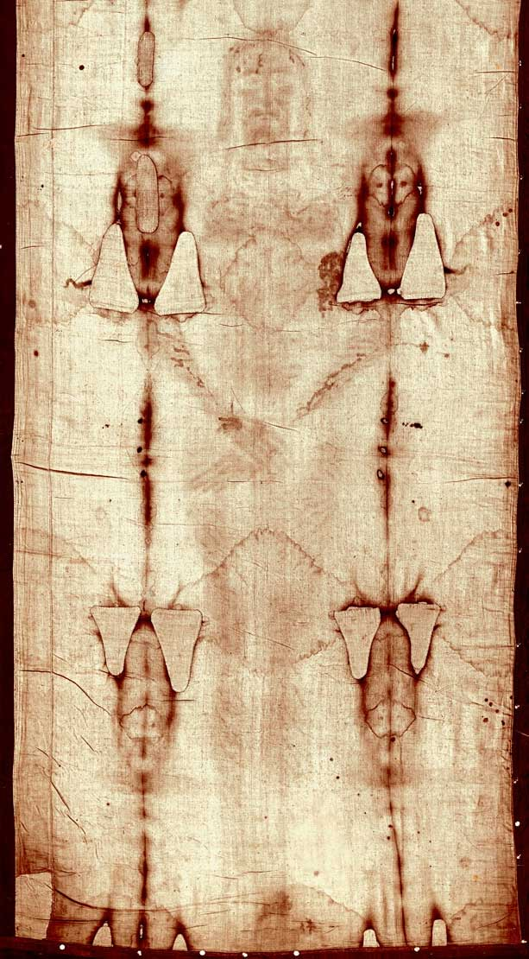
Frontal Image
Puncture wounds
Swollen cheek and nose
2” wide elliptical wound
Blood running down arm
Nail through wrist
Thumbs not visible
Scourge marks
Nose & knee abrasions
Side strip sown on
Photo ©1978 Barrie M. Schwortz Collection, STERA, INC.
ASNT: 16th INTERNATIONAL SYMPOSIUM OF NONDESTRUCTIVE CHARACTERIZATION OF MATERIALS

Slide 7
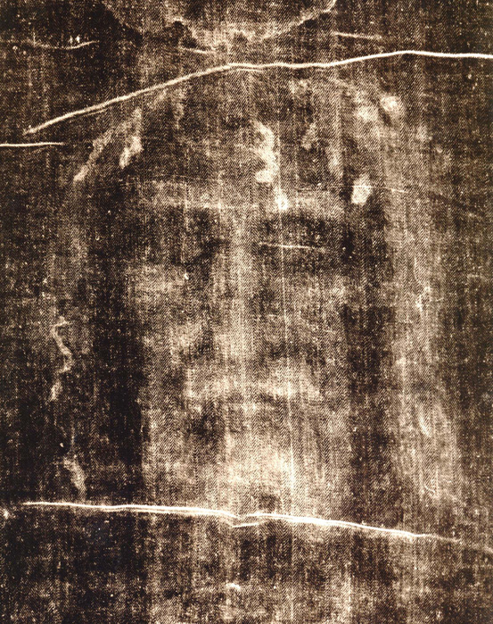
Photographic
Negative
of the Face
Photo ©1978 Barrie M. Schwortz Collection, STERA, INC.

Slide 8
Dorsal Image
Puncture wounds on the back of the head
Abrasions on shoulders
~ 120 scourge marks from 2 Roman flagrum with dumbbells on ends
Flow of blood and clear blood serum from the side wound
Two nails through feet
Rigor mortis in feet
Photo ©1978 Barrie M. Schwortz Collection, STERA, INC.
8

Slide 9
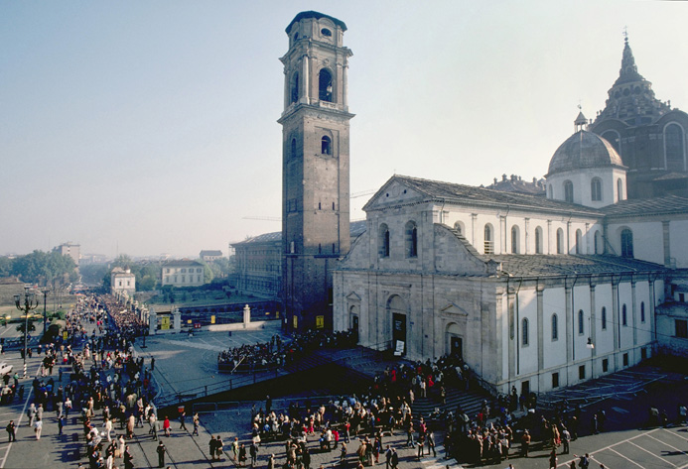
Cathedral in Turin (Torino), Italy
Photo ©1978 Barrie M. Schwortz Collection, STERA, INC.

Slide 10
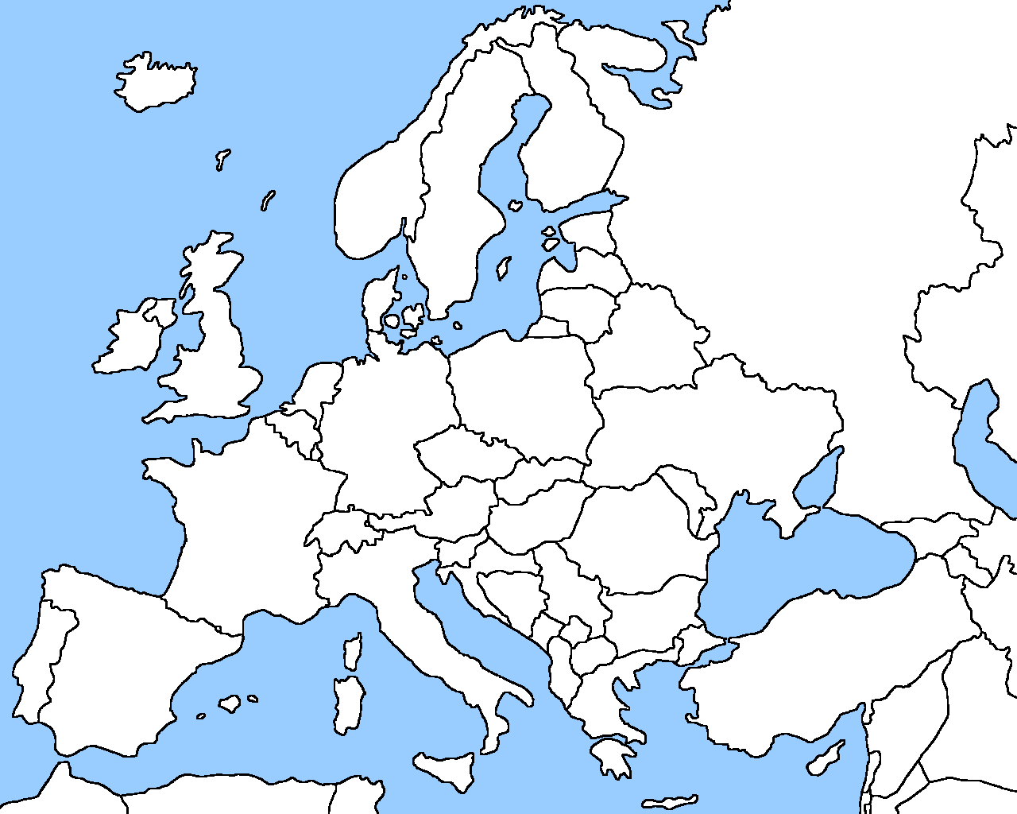
History of the Shroud (paper 19)
Jerusalem → Antioch (?) → Gal. 3:1 (?) → Edessa (Urfa), Turkey → Constantinople (Istanbul), Turkey → Athens (?) → Lirey, France → Turin, Italy

Slide 11
Opportunity for NDT of the Shroud
Last tested in 1978 after an exhibition
Rumors of an exhibition in 2025
Vatican could allow testing in 2025
Need NDT program to promote a decision to allow testing
Improvements in NDT since 1978

Slide 12
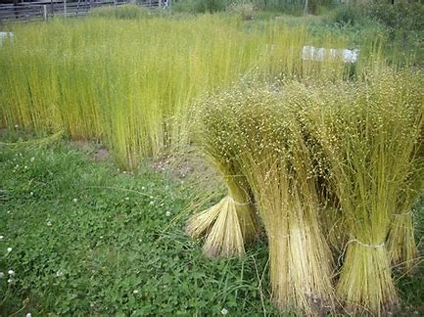
Linen is Made from the Flax Plant

Slide 13
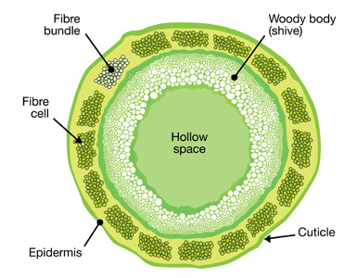
Stem of a Flax Plant

Slide 14
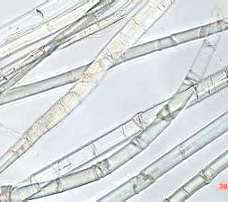
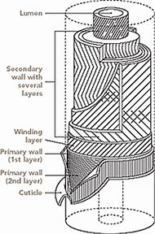
Flax Fiber

Slide 15
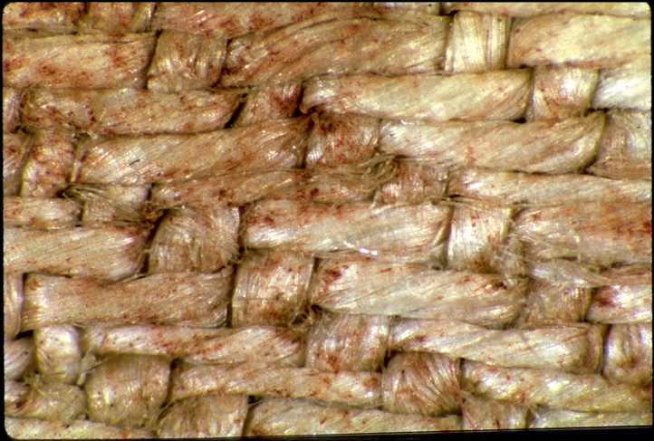
Dorsal Image, Small of the Back (32x)
Photo ©1978 Barrie M. Schwortz Collection, STERA, INC.

Slide 16
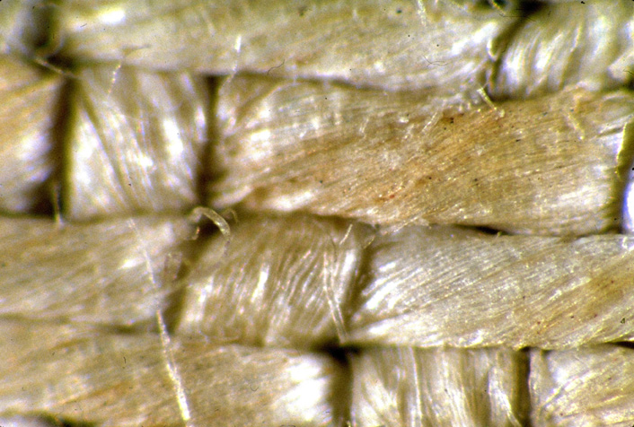
Tip of the Nose (64x)
16
Photo ©1978 Barrie M. Schwortz Collection, STERA, INC.

Slide 17
Shroud is the Most Researched
Artifact in Human Possession
Dr. Yves Delage, Prof. of Comparative Anatomy, Paris 1900-1902
Dr. Paul Vignon, Professor of Biology, Paris 1900-1943
Dr. Pierre Barbet, Prof. of Anatomy, Paris 1932-1961
Dr. Robert Bucklin, M.D, Forensic Examiner, LA 1941-1993
Dr. Frederick Zugibe, Chief Medical Examiner, NY 1953-2002
Dr. Alan D. Adler, Prof. of Chemistry, Conn. State U. 1978-2000
Dr. John Heller, Prof. of Medical Physics, Yale 1978-1995
Dr. John Jackson, Prof. of Physics, Air Force Aca. 1978-
Dr. Baima-Bollone, Chief of Forensic Medicine, Turin 1978-

Slide 18
STURP Scientific Investigation, 1978
STURP = Shroud of Turin Research Project
26 American scientists to Turin, Italy
Equipment worth 2.5 million dollars
Allowed to do any non-destructive experiment
5 days, 24 hours a day
Worked in three shifts
Led by Dr. John Jackson

Slide 19
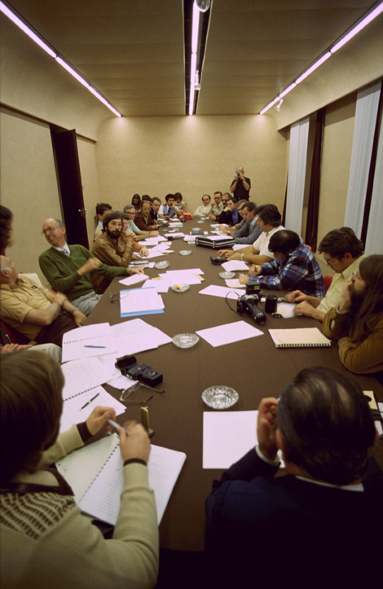
Shroud of
Turin Research
Project (STURP)
Photo ©1978 Barrie M. Schwortz Collection, STERA, INC.

Slide 20
Testing by STURP in 1978
Light (1000x) and electron microscopy
Photography, various wavelengths, front & back
UV spectrophotometry of fluorescence
X-ray fluorescence and absorption radiography
Thermal photography
Mass spectrography
Laser-microprobe Raman spectroscopy
Attempts to alter color on fibers using acids, bases, oxidants, reductants, organic chemicals

Slide 21
Testing by STURP in 1978
Testing image for the presence of protein using:
  Ultraviolet fluorescence test
  Biuret-Lowry test
  Proteolytic enzymes
  Fluorescamine test
Blood tested for protein, high Fe content, hemochromagen, human albumin, porphyrin fluorescence, cyanmethemoglobin, bile pigments, protease, bilirubin, immunoglobulin, serum clot rings, and blood reflectance spectra

Slide 22
STURP’s Conclusions
Image not due to paint, dye, or stain
  No pigment, no binder, no brush strokes
  No clumping of fibers or threads
  No stiffening of the cloth
  No cracking of image along fold lines
Image not due to any liquid: no capillarity
Not a scorch from hot object: no fluorescence
Not a photograph: 3D information in the image

Slide 23
STURP’s Conclusions
Only top 1 or 2 layers of fibers discolored
Discoloration ≤ 0.2 µm deep around 20 µm fiber
Discoloration caused by a change in the atomic structure of the atoms in the cellulose
Carbon atoms changed from all single electron bonds to some double electron bonds:
Not due to any substance added to the cloth
C C

Slide 24
Discolored Fiber
The discolored layer is a sepia or light straw-yellow color with a thickness of ≤ 0.2 micrometers around the fiber’s circumference. The diameter of a linen fibers is about 20 micrometers = 0.020 mm = about 1/5 the diameter of a human hair.

Slide 25
Mystery #1: Image Formation
We can see the image on the Shroud because the information that defines the form of a crucified man has been encoded into the pattern of discolored fibers on the cloth. (Paper 26)
Information was carried from body to cloth by vertically collimated radiation.
Caused an electrical discharge from top fibers → heat & ozone → discoloration

Slide 26
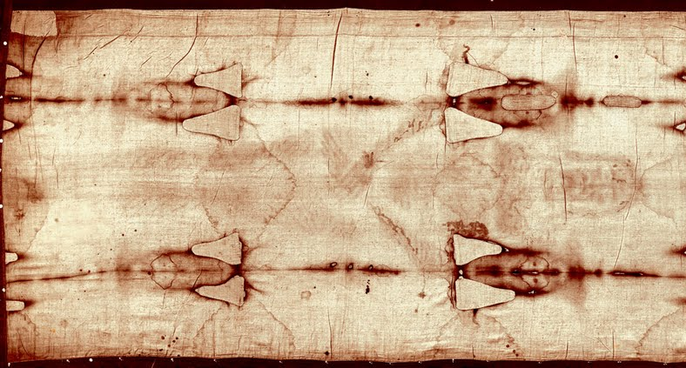
Mystery #2: Carbon Dating
Location of Samples for C¹⁴ Dating
Photo ©1978 Barrie M. Schwortz Collection, STERA, INC.

Slide 27
1260-1390 AD Should be Rejected
The technology did not exist
to make the image in 1260-1390
13 date indicators contradict 1260-1390
Statistical analysis of measurement data
  Dates depend on distance from end of cloth
  Two labs different by 104 ± 35 (3.0 sigma)
  Probability different dates are consistent with the random errors is only 1.4%
(Papers 9, 10, 11, 12, 23, 25, 28, and 30)

Slide 28
Dates are a Function of Sample Location
The best fit line is:
Y = 35.87 x + 1030.67

Slide 29
Neutron Absorption Hypothesis
29
If neutrons were included in the burst of radiation that caused the image, then a small fraction of them would have been absorbed in N¹⁴ in the Shroud to produce new C¹⁴ atoms:
N¹⁴ + neutron → C¹⁴ + proton
This would cause the Shroud to be C¹⁴ dated younger than its true age.

Slide 30
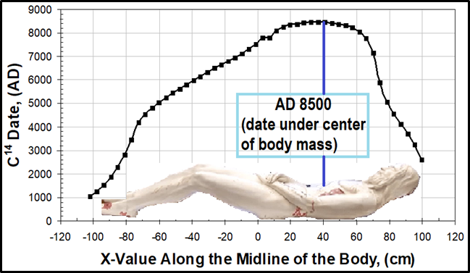
C¹⁴ Date in Shroud Below the Body

Slide 31
Mystery #3: Blood
It is blood, consistent with human blood.
Blood could drain onto the cloth from wounds in the scalp, wrists, side, & feet
But dried blood is not absorbed by cloth
  Blood from wrists that ran down the arms
  Blood from scourging
Burst of radiation could have thrust dried blood off the body onto the cloth by radiation pressure.

Slide 32
Questions for Future Testing
Image Formation
  Nature & location of discoloration?
  Evidence of bones, backside image, coins?
  Cause of banding and mottling?
  Evidence of radiation / neutron absorption?
Dating
  Carbon dates for other locations?
  Evidence of an invisible reweave?
  Other dating methods?

Slide 33
Questions for Future Testing
Blood
  Location, shape, composition, serum rings?
  Is blood human, male, type AB?
  DNA genome? What race?
  Why is it reddish? Has it been painted?
History
  Pollen?
  Limestone chips, dust, debris?
  Side piece and stitch?
ASNT: 16th INTERNATIONAL SYMPOSIUM OF NONDESTRUCTIVE CHARACTERIZATION OF MATERIALS

Slide 34
NDT Methods for Testing the Shroud
Light and electron microscopy
Multispectral & Hyperspectral imaging
X-ray fluorescence
Fourier Transform Infrared Spec.
Raman and Energy Dispersive Spec.
Atom probe tomography
Nuclear Activation Analysis
Radiation detection methods
ASNT: 16th INTERNATIONAL SYMPOSIUM OF NONDESTRUCTIVE CHARACTERIZATION OF MATERIALS

Slide 35
Further Information
Websites
  shroud.com, Barrie Schwortz
  shroudresearch.net, Bob Rucker
  testtheshroud.org, Mark Antonacci
Books
  “Report on the Shroud of Turin”, Heller 1983
  “The Blood and the Shroud”, Wilson 1998
  “Resurrection of the Shroud”, Antonacci 2000
  “Test the Shroud”, Antonacci 2015
  “The Shroud of Turin”, Fanti & Malfi, 2015
ASNT: 16th INTERNATIONAL SYMPOSIUM OF NONDESTRUCTIVE CHARACTERIZATION OF MATERIALS

Slide 36
Thank You
Bob Rucker
www.shroudresearch.net
robertarucker@yahoo.com
509-375-4770

