Slide 1
FY 2012 DoD Information Technology
President’s Budget Submission
Overview
May 18, 2011
Bonnie Hammersley
OASD(NII)/DoD CIO DASD Resources

Slide 2
DoD’s IT Budget
 | FY11 Request | FY11 CR | FY12 PB
DoD Total | $ 708.2 B | $ 685.1 B | $ 670.9 B
IT Total | $ 36.6 B (5.2%) |  | $ 38.4 B (5.7%)
$1.8 B Delta
DoD IT Budget information can be found at:
https://snap.pae.osd.mil/snapit/BudgetDocs2012.aspx

Slide 3
Distribution of the FY12 Budget Estimates
Across DoD Components
(Dollars in Thousands)
Total | $ 38,447,044

Slide 4
FY 2012 Factoids
    Total IT Investments (2,423)
    Total Major IT Investments (79)
      IT Invested reported Green (52)
      IT Invested reported Yellow (26)
      IT Invested reported Red (1)
    Components Reporting (33)
    Total Defense Business Systems (1,637)
    Total Resource Lines (5,776)
    Total number of Appropriations (61)
    Total number of PEs (958)

Slide 5
The Reality ...
Themes and focus areas
  1990’s: Environmental Protection
  2000’s: Information Technology
        More than just computers
        Net-Centric Warfare
Taxes & IT Reporting
  not optional without severe consequences

Slide 6
By the Way ...
IT “Budget” is a misnomer
  not a “budget” like in household budgeting
    e.g. set aside X dollars for utilities
  is a SUBSET of the DoD Budget
    define subset entitled “IT”
      e.g. define utilities to be electric, gas, telephone landline and water
    count subset
      e.g. count dollars for electric, gas, telephone landline and water

Slide 7
Why is reporting not a DoD Comptroller Function?
Jan 98 memo: Review and compilation of the DoD Information Technology Budget transferred responsibility from OUSD(C) to ASD(C3I)

Slide 8
So what’s IT?
Any equipment or interconnected system or subsystem of equipment, that is used in the automatic acquisition, storage, manipulation, management, movement, control, display, switching, interchange, transmission, or reception of data or information by the executive agency.
The term "information technology" includes computers, ancillary equipment, software, firmware and similar procedures, services (including support services), and related resources.
Clinger-Cohen Act of 1996

Slide 9
And ...
ARE WE SPENDING THE TAXPAYER’S MONEY WISELY?

Slide 10
AND IF WE’RE NOT?

Slide 11
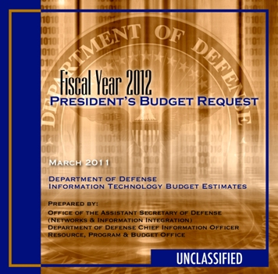
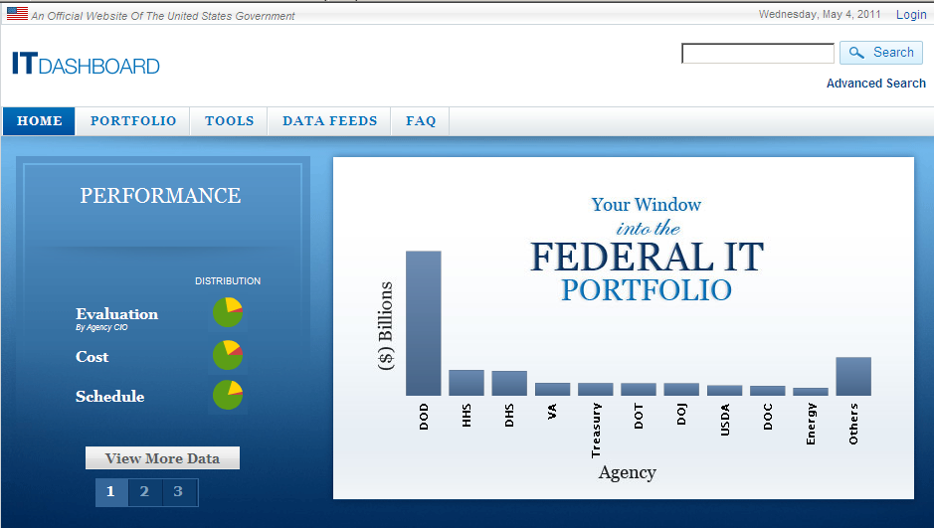
Process for Collecting IT Budget
Resource Data
OMB/Congressional Budget Submissions
DoN
Nitestar
Army
PROBE
AF
EITDR
All
Others
IT Budget Overview
Exhibit 53
Resource Summary (IT-1)
Section 351 Report
Section 332 Report
Capital Investment Reports
Selected Capital Investment Rpts
Statements of Compliance
Batch upload/update
XLS
Online
Updates*
SNaP-IT
2,423 Initiatives
33 Components
5,776 Resource Lines
CAPE Owned
Web Based
CAC Enabled
Integrated w/
CAPE & Compt DBs
SNaP
OMB IT Investment Performance Reporting
Batch
upload/update
XML
Online Updates*
Monthly updates to the IT
Dashboard
  Cost Reporting
  Schedule Reporting
  DoD CIO Assessments
TechStats (based on performance)
AF
EITDR
DoN
Army
All
Others
Exhibit 300 Data
*Online updates are available to all users.

Slide 12
Statement of Compliance (SOC)
DoD FMR, Vol. 2B, Chapter 18, para. 180102G
  CIO & Comptroller/CFO sign a joint memo
    Submissions are complete
    Accurately aligned with primary budget, program and/or acquisition materials
    Consistent with Public Law
  Due February 14 (or the following business day) of each year for the final submission for the PB submission
DoD IG requirement
Timeliness
  On-Time 21 (64%)
  Late <10 Days 7 (21%)
  Late >10 Days 2 ( 6%)
  Not Received 3 ( 9%)

Slide 13
The Schedule Simplified
July A-11 establishes OMB requirements
July-Sep MILDEPS/Agencies generate and collect data
Sep BES submit to OMB
Dec OMB Draft Guidance
Jan President’s Budget
Feb PB submit to OMB
Mar Congressional justification
Mar – July Begin process for the next budget year
Where are you in the process?

Slide 14
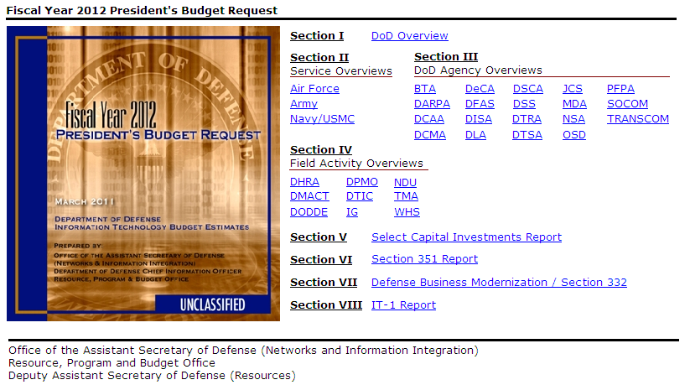
OMB/Congressional Budget Submissions
A series of DoD budget documents that assist Congress and OMB in understanding
IT investments and the associated spending levels within the Department.
The DoD IT Budget Represents 5.7% of the entire DoD Budget
(Does not include IT embedded in DoD weapons systems)

Slide 15
OMB IT Dashboard
http://it.usaspending.gov/
A public facing web site that tracks the performance of
major federal government IT investments
DoD Represents ~50% of all federal IT spending
(Based on FY11 CRA)

Slide 16
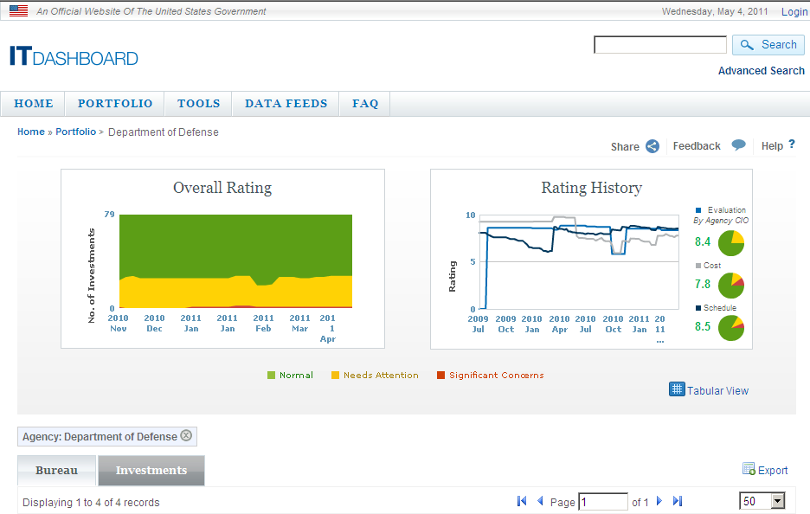
OMB IT Dashboard
http://it.usaspending.gov/
DoD reports performance of 79 major investments that make up
36% of DoD’s IT spending

Slide 17
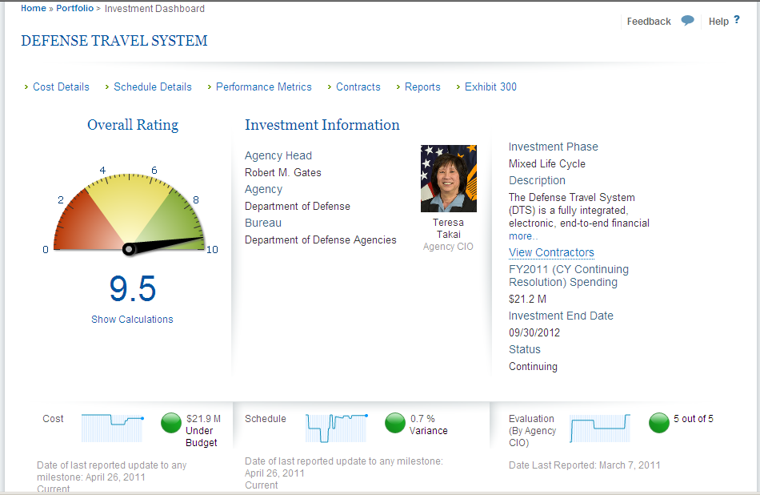
OMB IT Dashboard
http://it.usaspending.gov/
Each IT investment’s performance is measured monthly based on
cost, schedule, and performance

Slide 18
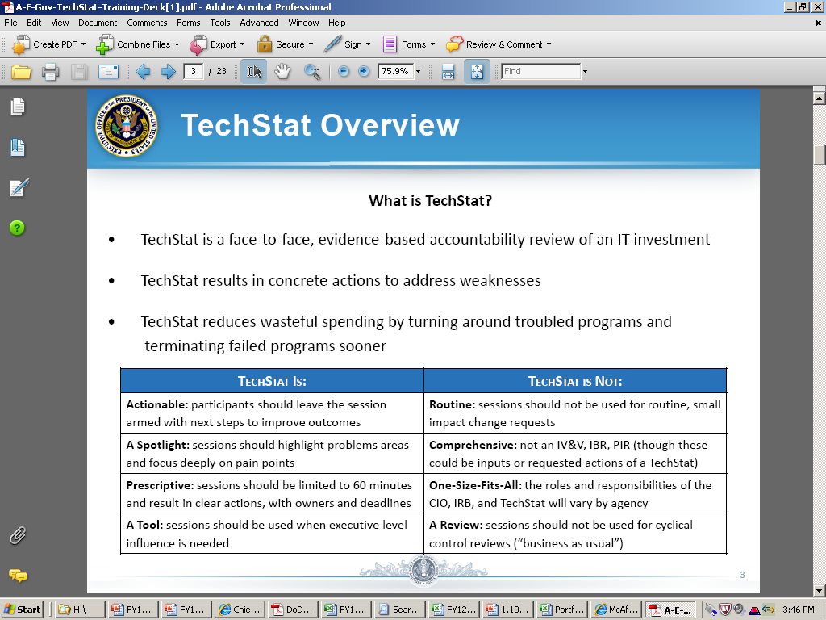
Investment Performance Review (a.k.a OMB TechStat)
OMB and Agencies CIO’s will conduct TechStat reviews based on poor performance as reported on the IT Dashboard
TechStat to Date:
ECSS – 7 May 2010
FPPS – 27 Oct 2010 & 31 Jan 2011
IPPS-A – 27 Oct 2010 & 31 Jan 2011
IPPS-AF – 27 Oct 2010 & 31 Jan 2011
http://www.cio.gov/modules/techstat/

Slide 19
Points of Contact
John Casteel
  John.Casteel@osd.mil
  (703) 695-2653
Cynthia Curry
  Cynthia.Curry@osd.mil
  (703) 697-4542
Craig Garant
  Craig.Garant@osd.mil
  (703) 693-9364

Slide 20
QUESTIONS

Slide 21
Why is IT important to DoD?
“There is no exaggerating our dependence on DoD’s information networks for command and control of our forces, the intelligence and logistics on which they depend, and the weapons technologies we develop and field. In the 21st century, modern armed forces simply cannot conduct high-tempo, effective operations without resilient, reliable information and communications networks and assured access to cyperspace.”
Quadrennial Defense Review, February 2010

Slide 22
Purpose Of Reporting
  For evaluating how well we are adhering to the
  e-government statutory framework:
  E-Government Act of 2002
    Furthers the Administration’s “Expanding E-Government” President Management Agenda Item.
  Government Paper Elimination Act Make all transactions electronic, when practicable, by October 2003.
  Clinger-Cohen
    Requires sound investment through Capital Planning that is tied to Agency missions and strategic goals
  Federal Information Security Management Act
    Attention to security in all agency applications, accountability to OMB and Congress
  Privacy Act
    Continues to be the foundation of Federal policy for protecting and sharing personal information
  Section 508
    Ensure accessibility for all

Slide 23
FY12 Budget Estimates by Areas of Spending
(Dollars in Thousands)
Total | $ 38,447,044

Slide 24
FY12 DoD Components Budget Estimates by Area of Spending
(Dollars in Thousands)

Slide 25
FY12 Budget Estimates by Categories
(Appropriations) of Spending
(Dollars in Thousands)

