Slide 1
Coast Guard
Audit Success
CDR Colin Campbell

Slide 2
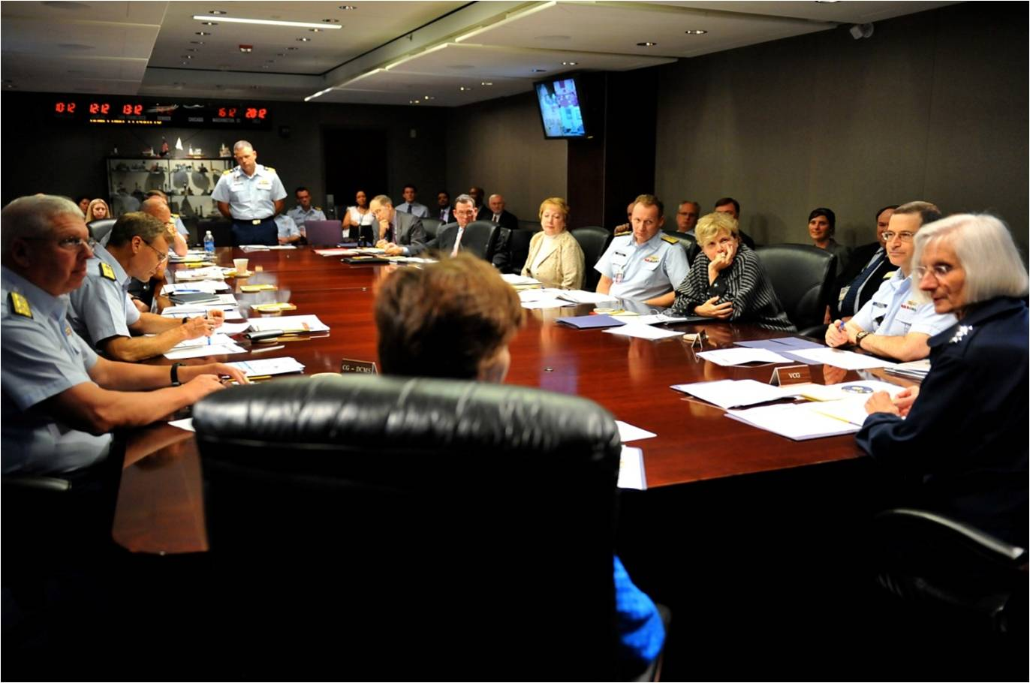
US Coast Guard

Slide 3
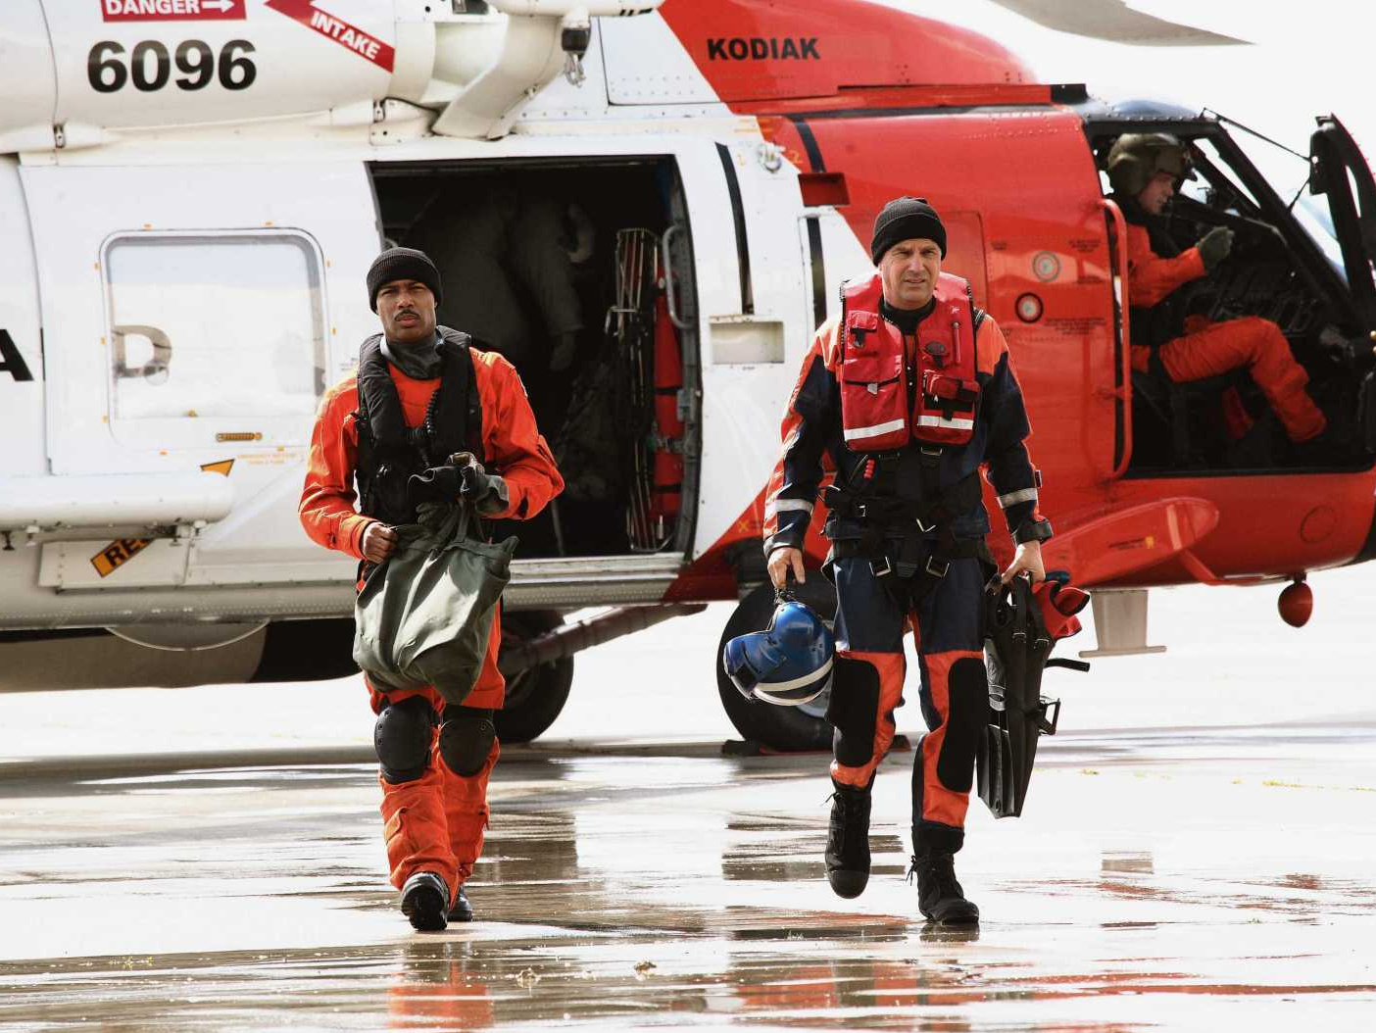
Touchstone Pictures and Holding Pictures Distribution Co., LLC.

Slide 4
Obey the Law
Federal Financial Management Improvement Act (1982)
Improving info for decisions and accountability
CFO Act of 1990
CFO in all Executive agencies
DHS Financial Accountability Act (2004)
CFO; Internal Controls Over Financial Reporting
DHS Audit Requirement Target Act (2012)
Clean financial audit by 2013

Slide 5
Year | Dept | Auditor | Opinion
1999 | DOT | DOT IG | Unqualified
2000 |  |  | Unqualified
2001 |  |  | Unqualified
2002 |  |  | Unqualified
2003 | DHS | KPMG | Qualified
2004 |  |  | Disclaimer
2005 |  |  | Disclaimer
2006 |  |  | Disclaimer
2007 |  |  | Disclaimer
2008 |  |  | Disclaimer
2009 |  |  | Disclaimer
2010 |  |  | Disclaimer
2011 |  |  | Qualified
2012 |  |  | Qualified
2013 |  |  | Unmodified

Slide 6
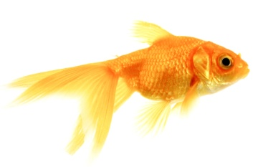
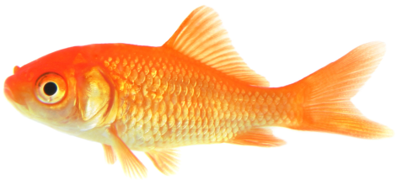
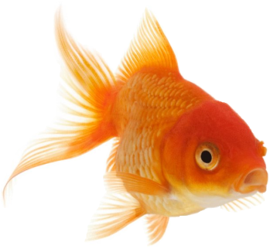
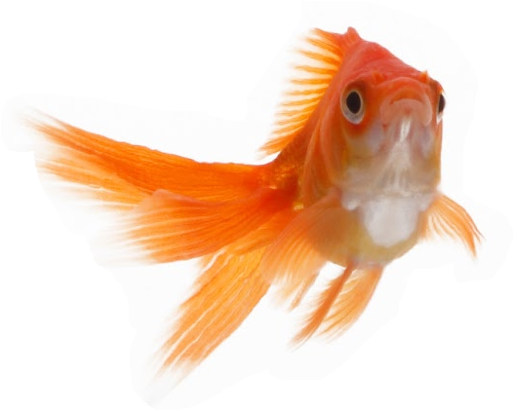
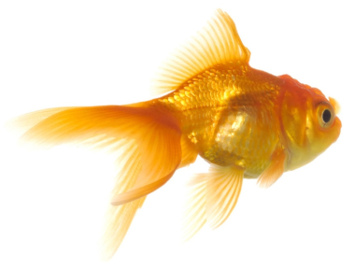
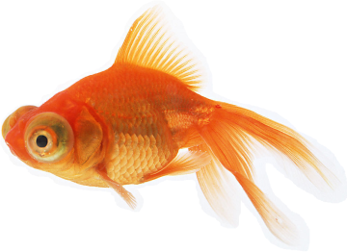
DOT

Slide 7
DHS
47% property/inventory, 22% outlays, 42% liabilities
FY 2013

Slide 8
Year | Dept | Auditor | Opinion
1999 | DOT | DOT IG | Unqualified
2000 |  |  | Unqualified
2001 |  |  | Unqualified
2002 |  |  | Unqualified
2003 | DHS | KPMG | Qualified
2004 |  |  | Disclaimer
2005 |  |  | Disclaimer
2006 |  |  | Disclaimer
2007 |  |  | Disclaimer
2008 |  |  | Disclaimer
2009 |  |  | Disclaimer
2010 |  |  | Disclaimer
2011 |  |  | Qualified
2012 |  |  | Qualified
2013 |  |  | Unmodified

Slide 9
US Navy

Slide 10
62,379
Capitalized Property Assets
1,493
Operating Locations Worldwide

Slide 11
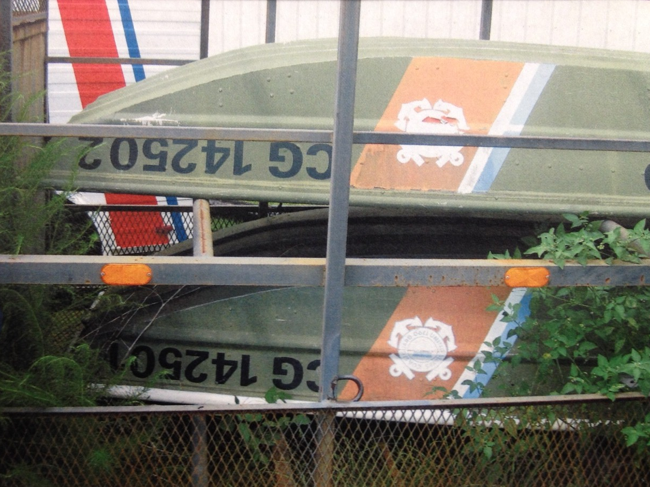
US Coast Guard

Slide 12
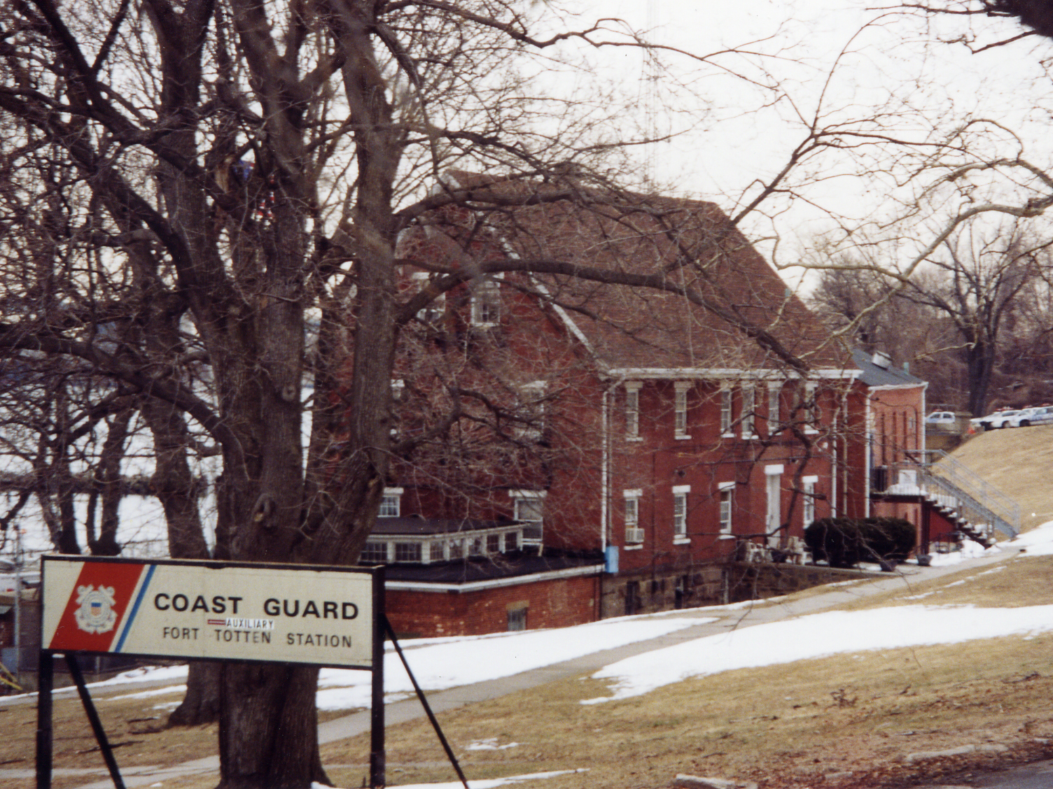
Historic District Council

Slide 13
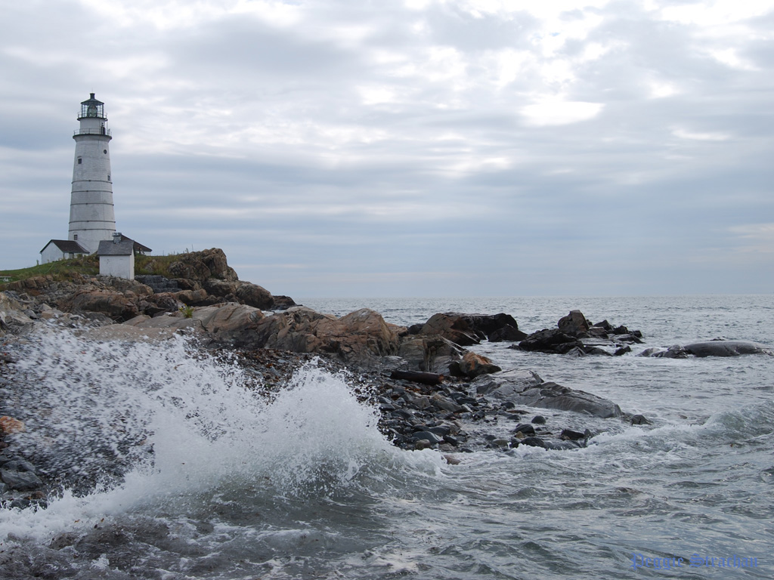

Slide 14
Library of Congress

Slide 15
SAGE

Slide 16
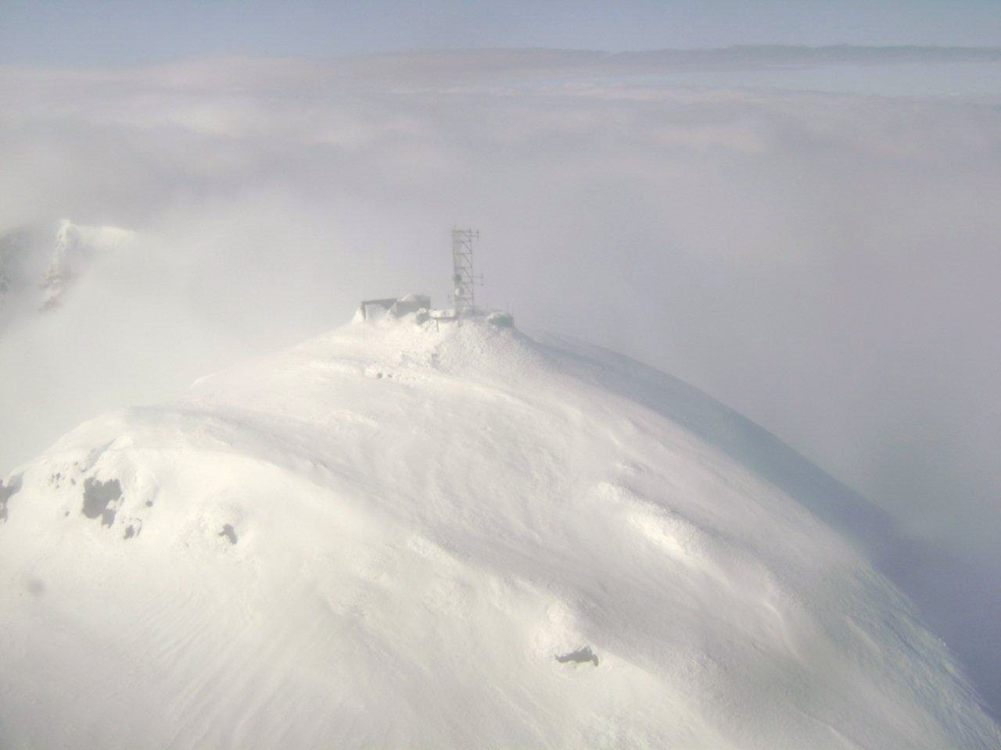
US Coast Guard
SAGE

Slide 17
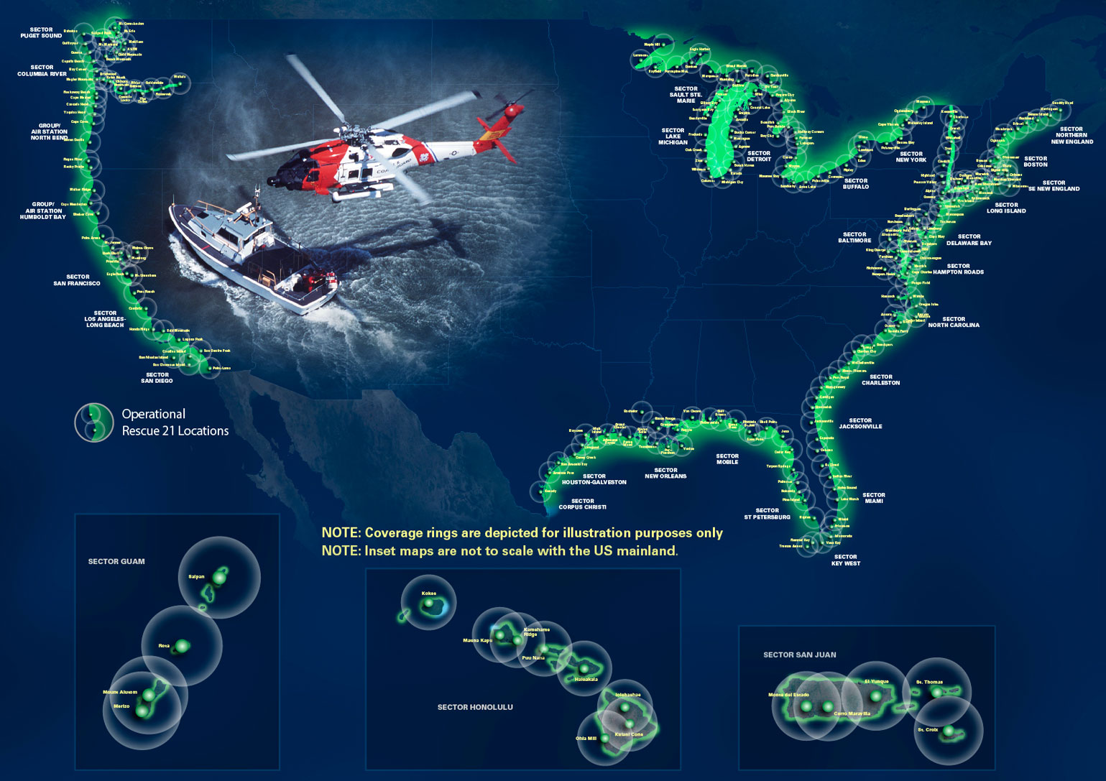
General Dynamics C4 Systems

Slide 18
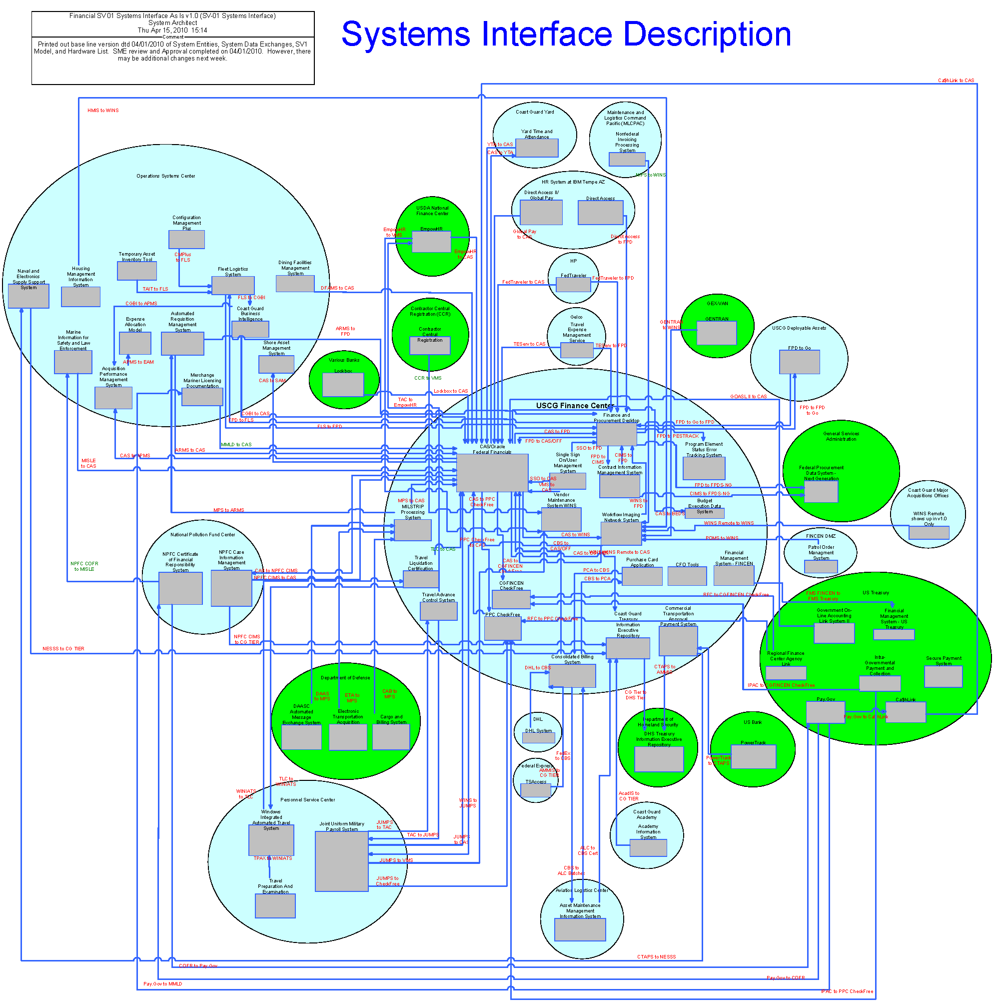

Slide 19
Audit Path
ad hoc repetitive continuous
Level 1
Basic
Level 2
Applied
Level 3
Managed
Level 4
Automated
Level 5
Monitoring
Foresight
Insight
Audit Contribution
Hindsight
Sophistication

Slide 20
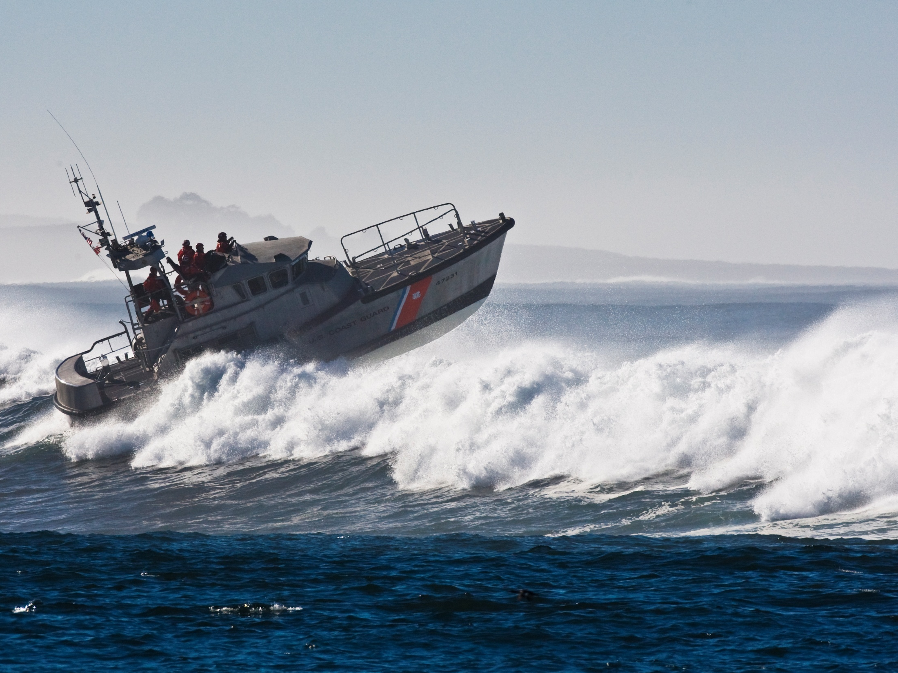
US Coast Guard

Slide 21
CDR Colin Campbell
CG-845
(202) 372-3673

