Slide 1
It’s 2024,
We have 5 Full Statement Favorable Opinions
What have we been doing about it?
Mr. Charles E. Cook, III
Principal Deputy Assistant Secretary of the Navy
(Financial Management and Comptroller)
21 May 2014
Notes:
1

Slide 2
“Some look at things that are,
And ask why.
I dream of things that never were
And ask why not?”
George Bernard Shaw

Slide 3
The Throwdown

Slide 4
HSGAC Quotables…5/13/2014
“I want to explore this term ‘audit ready’…The audit should be used as a management tool to tell you where you have deficiencies.”
Sen Ron Johnson, R-WI
“Help me understand…how is this going to help us with acquisition programs?”
Sen Kelly Ayotte, R-NH

Slide 5
HSGAC Quotables…5/13/2014
“Here’s the challenge, Bob…in a large business with large acquisitions, the CEO gets weekly updates if programs are on time or on budget.
We don’t have that. Sec Hagel doesn’t know…That is why audit is so important to get the financial information so you can see the red flags and flow the information up so he can do something about it.”
Sen Tom Coburn, R-OK

Slide 6
So How Does It Flow?

Slide 7
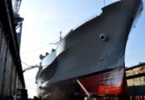
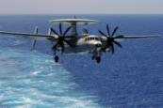
Field Activities to Financials
Events
Paying Military Employees
Transactions
Financial
Statements
Shipyard operations
Paying Civilian Employees
Refueling
Buying Goods and Services
Travel and Transportation
Collections and Disbursements
Flying Hours
Reimbursable Work Orders
MILSTRIP
Supply Purchases
Financial Process
Audit
Notes:
[Script]
“Events are anything that takes place in the field, such as buying equipment, running a ship and replacing uniforms. These events fall into seven different process areas which produce transactions financial transactions various types of financial transactions. The resulting from these events ultimately show up in financial statements. It is hard to think of something that you do during the day that doesn’t tie to one of these process. From refueling to purchasing supplies, each activity relates to dollars spent and reported on the financial statement. From events to the financial statements make-up the financial process. Please hover over each core process for further explanation.”
Additional Information:
Paying Military Employees:
The process of paying military personnel salaries and providing benefits for serving the country.
Paying Civilian Employees:
The process of paying civilian personnel and providing benefits.
Buying good and services:
The process of purchasing food, uniforms, equipment repairs, etc.
Travel and Transportation:
The Process of securing travel for Navy personnel, getting inventory (i.e. fuel) from location A to Z, other related expenses.
Collections and Disbursements:
The process of the Navy collecting money for services rendered and money paid for goods and services.
Reimbursable Work Orders:
The process of recovering costs incurred up to the dollar amount documented in the work order.
Collections and Disbursements:
The process of the Navy collecting money for services rendered and money paid for goods and services.
Reimbursable Work Orders:
The process of recovering costs incurred up to the dollar amount documented in the work order.
MILSTRIP:
Military Standard Requisitioning and Issue Procedures is the process used by all Military Services, Defense Agencies, and participating Federal Agencies to obtain supply support from within the DoD and participating Federal Agencies. MILSTRIP also refers to a set of data that makes up a supply requisition such as, uniform formats and data contents. Furthermore, requisitioning is based upon the use of a coded, single line item document for each supply transaction.

Slide 8
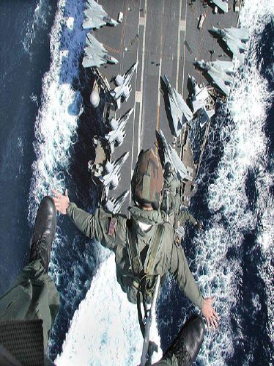
Warfighting Capability: Which One?
24

Slide 9
The BS Mystery

Slide 10
Dept of Navy Consolidated Balance Sheet 2013/2012
 |  | FY 2013 |  | FY 2012
Assets ($ in B)
Funds Balance with Treasury |  | $ 143.4 |  | $ 143.7
Accounts Receivable/Oth |  | 3.9 |  | 3.7
Inventory and Related Property, Net |  | 75.1 |  | 68.3
General Plant, Property and Equipment, Net |  | 270.0 |  | 228.9
Other Assets |  | 50.7 |  | 46.1
Total Assets |  | $ 543.1 |  | $ 490.7
Liabilities ($ in B)
Intragovernmental (A/P and Oth) |  | 6.4 |  | 6.0
Federal Employee and Veteran Benefits/Oth |  | 2.1 |  | 1.9
Environmental, Disposal & Other Liabilities |  | 30.3 |  | 29.8
Net Position – Unexpended Appropriations |  | 187.1 |  | 184.6
Net Position - Cumulative Results of Operations |  | 317.2 |  | 268.5
Total Liabilities and Net Position |  | $ 543.1 |  | $490.7
1
7

Slide 11
HSGAC Quotables…5/13/2014
“I wish I could have back the first 15 years of GMRA.”
Sec Bob Hale

Slide 12
So what will YOU say 10 years from now?

Slide 13
“The task of government is not for the timid.”
Domingo Cavallo

